Slide 1
Learning intention
To tell the time to 5 minutes

Slide 2
Today we're going to look at how to tell the time to the nearest 5 minutes.

Slide 3
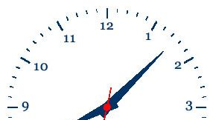

Telling the time to 5 minutes
When the minute hand on a clock moves from one number to the next, it has moved 5 minutes.
So when the minute hand has moved from the 12 to the 1, 5 minutes have passed so the time is 5 past.
1
2
3
4
5

Slide 4
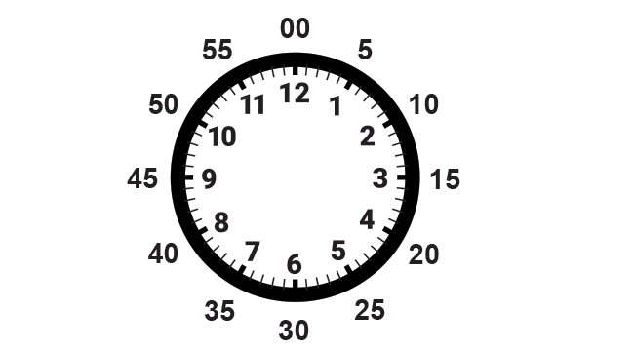
There are 12 numbers around the clock face, and each interval is 5 minutes.
So there are 12 × 5 = 60 minutes in an hour.
60

Slide 5
How many minutes have passed when the minute hand has moved from the 12 to the 2?
10 minutes have passed so it is 10 past
60

Slide 6
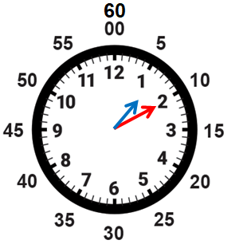
The minute hand tells us how many minutes have past. The hour hand tells us how many minutes past which hour. So this clock says
10 minutes past 1 O’clock or
10 past 1

Slide 7
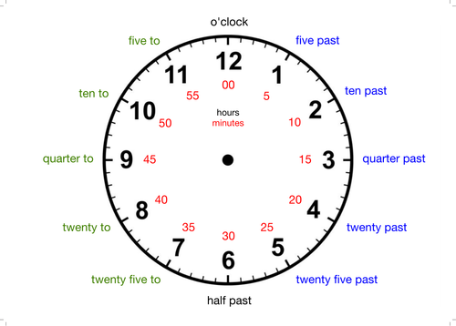
15 past ?
As we have learned when the minute hand gets to 3 then it is quarter past,
because the minute hand has made a quarter turn around the clock face.

Slide 8
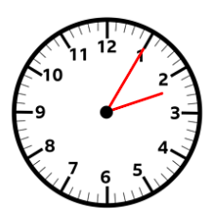
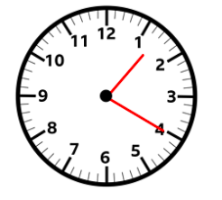
What time do these clocks say?
5 minutes past 2 o'clock,
or
5 past 2
20 minutes past 1 o'clock,
or
20 past 1

Slide 9
What happens when the minute hand gets to half past? (30 minutes past?)
The hour hand is half way between 2 and 3. The time below is half past 2

Slide 10
But when the minute hand goes past half past things change.
Because the minute hand is now heading towards the next hour we say that the time is not past but to.
So this clock does not say 35 past 3 but 25 to 4. The hour hand is nearer to 4 than to 3.
5
10
quarter
20
25

Slide 11
So this clock says 20 minutes to 11 o’clock or 20 to 11.

Slide 12
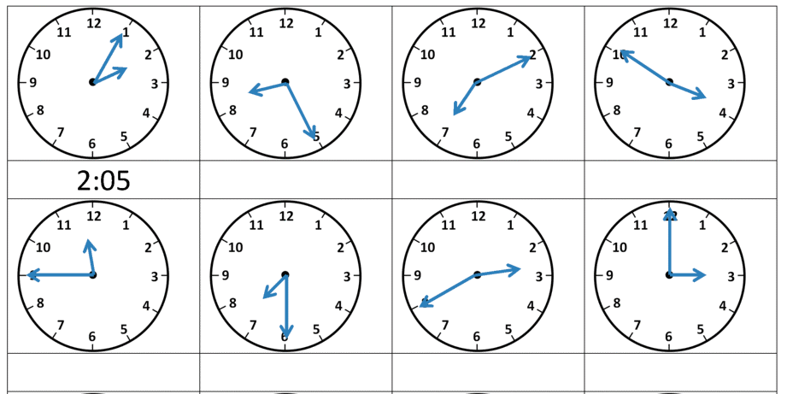
What is the time on these clocks?
Use the slide before to help you.
5 past 2
___ past ___
___ to___

Slide 13
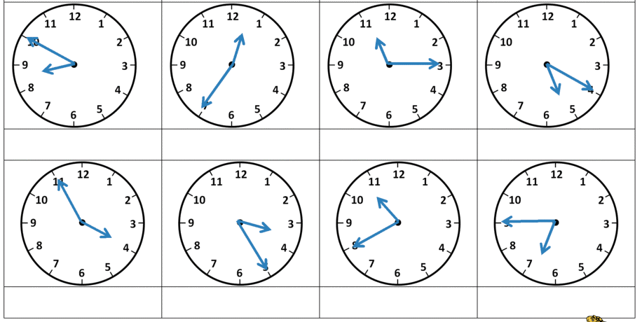
What about these?

