Slide 1
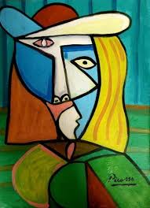
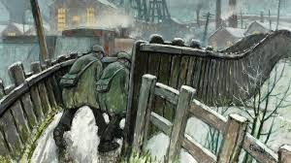
What have I learnt?
Art

Slide 2
Quiz time!
Go through the next slides answering the quiz questions all about Pablo Picasso and Norman Cornish.
You could write down your answers or discuss them with someone at home.

Slide 3
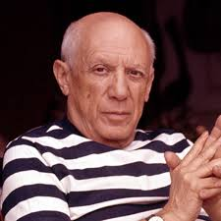
Pablo Picasso
Who was Pablo Picasso?

Slide 4
Pablo Picasso
2. Where was he from?

Slide 5
Pablo Picasso
3. What type of art did he create?

Slide 6
Pablo Picasso
4. What tools did he use in his work?

Slide 7
Pablo Picasso
5. A lot of Picasso’s pieces were paintings of faces, what is this called?

Slide 8
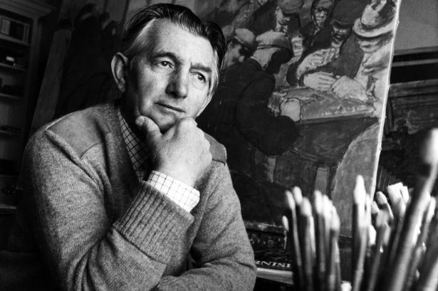
Norman Cornish
6. Who was Norman Cornish?

Slide 9
Norman Cornish
7. Where was Norman Cornish from?

Slide 10
Norman Cornish
8. What type of artist was he?

Slide 11
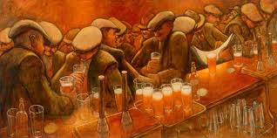
Norman Cornish
9. What is the name of a painting which uses only one colour?

Slide 12
Norman Cornish
10. Where did Norman Cornish work before he was an artist?

Slide 13
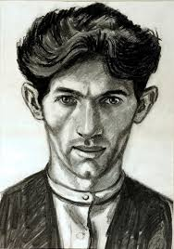
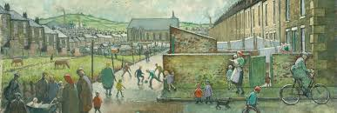
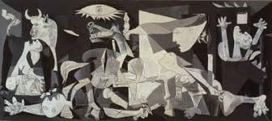
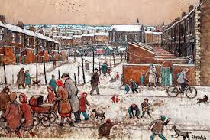
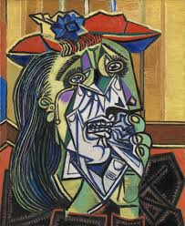
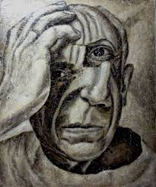
11. Have a look at these pictures, who painted each one, Norman Cornish or Pablo Picasso?

Slide 14
12. Name two similarities and two differences between Pablo Picasso and Norman Cornish’s art work?

Slide 15
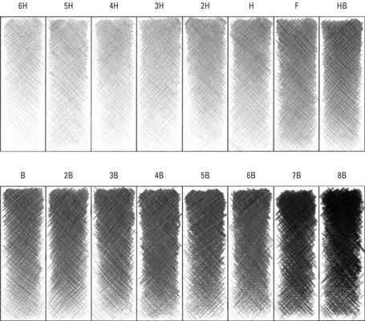
13. What is it called when you create different tones using a pencil?

Slide 16
Answers
Picasso was a very famous artist who lived in France.
Picasso was born in Malaga, Spain.
Paintings but he was also a sculptor and drawer.
He used: paint, chalk, paintbrushes, pens, pencils and sometimes used unusual materials like newspaper.
Portrait or self portrait.
Norman Cornish was a mining artist.
He was from Spennymoor in Durham.
He was a painter who created paintings of his local area.
Monochromatic.
He was a miner.

Slide 17
11. Picasso Norman Cornish

Slide 18
12. Similarities: - They were both painters.
- They both liked to create portraits.
Differences: - Picasso used cubism.
- Norman Cornish created paintings of the area around him (his local town).
You might have some other similarities and differences!

Slide 19
13. What is it called when you create different tones using a pencil?
Shading

