Slide 1
Learning intention: To understand the ‘x’ and ‘÷’ symbols.

Slide 4
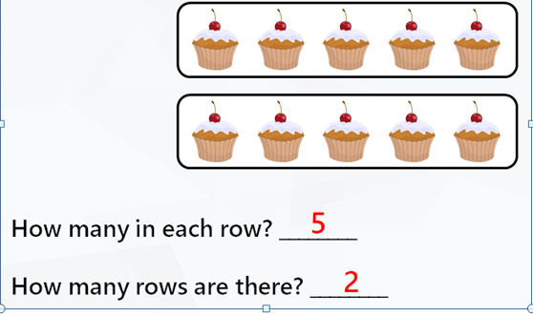
What is a row?
Rows go across ( left to right)
We could use the multiplication symbol
2 x 5= 10

Slide 5
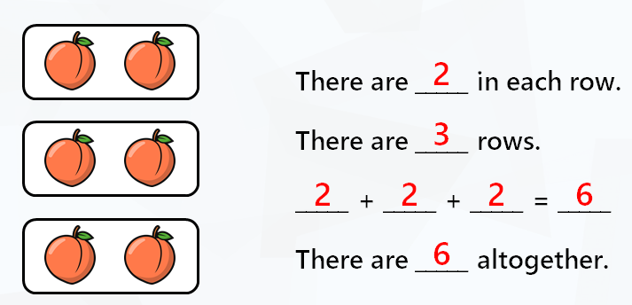
Look at this picture representation.
Now let’s use the multiplication symbol.
3 X 2= 6

Slide 6
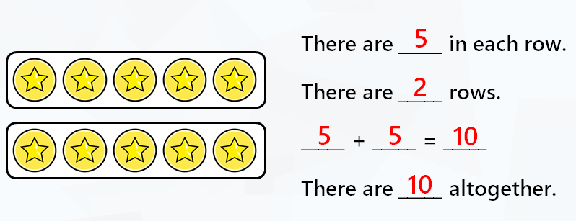
Look at this picture representation.
Write the calculation using the multiplication symbol.

Slide 8
Turning around.
Write the two multiplication calculations for this array.

Slide 9
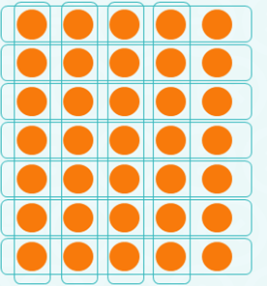
Turning around.
Write the two multiplication calculations for this array.
7 x 5 = 35
5 x 7 = 35

Slide 10
Making Groups
Pasha and Anna are making groups.
Anna makes 3 groups of 5.
Pasha makes 5 groups of 3.
3 x 5 = 15 5 x 3 = 15

Slide 11
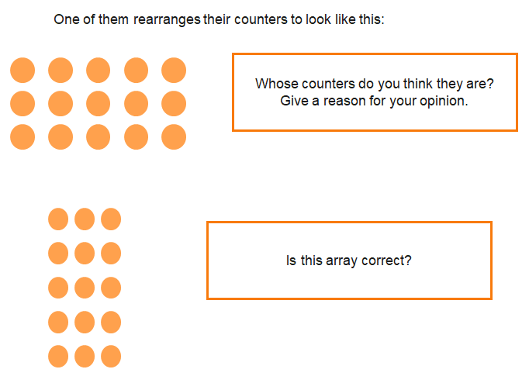

Slide 12
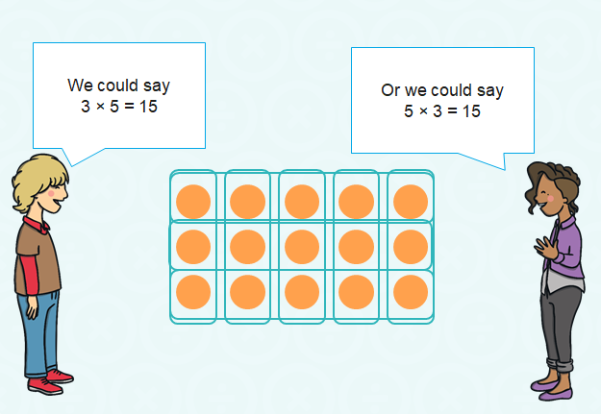
We can multiply in any order. It is commutative.

Slide 13
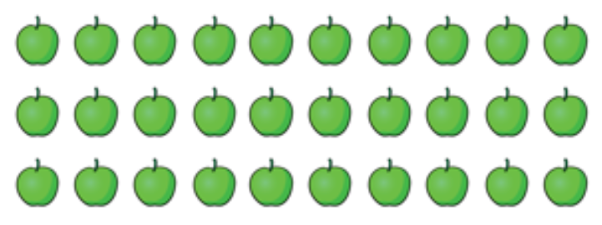
Write the two multiplication calculations for this array.

Slide 14
Write the two multiplication calculations for this array.
3 x 10 = 30
10 x 3 = 30

Slide 15
Remember we can multiply in any order.
The mathematical word for this is ‘commutative’. This means any order.
You have used arrays to show you can multiply in any order by turning them around.
Now try the tasks on the worksheet.

