Slide 1
Learning Intention
To use descriptive language

Slide 2
Yesterday, you looked at adjectives and expanded noun phrases.
Adjectives
Adjectives are words that describe what you can sense about a noun including
sight, sound, smell, taste, touch, and how they feel.
Expanded noun phrases
An expanded noun phrase is when you use two adjectives in a sentence.
Here is an example
A tall, towering tree swayed in the wind.

Slide 3
Today’s task.
Today, you are going to use some of your ideas from yesterday to write some expanded noun phrases, in full sentences, for some different rainforest animals.
Think about how you would describe the animals and what its doing or where is it.
There is an example to look at on the next slide.

Slide 4
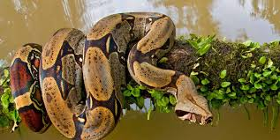
A snake
I have to think about adjectives to describe the snake to make the expanded noun phrase and think about what its doing.
The long, slimy snake was twisting itself around a branch.
The sly, poisonous snake was waiting for its prey.

