Slide 1
World book day

Slide 2
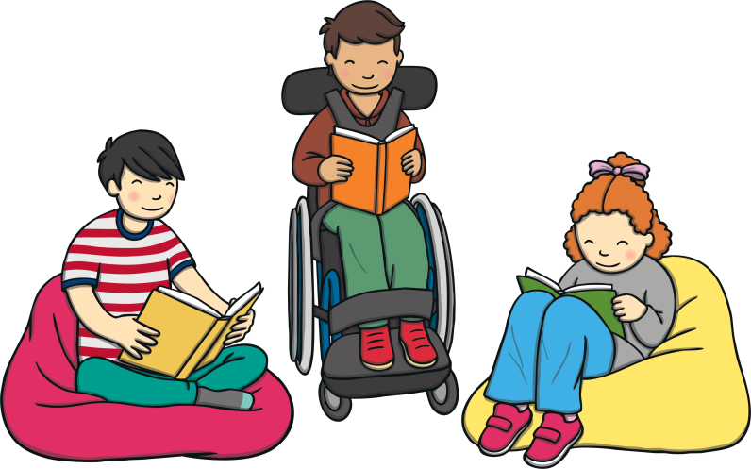
What is World Book Day?
World Book Day is a day each year to celebrate books, authors, and reading!
What are some of your favourite books?

Slide 3
World Book Day celebrations
World book Day can be celebrated in lots of different ways.
Children may dress up as their favourite book characters. Which would you pick and why?
Children may read their favourite books. Some authors may visit different schools.

Slide 4
Reasons why we celebrate World Book Day
Books help us to learn.
Books are magical and help you to use your imagination.
Books are relaxing to read.
Books can be special to us if we find a favourite book.

Slide 5
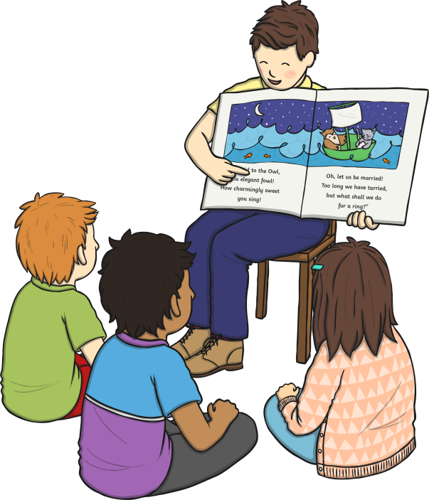
Where can we find a new favourite book?
There are lots of different ways to find a special book.
Visit your school or local library. The librarians there would be so happy to help you find a great read!
Ask Miss Swan or Miss Kiddy about their favourite books.
Ask your parents or friends.
Make your own book!

Slide 6
On the worksheet, can you draw a picture of your favourite book? It could be a book you have at home or it could be a book we have read at school.

