Slide 1
Art Learning Intention – to analyse the designs of Lucie Carrasco
Fashion at the Cannes Film Festival

Slide 2
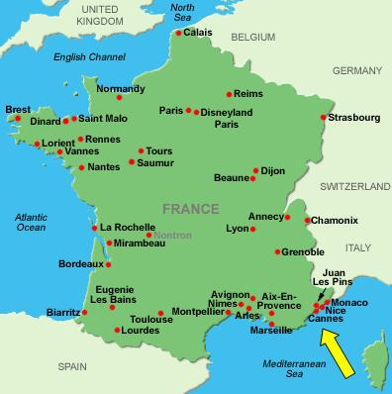
In art last week, we researched the fashion designer Lucie Carrasco. Today, we are going to look at some of the items of clothing that she has made. She is especially famous for designing and making beautiful, glamorous dresses for celebrities who go to the Cannes Festival in the South of France. The Cannes Festival is an annual film festival which previews new films of all genres, including documentaries, from all around the world. It is well known for many rich and famous people attending.
This map shows where the festival is held.

Slide 3
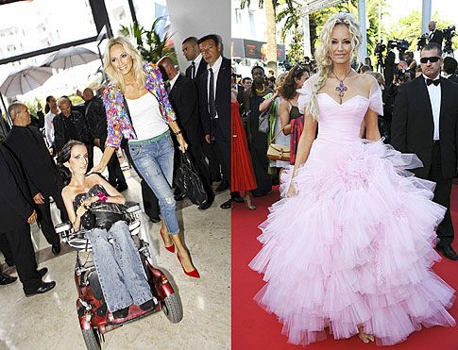
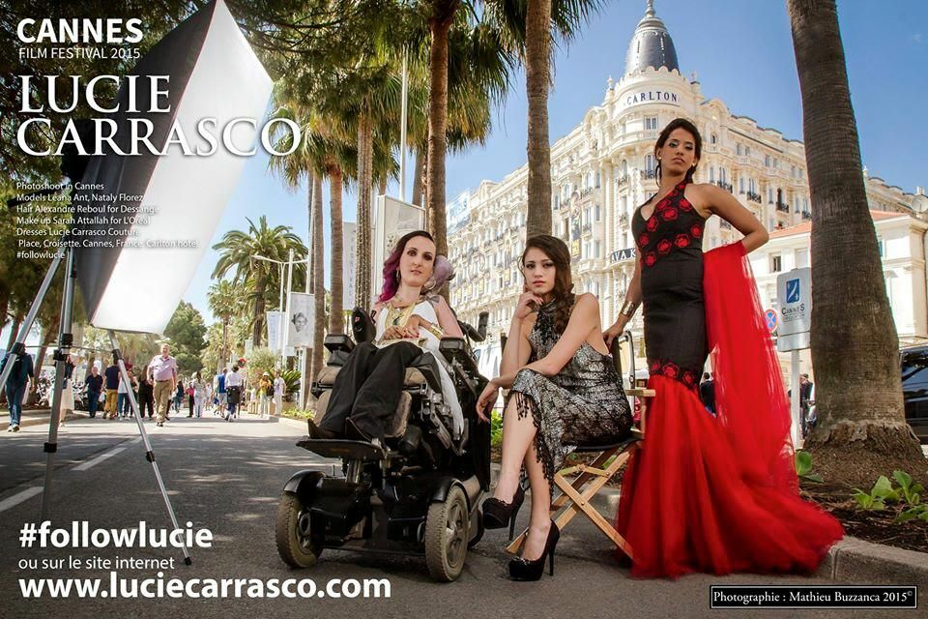
These photographs show the designer Lucie Carrasco with models in Cannes. The models are wearing dresses that she has designed. What do you think of the dresses? How would you describe them?
Look at the image of the dress designed by Lucie Carrasco on the worksheet.
Around the image think of as many words as you can to describe the dress. Think of texture, materials, fabrics, colour, technique and tones.

