Slide 1

Learning intention: to write instructions.
Can you remember all of the important features of instructions?

Slide 2
Learning intention: to write instructions.
Imperative verbs (bossy verbs)
Second person (you)
Instructions in lists (e.g. touch the handle, open the gate and go through it)
Numbers or bullet points
Numbers or bullet points
Second person
Imperative verbs
Lists

Slide 3
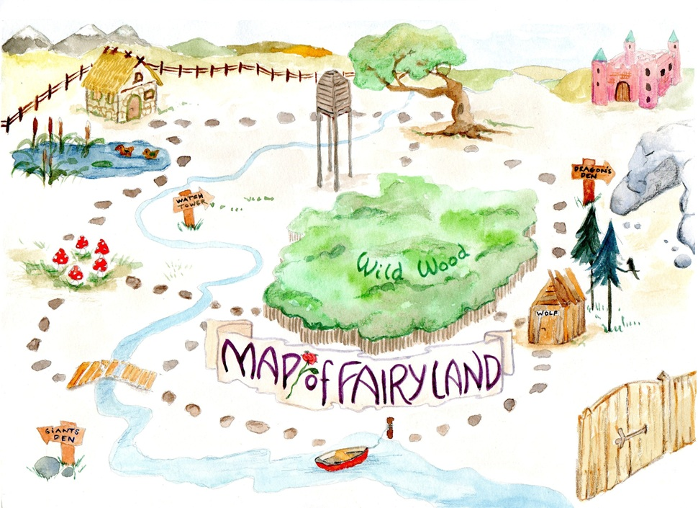
Learning intention: to write instructions
You are going to be writing instructions for an adventure! Using the story map from last lesson, write the instructions one at a time.

Slide 4



Watch how I use my story map to help me to write instructions. Then have a go by yourself!
trust
journey
go travel
begin
slimy, green goblin
rainbow shark’s dangerous den
return

Slide 5
First I think of what I want the reader to do. Then I say my sentences one at a time. Finally, I write each sentence.
Imperative verbs ✓
Second person ✓
Lists (not yet!)
You must begin your journey. Walk towards the wooden gate which is protected by a slimy, green goblin. Say hello but do not trust the goblin’s teeth. Open the gate.

Slide 6
Your turn! Use your story map to write your instructions one at a time. Remember to use the features of instructions.
Imperative verbs ✓
Second person ✓
Lists ✓

