Slide 1
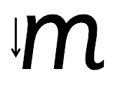
Your turn! Write m in your book using the lines.
m – Start at the top, come down, come back up and over. Down, bounce back up and over. Down and flick.

Slide 2
Your turn! Write m in your book using the lines.
Then try:
mat
sam
mad

