Slide 1
We will be reading the text ‘Silly games’.
You can search for it on Oxford Owls website or follow the elibrary to read write inc grey level.
https://www.oxfordowl.co.uk/api/interactives/29276.html

Slide 2
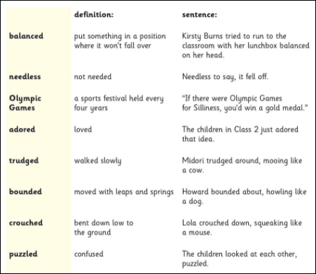

Slide 3
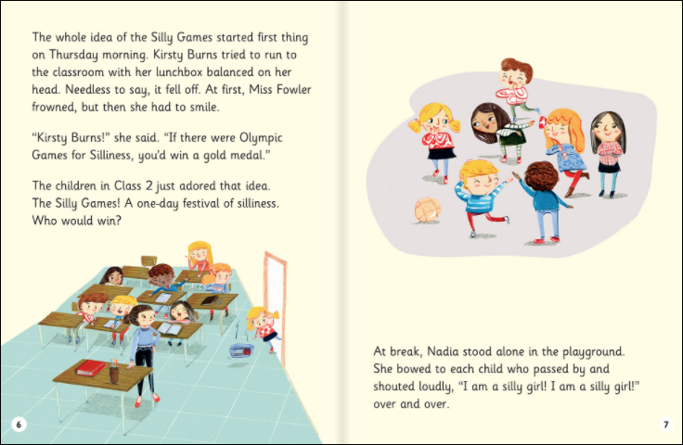

Slide 4
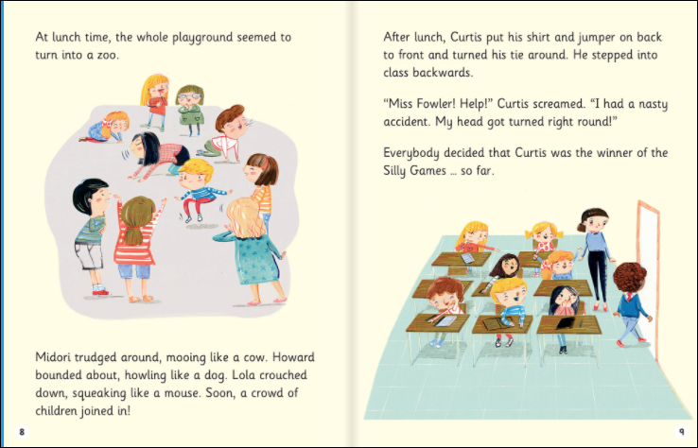

Slide 5
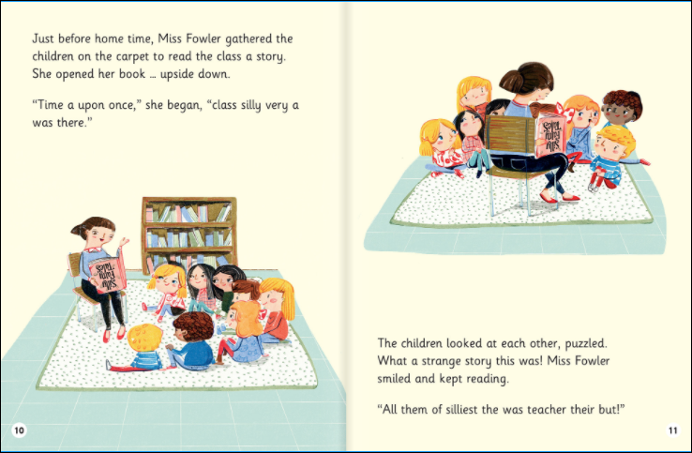

Slide 6
