Slide 1
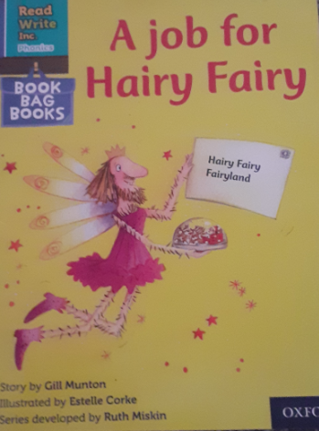
You are going to read the story ‘A job for Hairy Fairy’.
In this story you will hear words with the sound:
air
The air sound is in the words:
hair
chair
Look at the picture. What can you see? What will happen in the story?
Notes:
1

Slide 2
Let’s read these words together. These are words you will come across in the story.
Green Words
Lapland
Qu een
Vixen
Comet
Rudolf
Blitzen
harnesses
sledge
Red Words
are
do
Th eir
put
Notes:
2

Slide 3
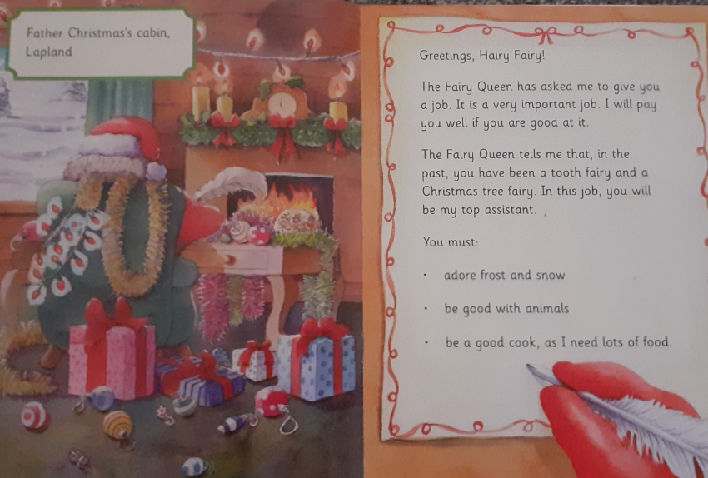
What words can you see which have the air sound?
What two jobs has the hairy fairy done in the past?
Why does the hairy fairy have to be a good cook in this job?
Notes:
3

Slide 4
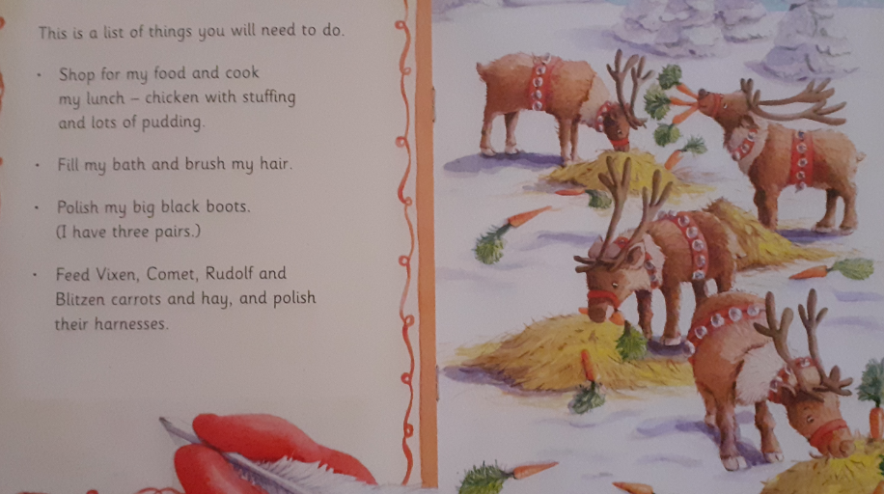
How many pairs of big black boots does Father Christmas have?
What does the hairy fairy need to feed Comet, Rudolf and Blitzen with?
Notes:
4

Slide 5
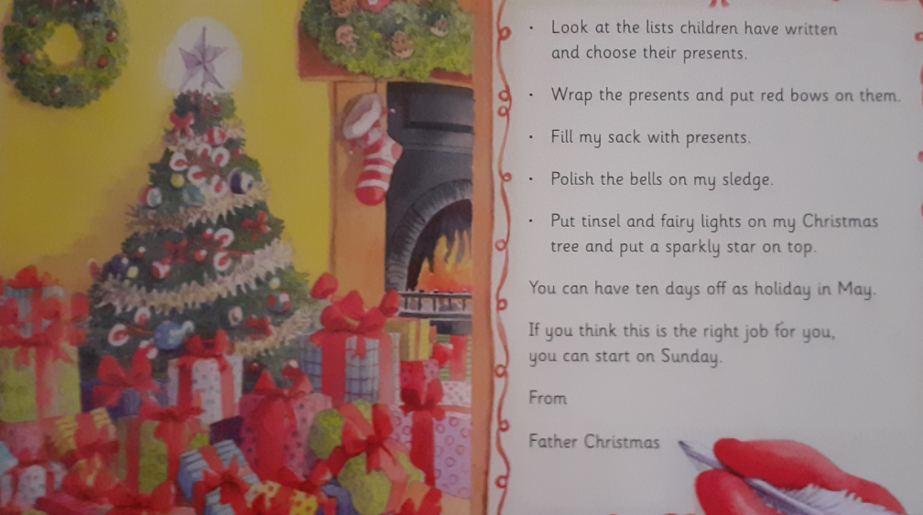
What does the hairy fairy have to put on the presents?
What does the hairy fairy have to put on top of the Christmas tree?
Who wrote the letter?
Notes:
5

Slide 6
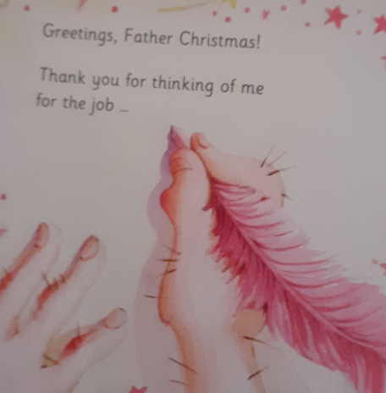
Do you think this job would be fun? Explain your answer.

Slide 7
Recap questions
Where is Father Christmas from?
What kind of weather must the hairy fairy adore?
What does the hairy fairy have to do to Father Christmas's boots?
What does the hairy fairy have to fill the sack with?
When does the hairy fairy's job start?
Notes:
7

