Slide 1


Physical Geographical Features of Europe

Slide 2
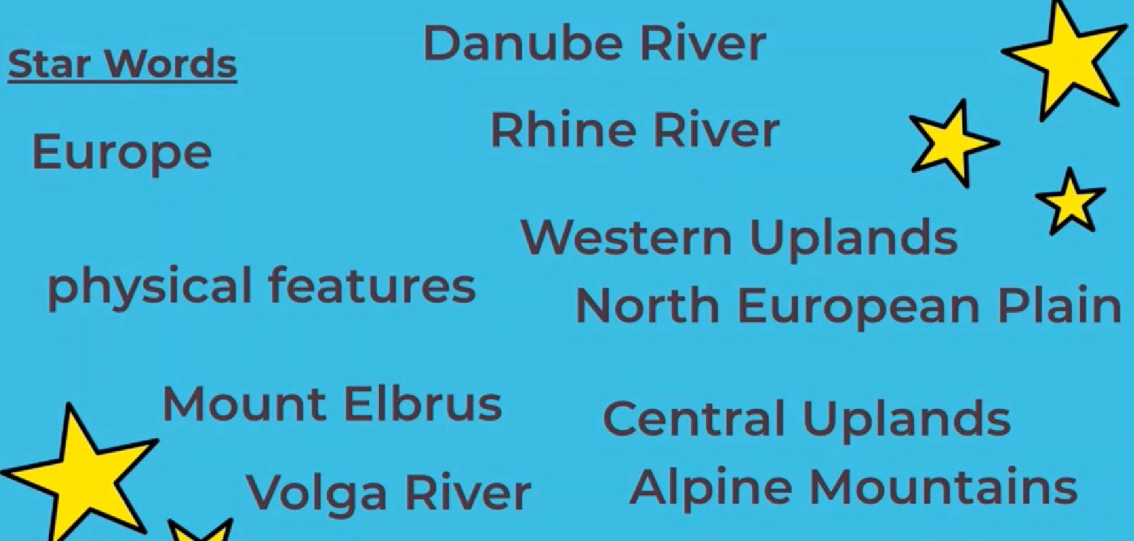
Key Vocabulary

Slide 3
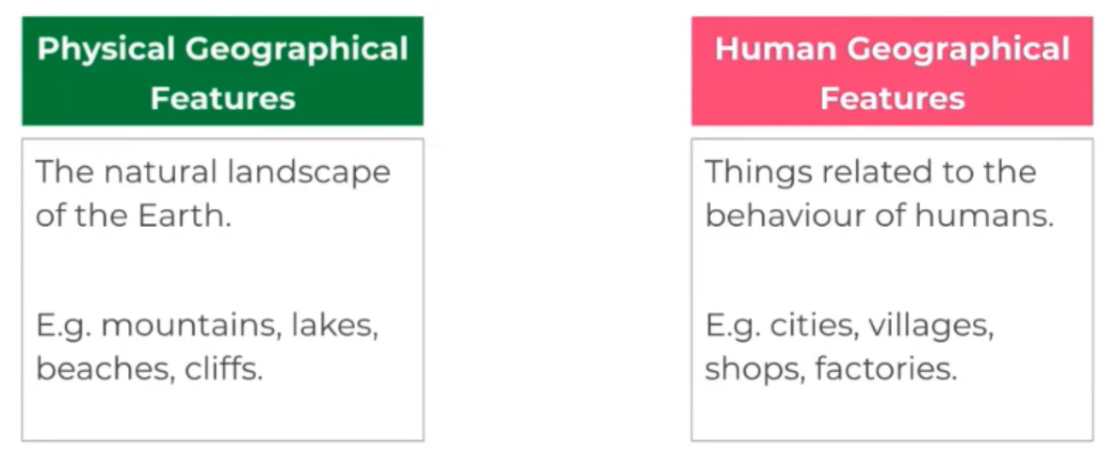

Slide 4
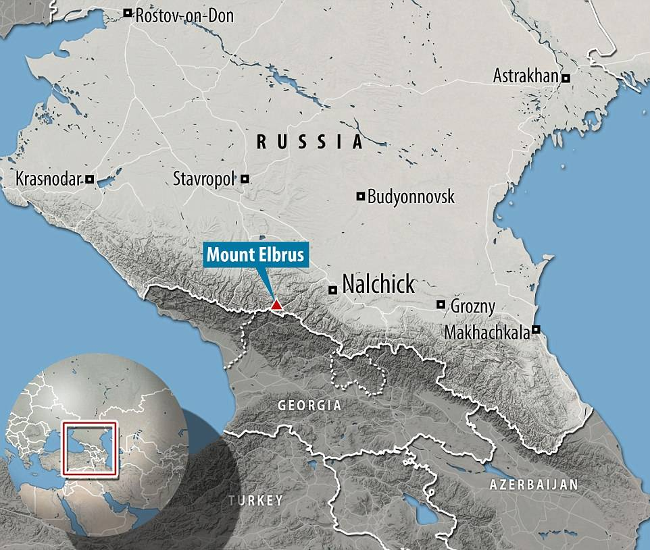
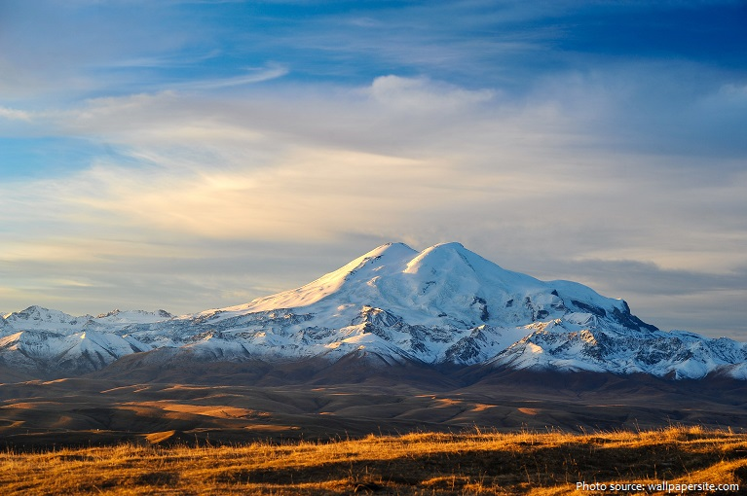
The Tallest mountain in Europe
Mount Elbrus
Caspian Sea
Black
Sea
A dormant (inactive) Volcano
5,700 metres tall
2.5 million years old

Slide 5

What is the tallest mountain in Europe?
Do you know the other mountains?
You could research them on the internet

Slide 6
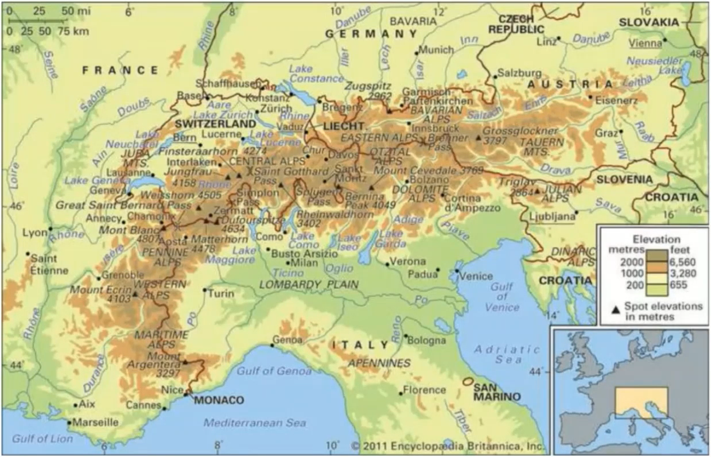
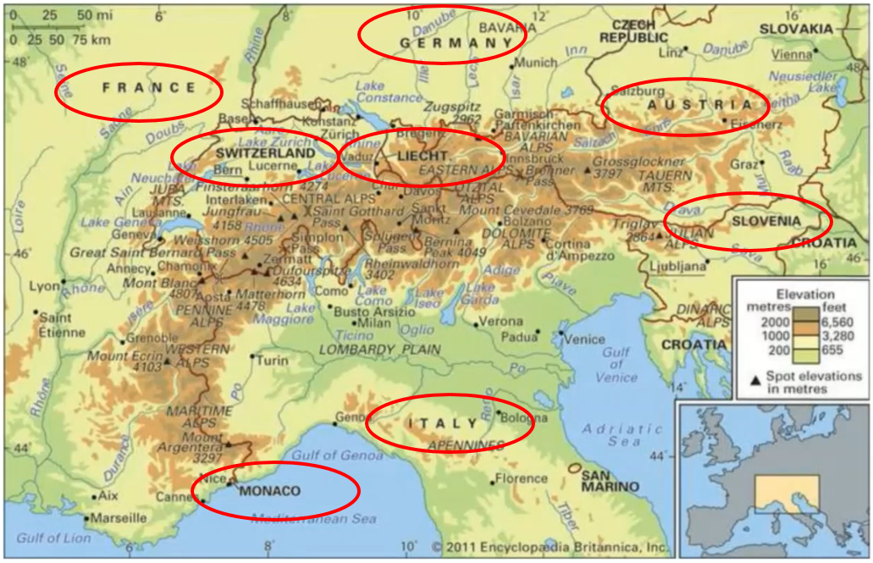
Mountain Ranges The Alps
Which 8 Countries does the Alps pass through?

Slide 7
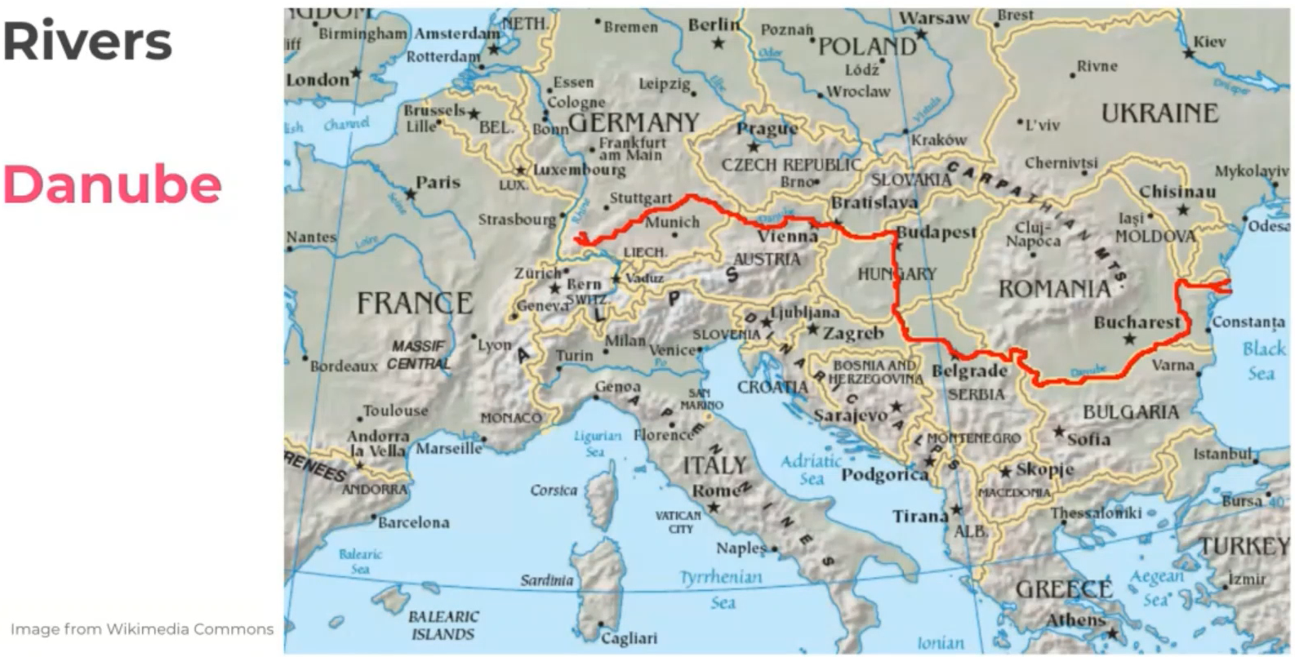

Slide 8
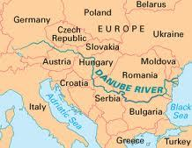

True or False
False
The Mouth of the Danube is in the Black Sea

Slide 9
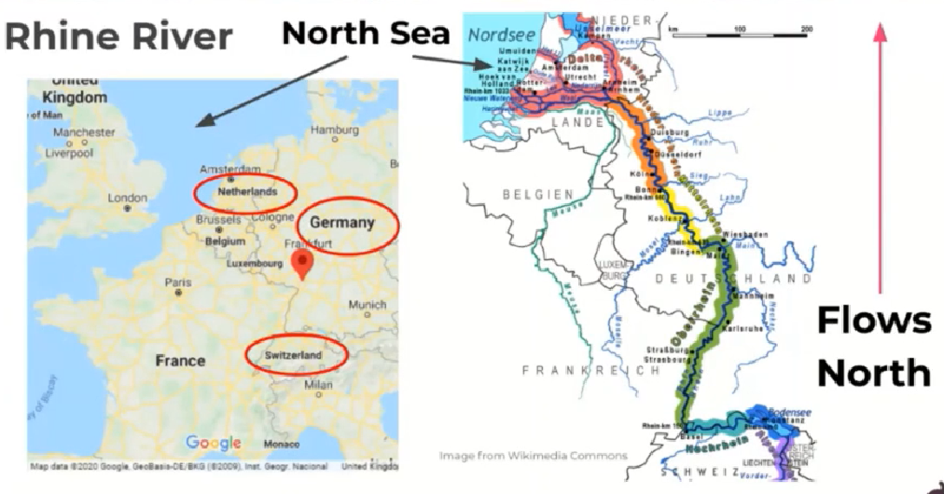

Slide 10
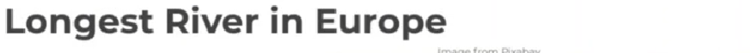
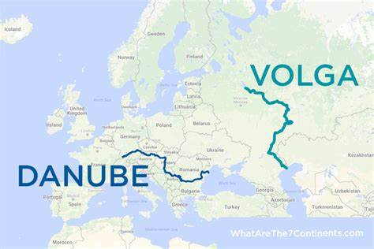
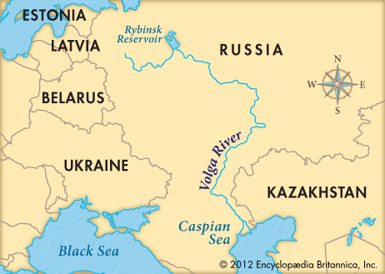
The

Slide 11
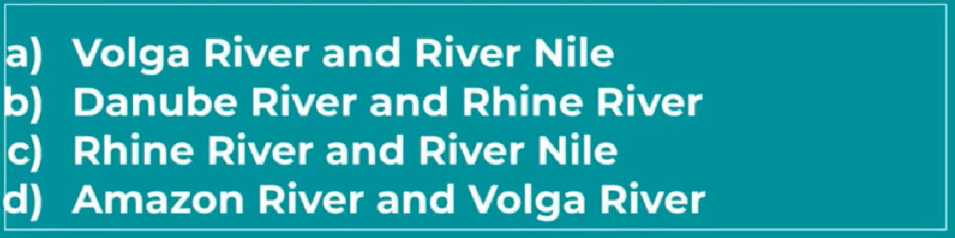
The two major rivers that divide Europe are…
Do you know any of the other rivers? You could research them on the internet.

Slide 12
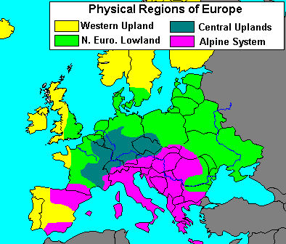
Environmental regions of Europe

Slide 13
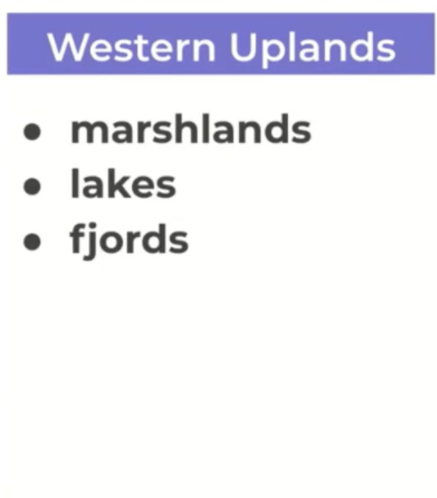
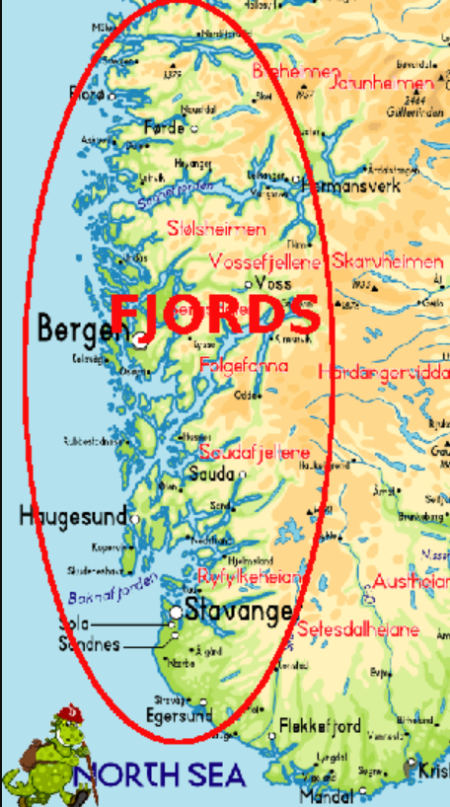
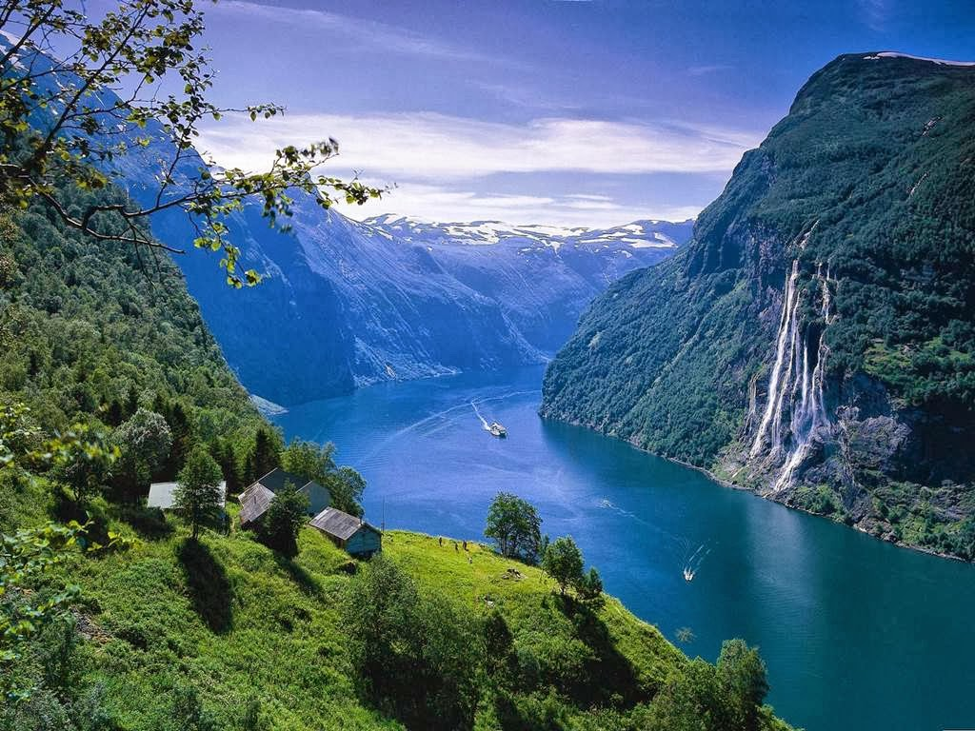
Fjords can be found on the coast of Norway

Slide 14
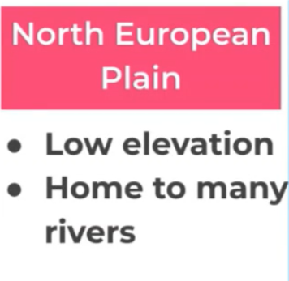
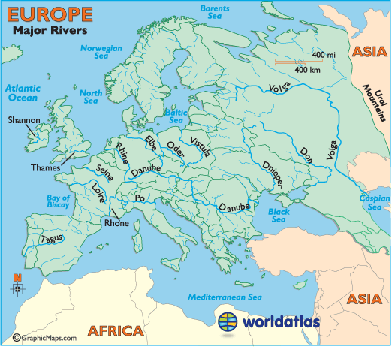
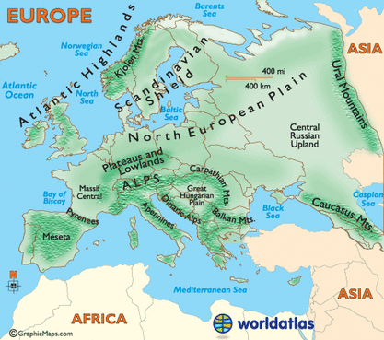
Can you see the Danube, the Rhine and the Volga Rivers that we have learned about?

Slide 15
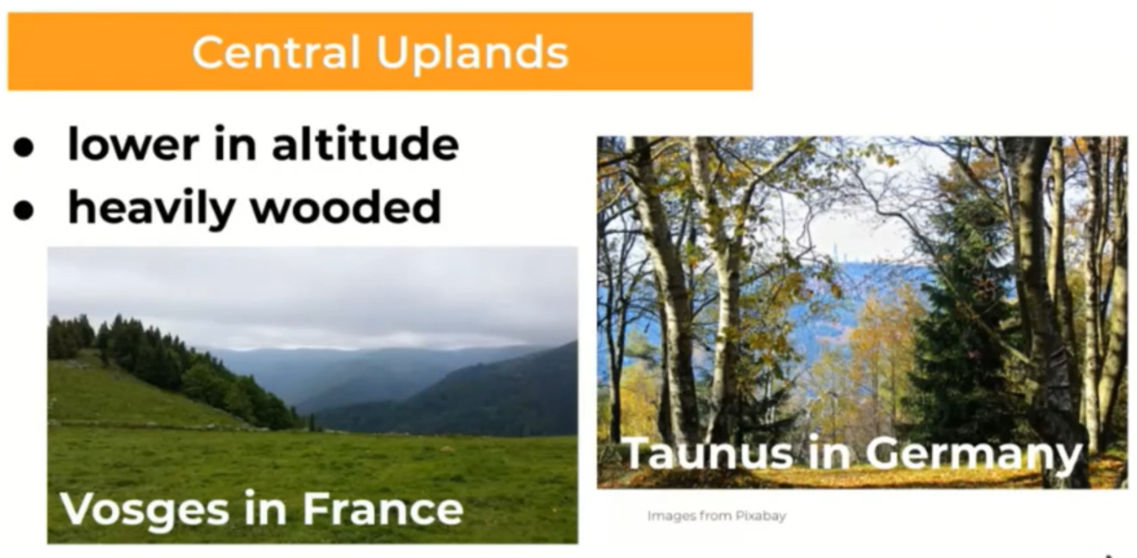

Slide 16
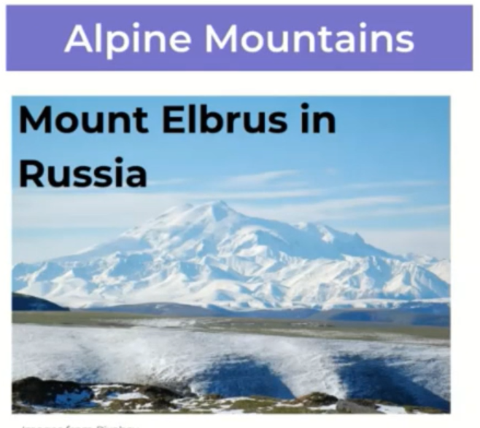
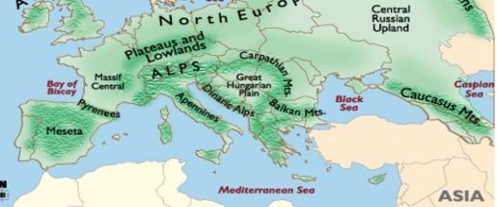
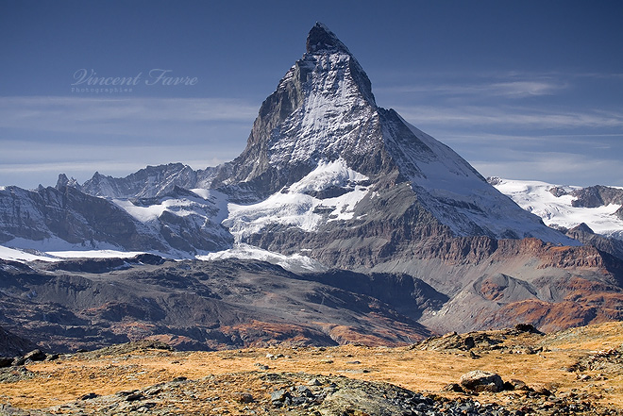
The Matterhorn in
The Alps in Switzerland

Slide 17
Challenge Task
Now with all that you have learnt about the Physical Geographical features and environmental regions in Europe can you answer these questions.
What is the tallest mountain in Russia?
What is a mountain Range?
What is the longest River in Europe?
Which large country can it be found in?
Can you name any one of the other rivers we have looked at?
What is one of the features of the Western Uplands Environmental region?
The Central uplands have no woodland areas? True or False.
Which Environmental area has the highest mountains?

Slide 18
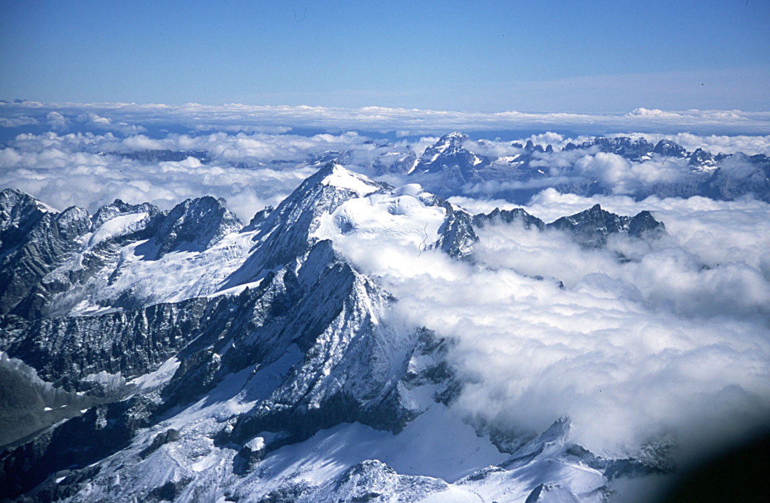
Well done!

