Slide 1
To investigate which time period we will be learning about.

Slide 2
Today’s task
Today I am going to give you some clues about who we will be learning about this half term. For each picture I have given you a little question that you can talk about with someone in your house or write down your answers in the space.
Let’s see if by the end you can work out who we are going to be learning about.

Slide 3
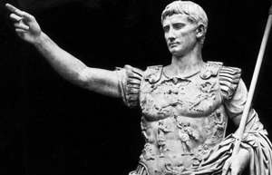
Clue 1: They ruled around 2,000 years ago
What can you see in the picture?

Slide 4
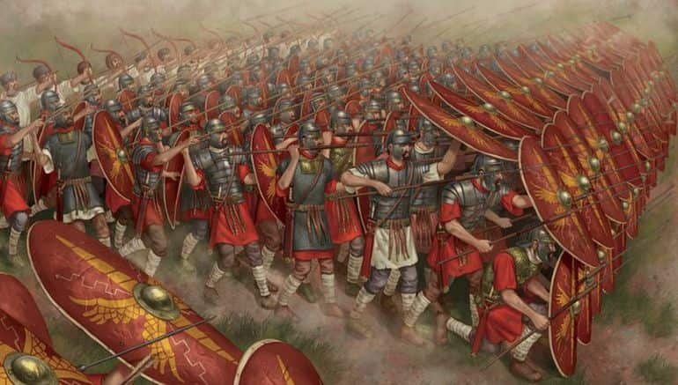
Clue 2: They were very strong soldiers
Why do you think they were good soldiers?

Slide 5
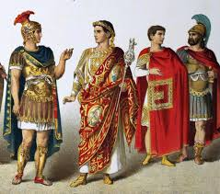
Clue 3: They were very rich
Why do you think they were rich?

Slide 6
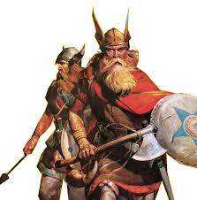
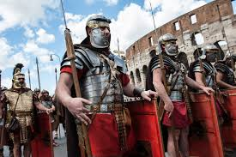
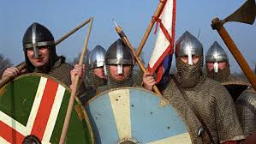
Time to predict. Who do you think we are learning about this half term?
The Romans The Normans The Vikings

