Slide 1
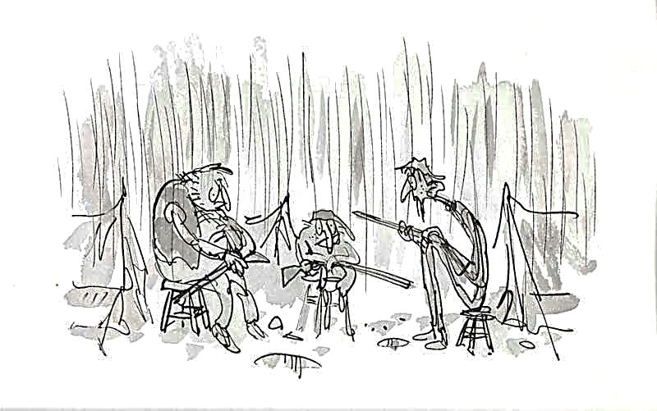

Learning intention
Reading for understanding
Identifying events

Slide 2

Listen to and read this chapter.
You will need to do an illustration to show the events of the chapter when you have finished.

Slide 3
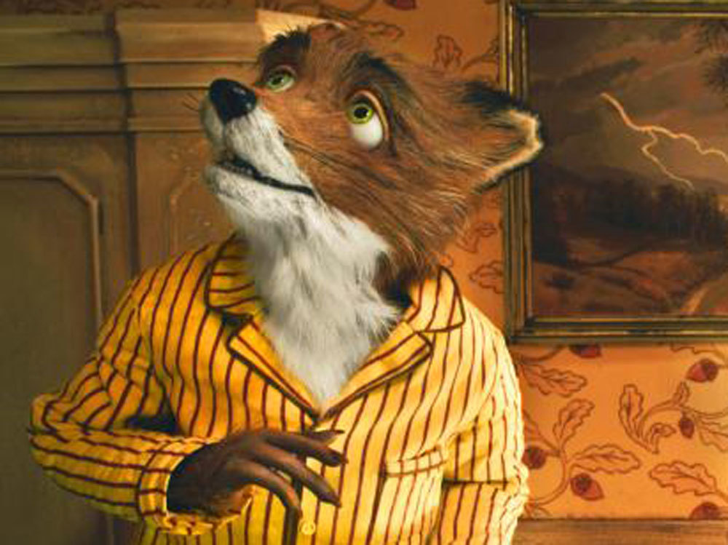
Fantastic Mr Fox
Chapter 8
The Foxes begin to starve

Slide 4
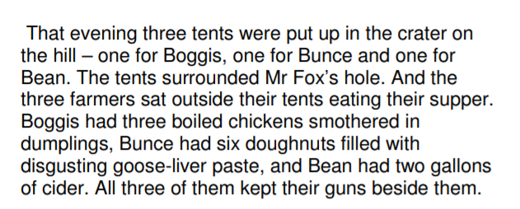

Slide 5
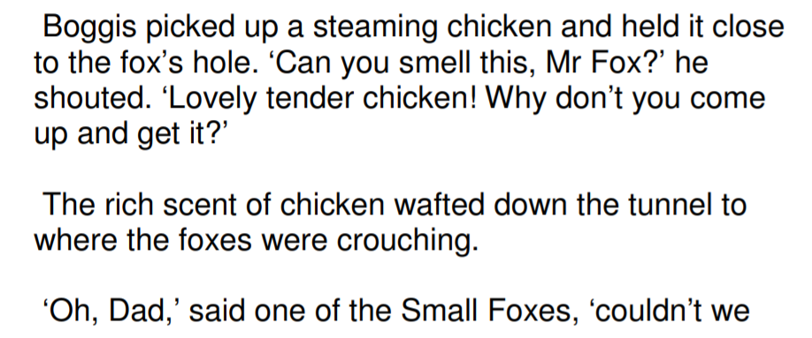
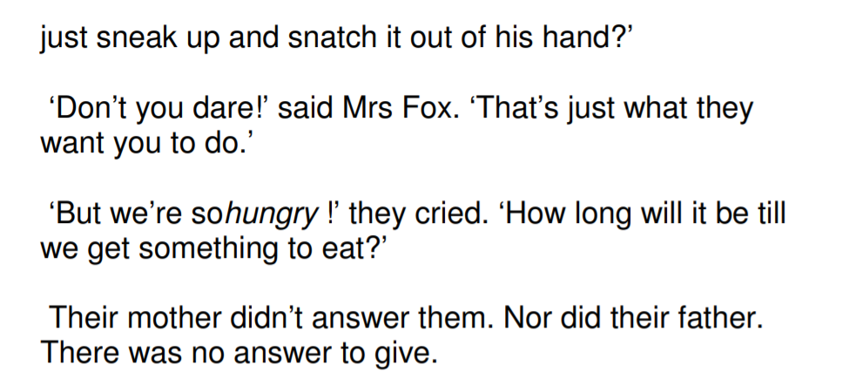

Slide 7
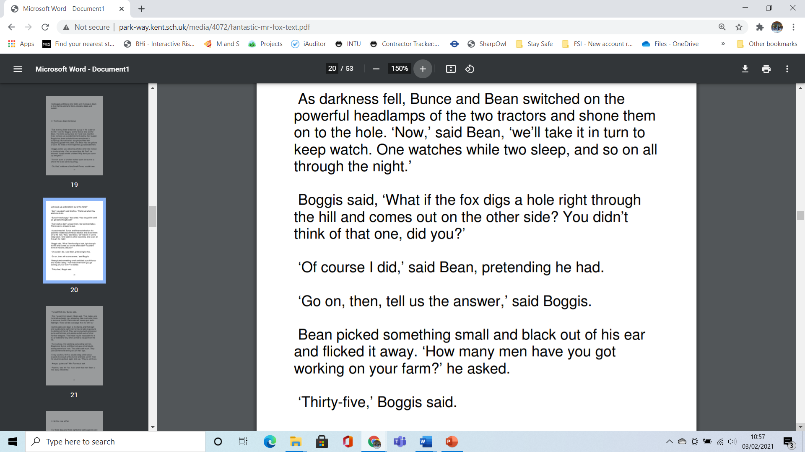

Slide 9
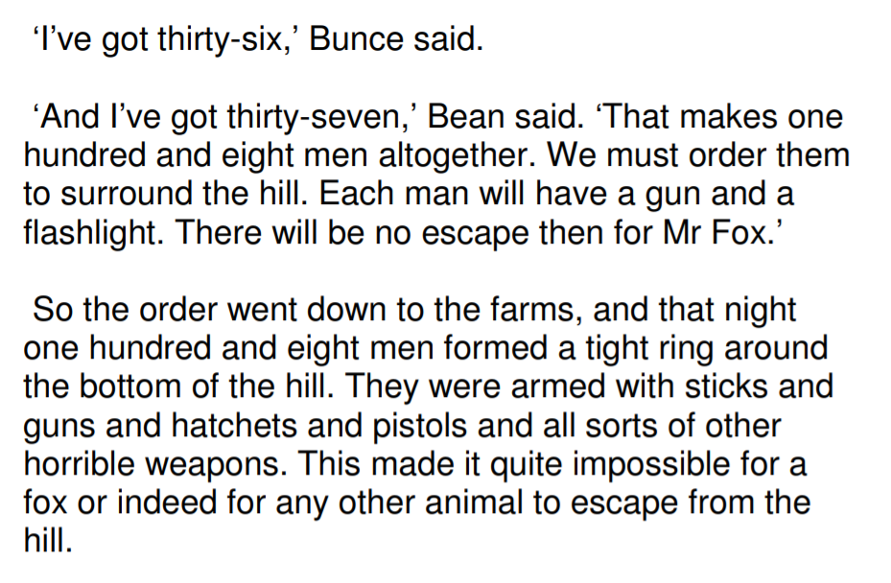

Slide 10
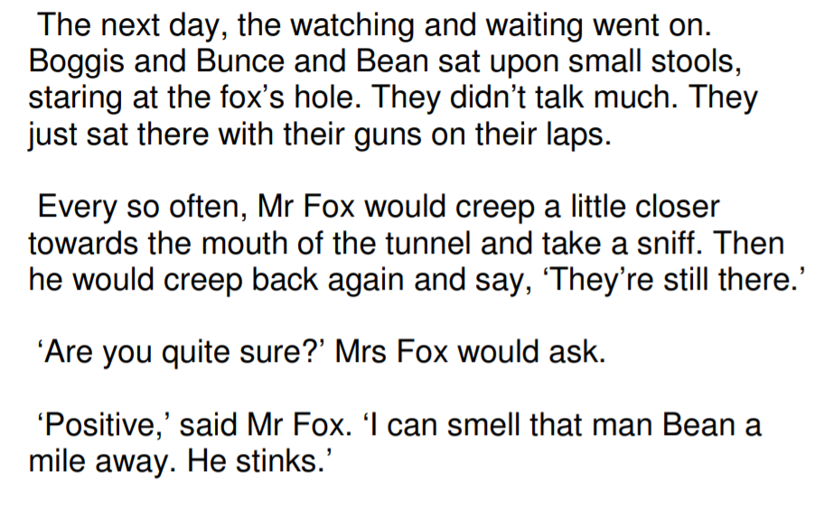

Slide 11
Now find the sheet English Chapter 8 Alternative 2.
Draw a picture to illustrate the events of the chapter.
On the sheet are;
- a word bank
- some of the main parts of the story
- ideas for speech
- examples of illustrations

