Slide 1
Comprehension reading
The Castle
by Tony Bradman
(level white)

Slide 2
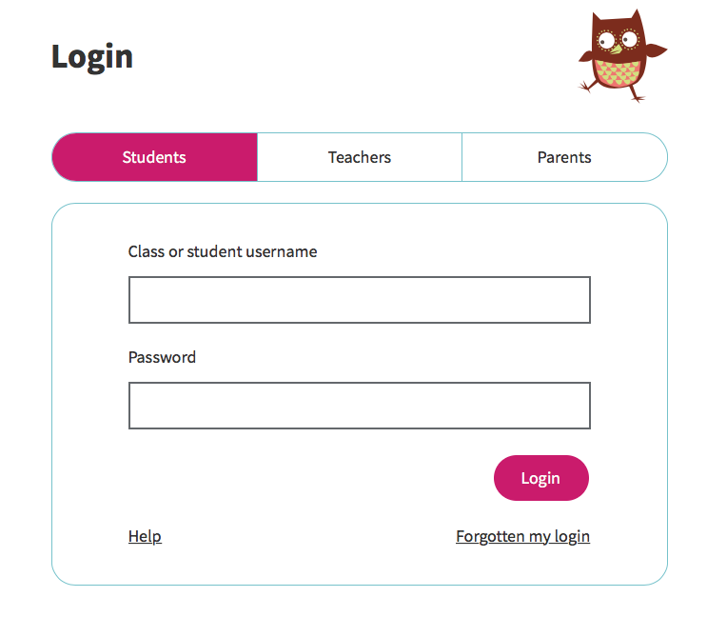
How to find the book
1. open the Oxford Owl link
https://www.oxfordowl.co.uk/
2. go to Oxford Owl for School and Log In using your details

Slide 3
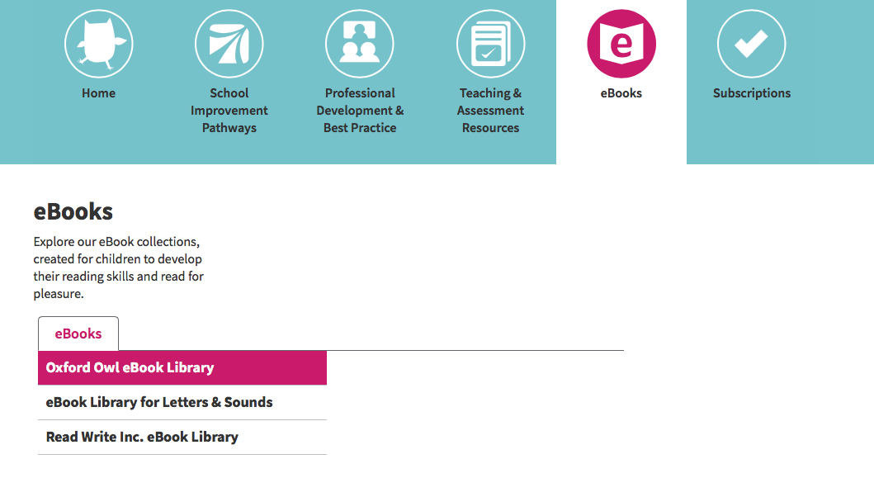
3. at the top of the page click on eBooks
and go to Oxford Owl eBook Library

Slide 4
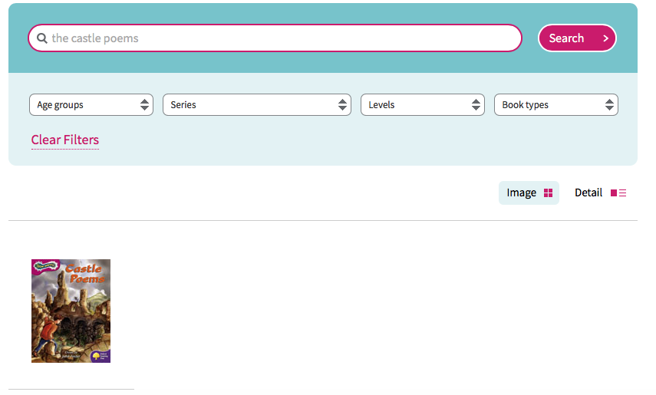
4. you can type the tile The Castle Poems in the search bar or go to page 2 and find the book on the list

Slide 5
Today we will
make predictions
read a short text and think about its structure and meaning
discuss the features of a poem
practice Year 2 vocabulary from the text
think about the meaning of the text and what emotions does it evoke

Slide 6
First, please open the book on page 2.
Predictions
Just by looking at the title and the picture tell me what is the text about?
Is it talking you to the olden days? Or is it happening now? Does it represent what the boy is seeing in his head?
Why do you think that?
Who is saying these words?
Does it make you want to find out what the text is about? Why?

Slide 7
Text analysis
Now read the text to your adult or listen to the audio on the website.
What type of text is it and why do you think that?
Here are some ideas to help you.
diary letter non-fiction fairytale poem list
It is a poem.
Answer on the next slide.

Slide 8
It is a poem.

Slide 9
How did you know this text is a poem?
Below are few words I’d like to you match with their definitions independently. Find examples in the text to support your answers.
stanza
(verse)
a group of words arranged in a row, doesn’t have to end with a full stop
lines
words ending with the same sound
a group of lines in a poem, set off from others by a blank line
rhymes
Answers on the next slide.

Slide 10
Answers
stanza
(verse)
a group of words arranged in a row, doesn’t have to end with a full stop
lines
words ending with the same sound
rhymes
a group of lines in a poem, set off from others by a blank line

Slide 11
Here are my examples.
stanza (verse)
I love the castle
On the hill;
When I’m there
Time stands still.
a line
I love the castle
I love the castle
On the hill;
When I’m there
Time stands still.
rhyme

Slide 12
Here are some features of fiction and poems.
Could you please help me to arrange them in the right box.
lines
stanza
sentences
paragraph
rhyme
plot
Fiction
Poem
Answers on the next slide.

Slide 13
Answers
Fiction
Poem
paragraph
stanza
sentences
lines
plot
rhyme

Slide 14
Vocabulary
Find these words in the poem.
Practice their reading and spelling.
knight - silent k
a spelled as or before l and ll
wall, hall, talk

Slide 15
Comprehension
Now read the poem again and thing about its meaning.
How does the boy feel?
Find the line in the text when he’s talking about his feelings.
How does the text and the picture make you feel?
Would you like to live in the castle? Who would you like to be if were ‘transported’ to the Medieval times?
Look at the 5th stanza. Why is the word real in italics?
Is it to emphasize the boy’s emotions? Are the knights and animals in the castle alive or is it just the boy’s imagination?
Was your prediction from the beginning of the session right? Or did you change the mind about the meaning of the text? Why?

