Slide 1

Learning intention: to explore apostrophes for possession.
What punctuation can you spot in this sentence?
I don’t want to get in Mum’s car.

Slide 2
Capital letter ✓
Full stop ✓
Apostrophe for contraction ✓ do not = don’t
I don’t want to get in Mum’s car.
What is this apostrophe for?

Slide 3
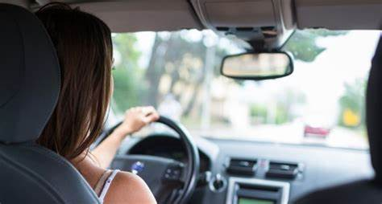
Mum’s car
apostrophe
Mum has a car. It is hers. It belongs to her.
We say Mum’s to show it is hers.
Adding an apostrophe and s (‘s) shows possession (something belongs to someone).

Slide 4
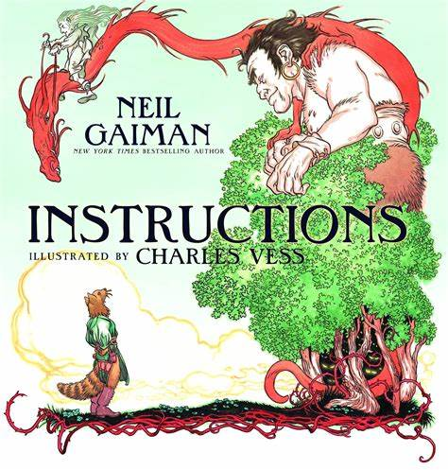
Look at this instructions from the story. Can you spot any possessive apostrophes?
You may pick strawberries in December’s frost.
Go in the ferryman’s boat.

Slide 5
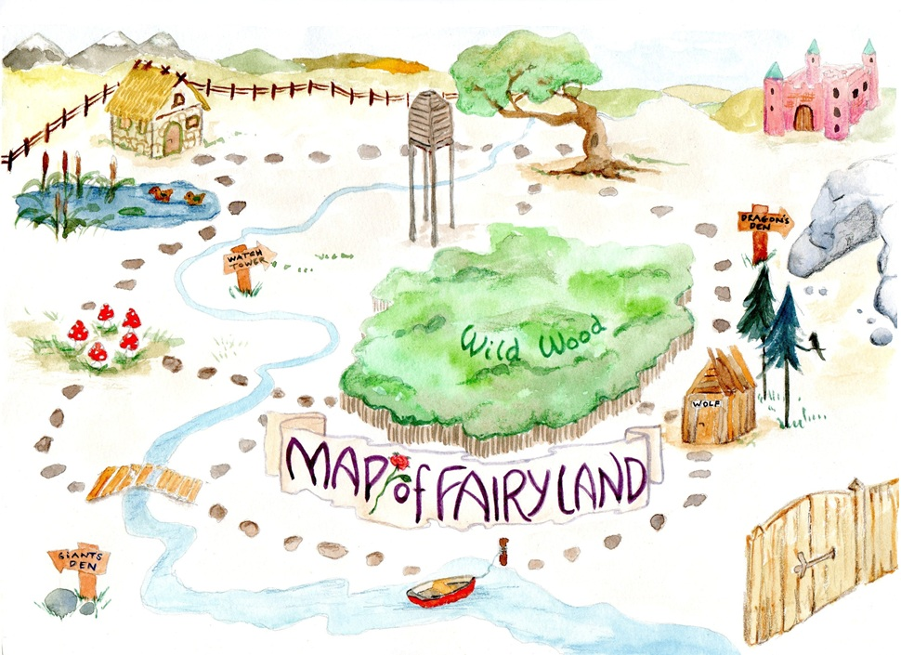
Where on the Fairy Land map can you spot possessive apostrophes?

Slide 6
giant’s den dragon’s den

Slide 7
Let’s fix these sentences by adding the missing possessive apostrophes.
The witchs house is old and spooky.
Go past the wild wood, find the path and look for the sailors boat.

Slide 8
Did you get them right?
The witch’s house is old and spooky.
apostrophe
The house belongs to the witch.
Go past the wild wood, find the path and look for the sailor’s boat.
apostrophe
The boat belongs to the sailor.

