Slide 1
Maths
Prime Numbers

Slide 2
12
7
1, 12
1, 7
2, 6
3, 4
Composite number
Prime number
Prime Numbers.

Slide 3
Prime number
A number with only two factors – 1 and itself. E.g. 2, 3 and 11.
Prime Numbers.

Slide 4
Prime numbers to 20
1
1x1
2 3 4 5 6 7 8 9 10 11
12 13 14 15 16 17 18 19 20
Prime Numbers.

Slide 5
Prime numbers to 20
2
1,2
2 3 4 5 6 7 8 9 10 11
12 13 14 15 16 17 18 19 20
Prime Numbers.

Slide 6
Prime numbers to 20
3
1,3
2 3 4 5 6 7 8 9 10 11
12 13 14 15 16 17 18 19 20
Prime Numbers.

Slide 7
Prime numbers to 20
4
1,4
2
2 3 4 5 6 7 8 9 10 11
12 13 14 15 16 17 18 19 20
Prime Numbers.

Slide 8
Prime numbers to 20
5
1,5
2 3 4 5 6 7 8 9 10 11
12 13 14 15 16 17 18 19 20
Prime Numbers.

Slide 9
Prime numbers to 20
6
1,6
2,3
2 3 4 5 6 7 8 9 10 11
12 13 14 15 16 17 18 19 20
Prime Numbers.

Slide 10
Prime numbers to 20
2 3 4 5 6 7 8 9 10 11
12 13 14 15 16 17 18 19 20
Prime Numbers.

Slide 11
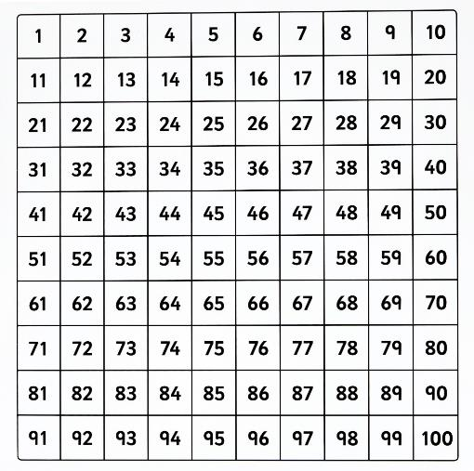
Prime numbers to 100
*Multiples of 2
Prime Numbers.

Slide 12
Prime numbers to 100
*Multiples of 2
*Multiples of 3
Prime Numbers.

Slide 13
Prime numbers to 100
*Multiples of 2
*Multiples of 3
*Multiples of 5
Prime Numbers.

Slide 14
Prime numbers to 100
*Multiples of 2
*Multiples of 3
*Multiples of 5
*Multiples of 7
Prime Numbers.

