Slide 1
Learning Intention
To use descriptive language

Slide 2
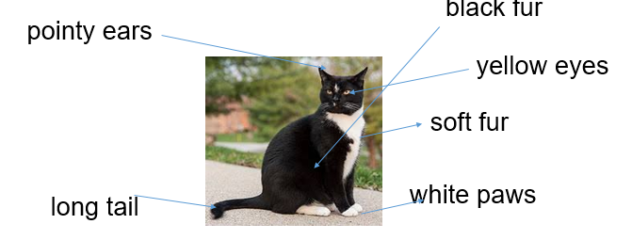
Yesterday, you thought about adjectives to describe animals
Adjectives
Adjectives are words that describe what you can sense about a noun including
sight, sound, smell, taste, touch, and how they feel.

Slide 3
Todays task
You have a sheet with a picture of some different animals and some adjectives. You have to think about which adjective is appropriate and put it into a sentence.
We can look at one together on the next slide.

Slide 4
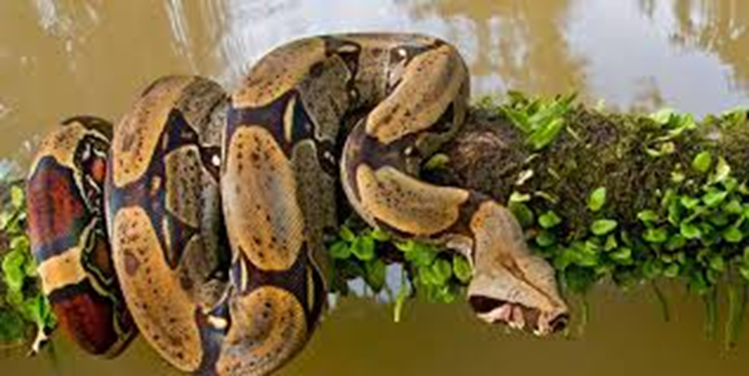
A snake
Which of the adjectives best describes a snake?
green tiny happy
The most suitable adjective is ‘green’ so lets put it in a sentence.
There was a green snake.
If you want a challenge you could add more information by telling me where is it!

