Slide 1
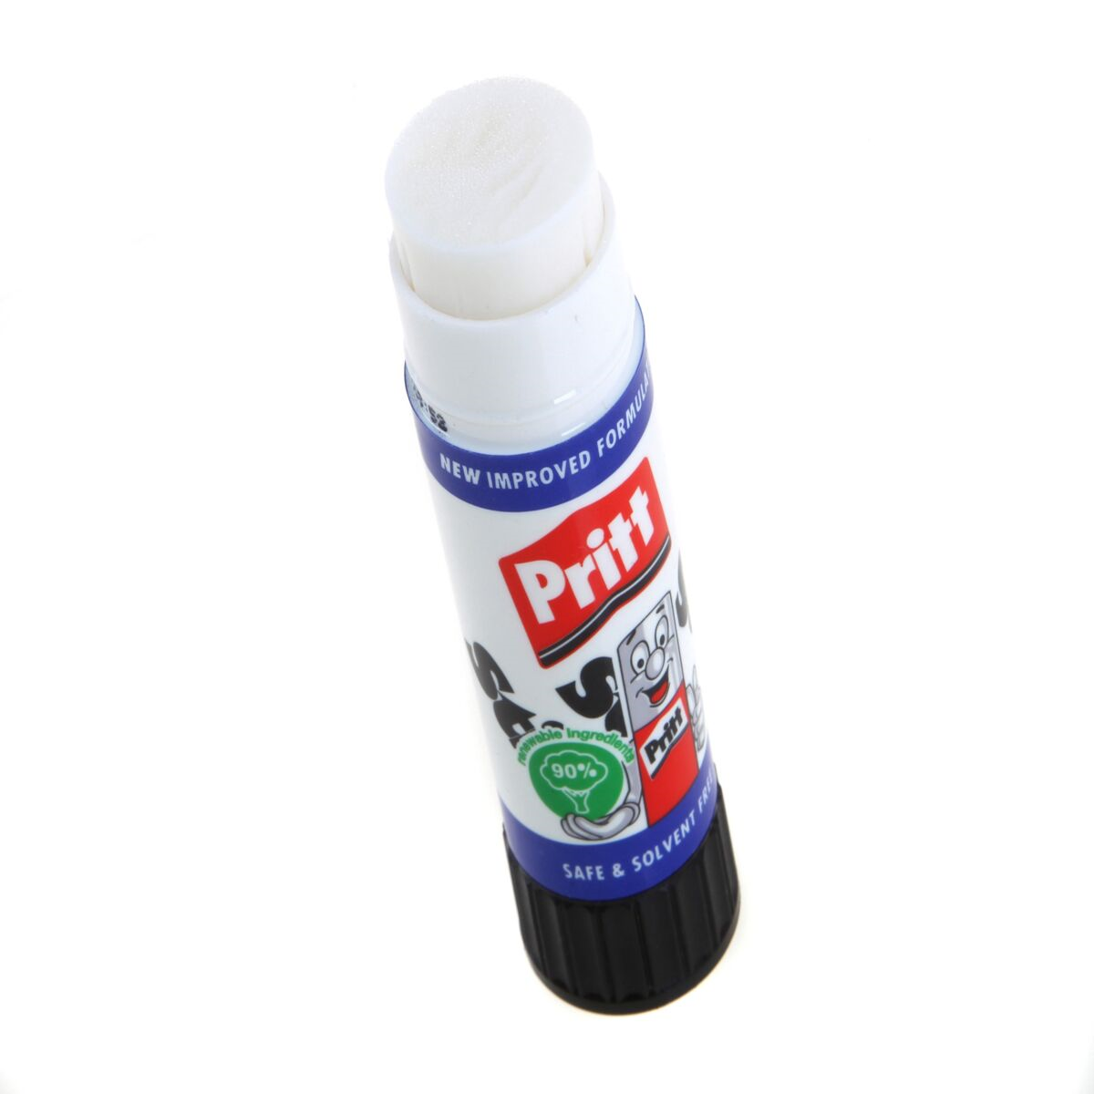
Today we will be looking at more conjunctions. Can you remember what a conjunction does?
Hint:

Slide 2
A conjunction is used to join (or stick) two parts of a sentence together. These parts are called clauses.
and or but
We have learned three co-ordinating conjunctions so far. These can be used to join two clauses together.

Slide 3
Co-ordinating conjunctions: and or but
These words join clauses together. Each clause (underlined in the example) makes sense on its own. Use a conjunction or use a full stop instead.
Gretel was scared that they were all alone in the forest so she cried bitterly.
Gretel was scared that they were all alone in the forest. She cried bitterly.

Slide 4
Subordinating conjunctions
We use this type of conjunction to add more detail to the main part of the sentence (the main clause).
Examples
when if that because

Slide 5
Subordinating conjunctions
when if that because
Hansel and Gretel were eating the roof when the wicked witch saw them from the window.
Main clause (main part of the sentence)
Subordinating conjunction
Subordinate clause (adds more detail)

Slide 6
Subordinating conjunctions
Find the conjunctions.
The stepmother left the children in the forest because she was a horrible woman.
Gretel decided to push the witch if she got into the oven.
Hansel promised Gretel that he would keep her safe.

Slide 7
Subordinating conjunctions
Find the conjunctions.
The stepmother left the children in the forest because she was a horrible woman.
Gretel decided to push the witch if she got into the oven.
Hansel promised Gretel that he would keep her safe.

Slide 8
Subordinating conjunctions
when if that because
Complete the sentence matching activity. Then extend the other sentences on the worksheet by using the subordinating conjunction given and adding your own second clause to the sentence. Make sure you check that your sentence makes sense.

