Slide 1
Year 2 History.
Homes now and then
How have homes changed over time?
Vocabulary:
past
present
artefacts
changes

Slide 2
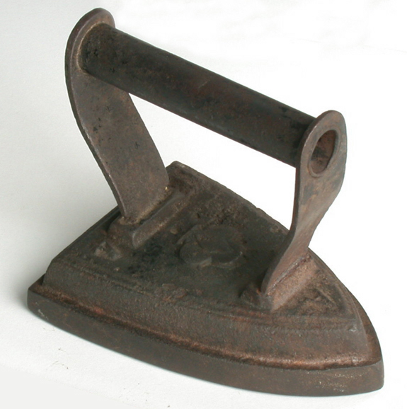
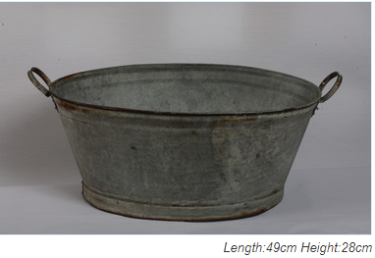
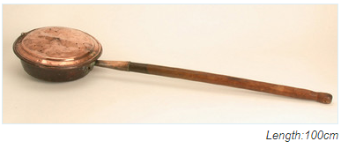
Looking at artefacts used in homes in the past
A
B
c

Slide 3
A
B
This is a tin bath.
Bathtime would usually happen once a week. People had to fetch the water from a pump or tap in the street then heat the water in pots and kettles on the stove. The family would then bathe in it one by one, in front of the fire, using the same water. It was warm but not very private.
An iron.
This was made from solid cast iron. You would place this face up in front of an open fire. Irons were used in pairs so whilst one was heating up on the stove the other could be used.
c
This is a bed warmer.
The pan was filled with hot charcoal or ashes then moved around on the bed using the long handle. They were often made in copper because it was quite light and this was important when the hot ashes had to be carried up and down stairs.

Slide 4
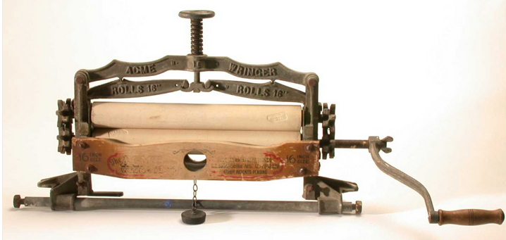
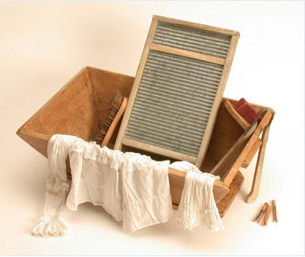
E
D

Slide 5
D
E
A clothes wringer.
This was used to get the excess water from the wet laundry and also press the clothes flat. The rollers were made from wood and the frame is very heavy because it is made from cast iron.
A washboard and tub.
The woman doing the washing rubbed the clothes with soap, up and down on the washboards bumpy surface.

Slide 6
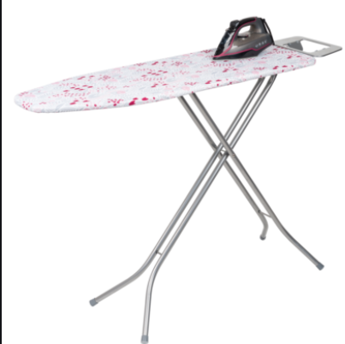
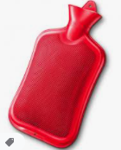
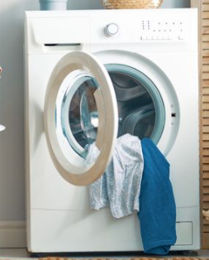
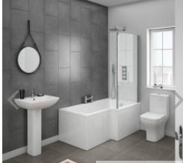
What do we use in the present?

Slide 7
Compare objects from the past and present.
Draw or write the objects from the past and present in the correct column
Select one of the objects from the past.
Write a description about it. Thinking about what it was used for, what it was made from and how it was used.
Compare this with a similar object from the present. What has changed?
Past | present
Flat iron | Electric iron

Slide 8
Transcript:
Slide 2-
Look at the artefacts from a Victorian home. What do you think they are? Do they look similar to anything you use in your home? Can you give reasons for your predictions?
Slide 3-
What did you notice about the material they were all made from? I noticed they were all types of metal. I wonder why nothing was made from plastic?
The iron would get extremely hot and was very heavy. Ironing would be hard work and probably took a long time.
The tin bath is very small. I wouldn’t want to get into the same bath water after everybody had used it.
I think the bed warmer could be quite dangerous, what might happen if the hot ashes fell onto the bed sheets?
Slide 5
The clothes went between the two wooden rollers. You can see the handle at the side that the woman would turn.
Slide 6
Now we use a washing machine instead of a wash board and wringer. This is much easier and less work. We put it in, switch on the electricity then leave it.
The red hot water bottle is sometimes used to warm beds. It is safer than using hot ashes but still uses very hot water. Not many people need them now as we have central heating and thick duvets to keep us warm.
You can see the bathroom with a bath and a shower. We don’t have to collect water from the street and heat it. We now have taps and hot water. The bathroom is much more private compared to the Victorian times.
The steam iron is much lighter and quicker to use. It doesn’t need to be heated in front of a fire because it uses electricity.

