Slide 1
Learning Intention - To understand the Gulf Stream

Slide 2
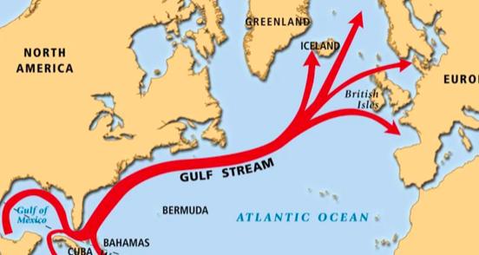
The Gulf Stream
The Gulf Stream is a large, underwater current that brings warm water from The Gulf of Mexico, across the Atlantic Ocean.
It is the reason why places like Cornwall have warm seas.

Slide 3
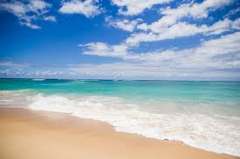
What is a current?
An ocean current describes the movement of water in the ocean.
If you have every stood in the sea, you might have felt the sea pulling you forwards and backwards, this is the current.

Slide 4
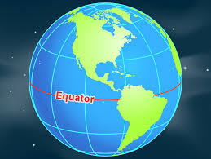
Why is the water warm?
The water is warm because The Gulf of Mexico is near the Equator.
If you remember, the equator is the imaginary line that goes around the middle of the Earth. Places near this line are warmer because they are nearer the Sun.

Slide 5
Today’s task
Today, you will have three questions to answer on your worksheet.
For some of the questions the information is in this PowerPoint, for some of the questions you may need to use an atlas or an online map like ‘google earth’ or ‘google maps’

