Slide 1
Maths- Alternative 2 Learning intention: Tell the time

Slide 2
Before and after
Before school
After school

Slide 3
Before and after
Before school
After school

Slide 4
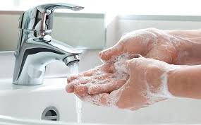
Before and after
Before Lunch
After Lunch

Slide 5
Before and after
Before Lunch
After Lunch

Slide 6
Morning, afternoon, evening
Sort thee pictures into morning, afternoon and evening

Slide 7
Morning, afternoon, evening
Sort thee pictures into morning, afternoon and evening

Slide 8
First, next, finally

Slide 9
First, next, finally

Slide 10
First, next, finally

Slide 11
First, next, finally

