Slide 1
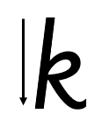

Focus sound:.
k - Start at the top, come all the way down, bounce half way back up. Loop. Slope and flick.

Slide 2
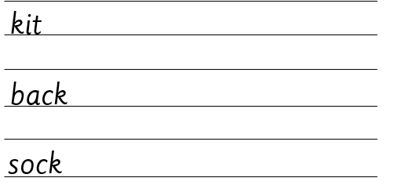
Your turn! Write k in your book using the lines.
Then try:

