Slide 1


The continent of Australia.
We are to find out some information about this continent.
To be able to identify some physical and human features.
Vocabulary:
Continent- A large mass of land surrounded by water
Physical feature- natural part of the land
Human feature- made by humans
What do you already know about Australia?

Slide 2
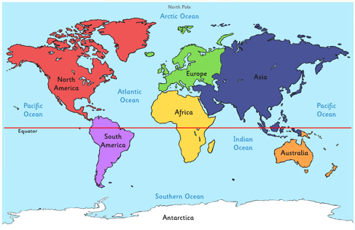
Can you remember the names of the seven continents in order of size from largest to smallest?
Is Australia one of the largest or smallest?
Reminder- Asia, Africa, North America, South America, Antarctica, Europe, Australia
The continent of Australia includes the country of Australia, New Zealand, Tasmania and New Guinea
and some surrounding islands.
Fascinating fact!
Millions of years ago Australia was connected to other continents. Over time, Australia moved very slowly away from the other continents.

Slide 3
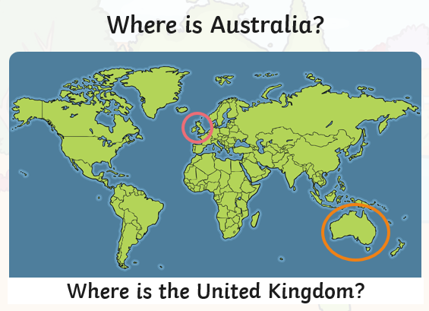
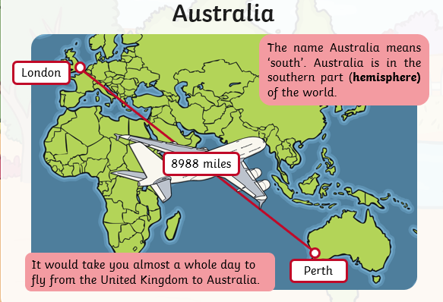

Slide 4
What are physical features?
Physical features are natural and would be here even if there were no people around. For example, seas, mountains and rivers

Slide 5
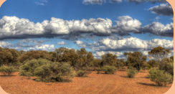
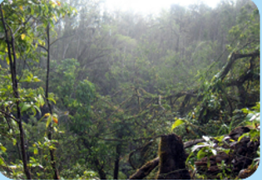
Physical features
Most of Australia is made up of a desert called the Outback.
Australia also has rainforests.
The Daintree Rainforest is the oldest rainforest in the world. You can find more than 1200 types of insects here.
Vocabulary:
Rainforest- .a tropical woodland with very tall evergreen trees. It usually rains lots.

Slide 6
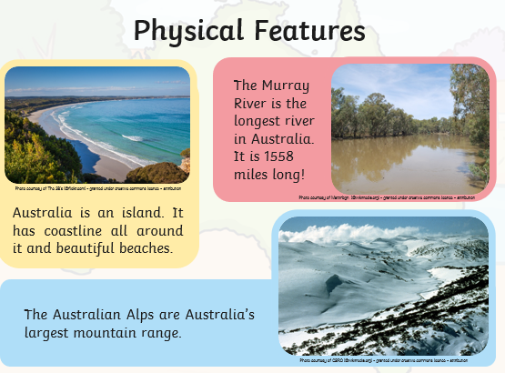
Vocabulary:
Alps- mountains

Slide 7
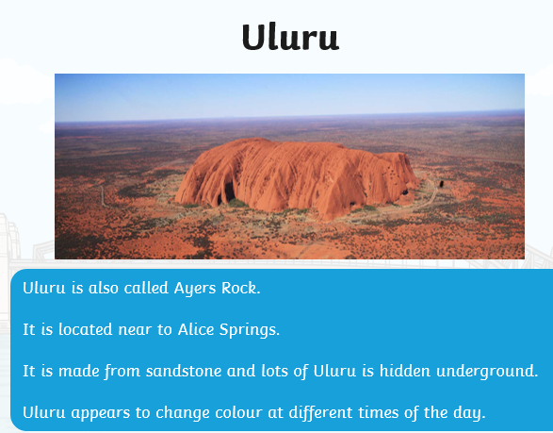
Physical features
Did you know:
Uluru is more than 600 million years old!

Slide 8
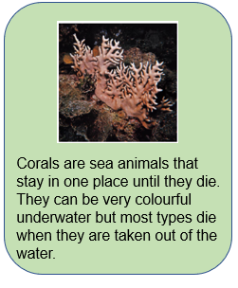
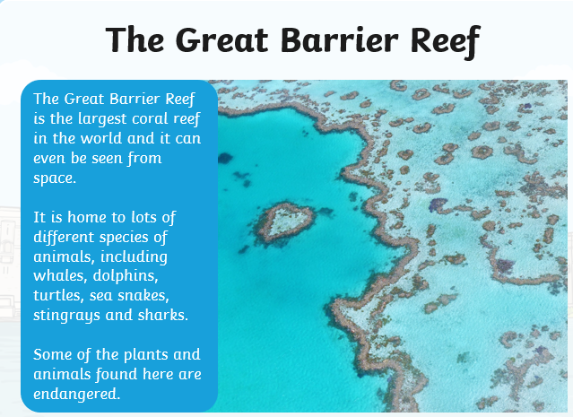
Physical features
Vocabulary:
Species- different kinds
Coral reef- made up of thousands of tiny animals called coral polyps.

Slide 9
What are human features?
These are things that have been built by humans. For example- roads, buildings and bridges.

Slide 10
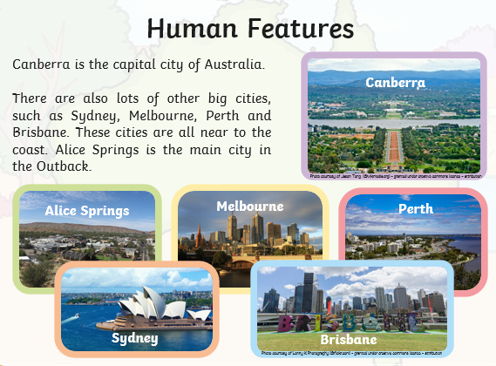

Slide 11
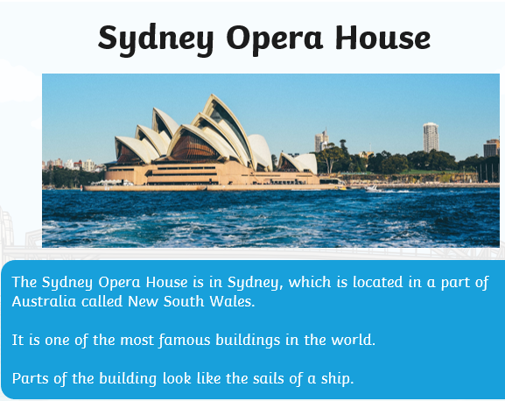
Human Features
Vocabulary:
Opera- a type of music
Sails- .large pieces of cloth that the wind blow into to make a ship move.

Slide 12
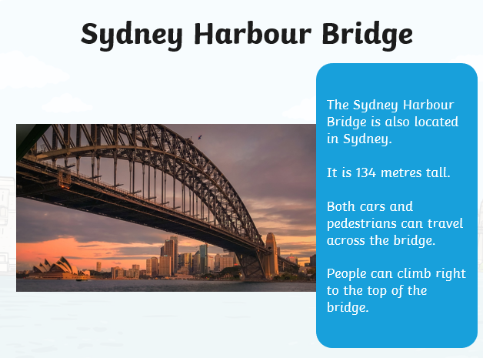
Human Features
Vocabulary:
Pedestrian- people walking
Harbour- this is near the land, boats go here to be protected from strong currents and waves

Slide 13
Task:
You want to encourage people to go and visit Australia. You need to tell them what physical and human features they might see. Your writing needs to be exciting and include lots of description.
For example:
Go to Australia and see the Sydney Harbour Bridge.
You must fly to Australia and visit the extremely tall Sydney Harbour Bridge. Why not be brave and carefully climb to the very top of the bridge. You will see the amazing views of the harbour.

