Slide 1
Learning intention: To learn about important people in history.

Slide 2
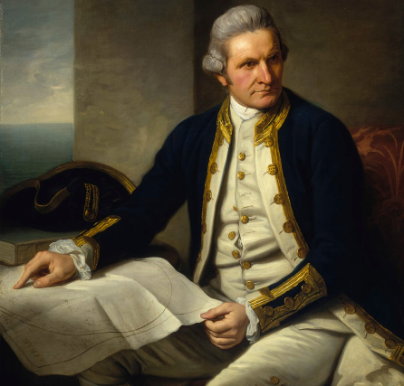
Last session you predicted who this person might be and why he was famous.
Some ideas:
He is rich because he is wearing gold and expensive clothes.
It is a man.
He is old because he has grey hair.
It is from a long time ago because it is a painting and not a photograph.
He is pointing to a piece of paper.
He looks like he has a pirate hat.

Slide 3
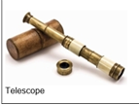
These were the pictures you looked at last session.
A telescope is an instrument which makes objects that are far away appear larger.
Why would this be useful?
A compass is an instrument used to show direction.
Remember in our Geography lessons we looked at the directions North, South, East and West.
Why do you think the man in the picture needed a compass?

Slide 4
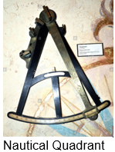
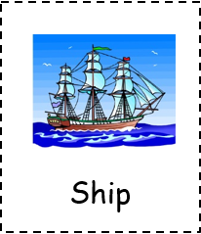
This is an instrument used by sailors when planning their journey on a map.
Does this give you a clue about why the man was famous?
A ship is used to travel on water. You can travel long distances on a ship.
Does this help us know about why the man was famous?

Slide 5
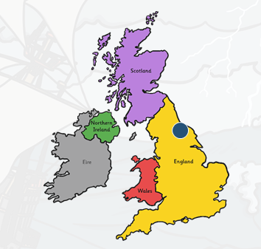
This man in the picture is called Captain James Cook.
James Cook was born on November 7th, 1728 in Marton, Yorkshire, England.

Slide 6
Some information about James Cook.
His father was a farmer.
As he grew older James became more and more interested in the sea. When he was about 18 years old he travelled to Whitby and got a job working on the coal ships.
Does this give you a clue about why he might be famous?
Talk to an adult or friend about this.

Slide 7
He joined the Royal Navy in 1755 and learnt how to sail ships.
He became extremely good at making maps.
This is one of the tools James Cook would use to help him draw maps.

Slide 8
James Cook was a famous explorer.
What is an explorer?
Talk to an adult or a friend about what you think an explorer is.

Slide 9
An explorer is someone who explores a new place or somewhere they don’t know much about.
They use drawings, maps or keep diaries to show people what they have discovered.
Explore means trying to find something new.

Slide 10
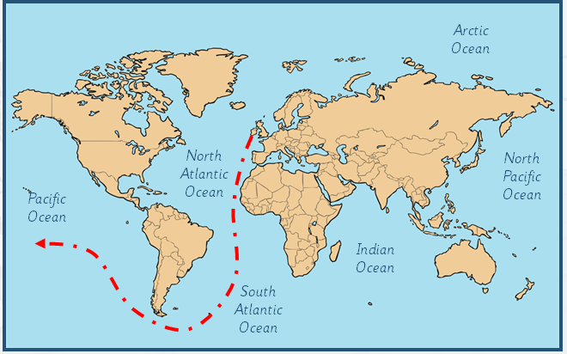
Here is a clue to where he explored.

