Slide 1
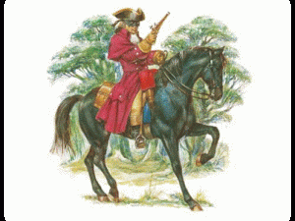
The Highway Man By Alfred Noyes

Slide 2
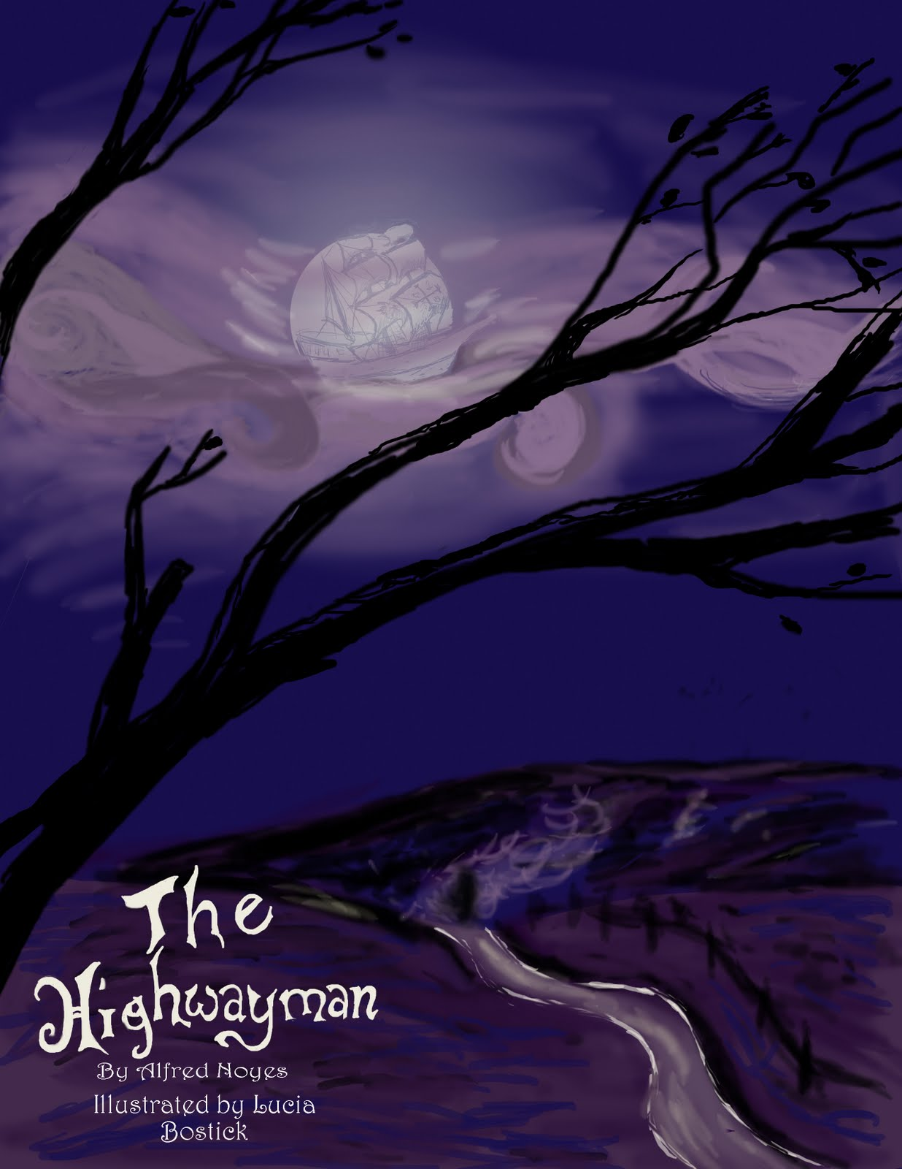
The wind blew through the darkness and the gusty trees,
The moon looked ghostly on the cloudy seas.
The road was moonlit over the purple moor,
And the highwayman came riding—
Riding—riding—
The highwayman came riding, up to the old pub door.

Slide 3
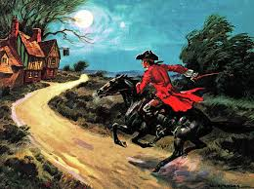
He had a round hat on his forehead and lace around his chin,
He wore a coat of red velvet, and trousers made from brown deer skin.
They fit him well and he wore boots up to his thigh.
He looked like a jewel twinkling,
The end of his gun was twinkling,
His long sword was twinkling, under the starry sky.

Slide 4
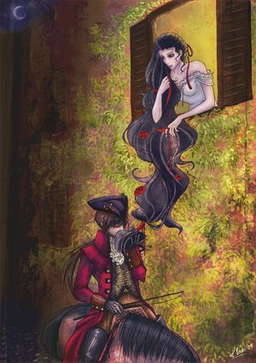
Over the cobbles he clattered and clashed in the dark yard.
He tapped with his whip on the shutters of the window, but it was all locked and barred.
He whistled a tune to the window, and who should be waiting there
But the landlord’s black-eyed daughter,
Bess, the landlord’s daughter,
Plaiting her long black hair.

Slide 5
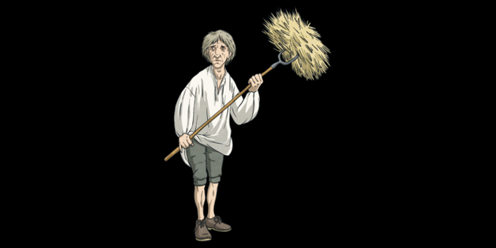
And in the dark yard a gate creaked
Where Tim listened. His face was white and scared.
His eyes were wide, his hair was messy like mouldy hay,
But he loved the landlord’s daughter,
The landlord’s red-lipped daughter.
Dumb as a dog he listened, and he heard the robber say-

Slide 6
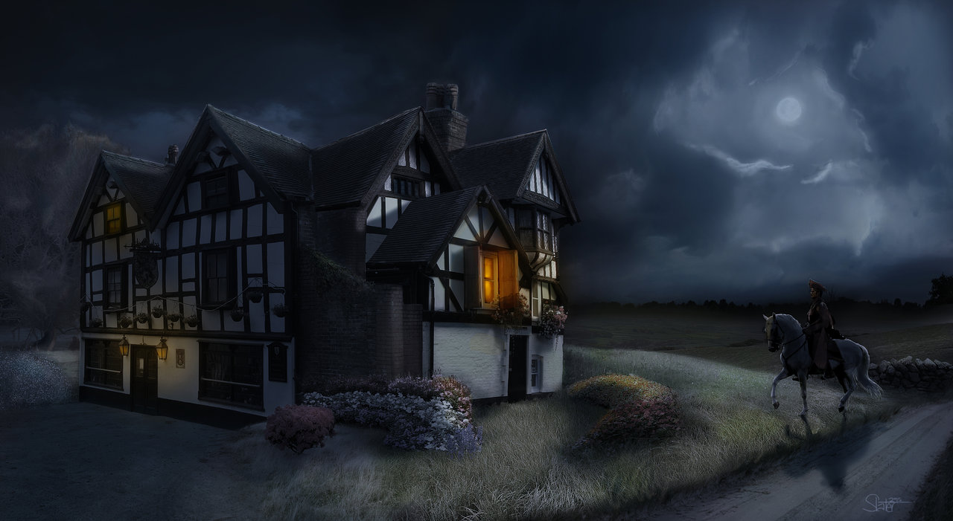
“One kiss, my sweetheart, I’m after a prize to-night,
But I shall be back with the yellow gold before the morning light;
Unless the king’s soldiers catch me and chase me through the night,
Then look for me by the moonlight,
Watch for me by the moonlight,
I’ll come to you at moonlight, no matter what might get in the way.”

Slide 7
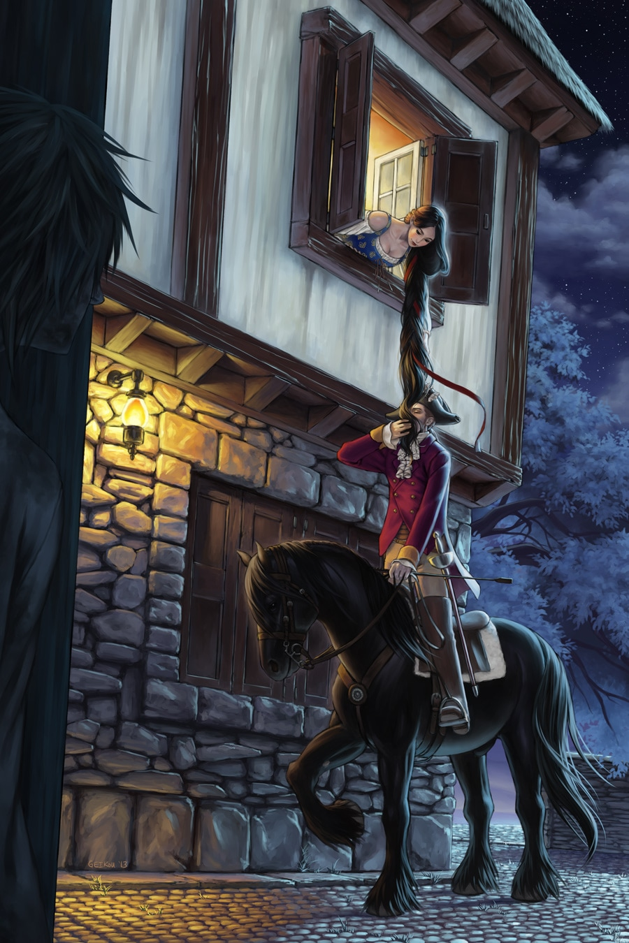
He stood up on his saddle but he couldn't reach her hand,
She loosened her hair
And the smell of perfume came from her neck;
He kissed its waves in the moonlight,
(O, sweet waves in the moonlight!)
Then he tugged at his horse's rein in the moonlight, and galloped away to the west.

Slide 8
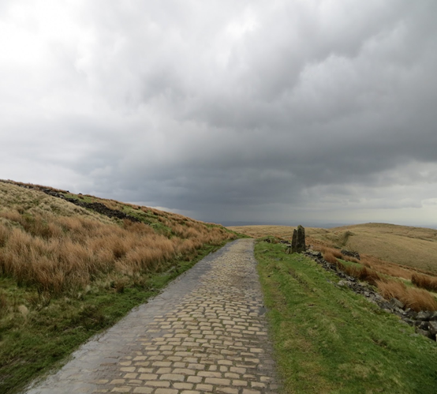
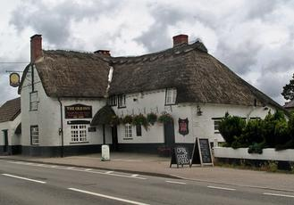
He did not come in the morning. He did not come at night;
And out of the sunset, before the rise of the moon,
When the road was a long ribbon, covering the purple fields,
A red-coat troop came marching—
Marching—marching—
King George’s men came marching, up to the old pub door.

Slide 9
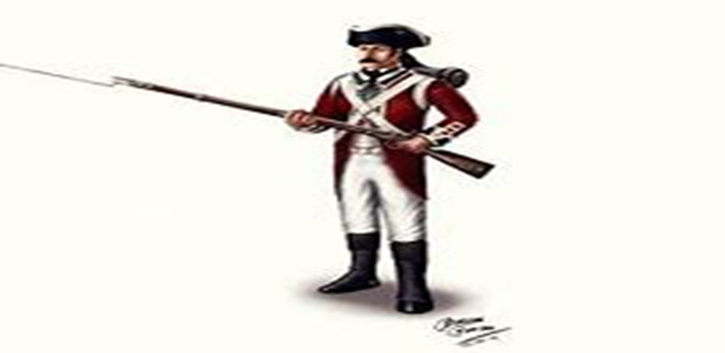
They said no word to the pub owner. They drank his beer instead.
But they trapped his daughter, and tied her to the bed.
Two of them stood beside her, with guns at their side!
There was death at every window;
And hell at one dark window;
For Bess could see, through her window, the road that he would ride.

Slide 10
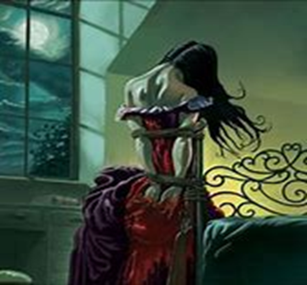
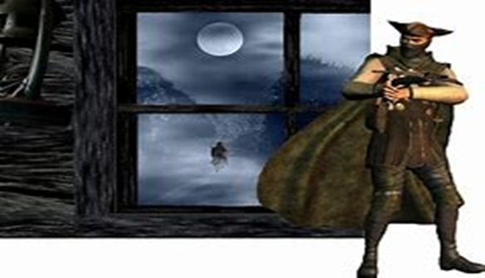
They had tied her up with many a nasty laugh.
They had bound a gun beside her, with the end of it beneath her head!
“Now, keep good watch!” and they kissed her. She heard the doomed man say—
Look for me by moonlight;
Watch for me by moonlight;
I’ll come to you by moonlight, though hell should stand in the way!

Slide 11
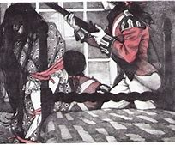
She twisted her hands behind her, but couldn’t untie the knot!
She twisted her hands till her fingers were wet with sweat or blood!
They stretched and struggled in the darkness, and the hours passed by like years
Until, now, on the stroke of midnight,
Cold, on the stroke of midnight,
The tip of one finger touched it! The trigger at least was hers!

Slide 12
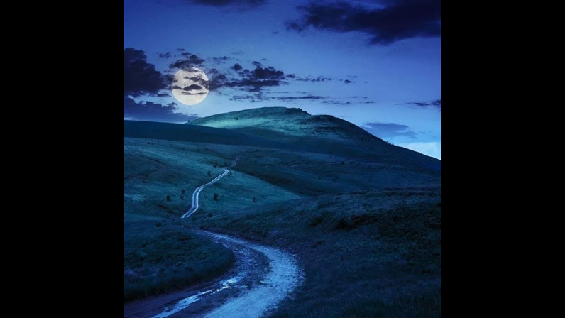
The tip of one finger touched it. She struggled no more for the rest.
Up, she stood up to attention, with the gun beneath her breast.
She would not risk their hearing; she would not struggle again;
For the road lay empty in the moonlight;
Empty and bare in the moonlight;

Slide 13
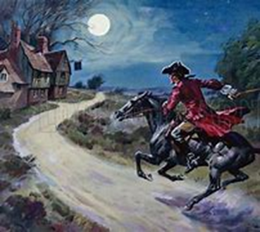
Tlot-tlot; tlot-tlot! Had they heard it? The horsehoofs ringing clear;
Tlot-tlot; tlot-tlot, in the distance? Were they deaf that they did not hear?
Down the ribbon of moonlight, over the top of the hill,
The highwayman came riding—
Riding—riding—
The red coats looked at her and she stood up, straight and still.

Slide 14
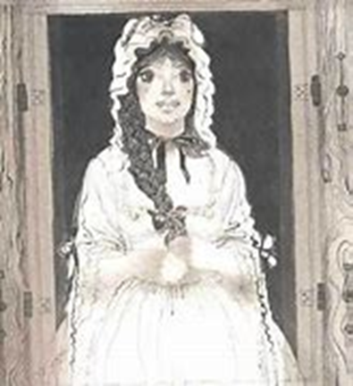
Tlot-tlot, in the frosty quiet! Tlot-tlot, in the cold night!
Nearer he came and nearer. Her face was like a light.
Her eyes grew wide for a moment; she drew one last deep breath,
Then her finger moved in the moonlight,
Her gun shattered the moonlight,
The loud noise warned him, warned him with her death.

Slide 15
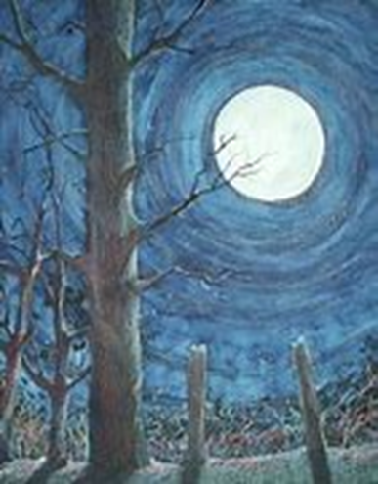
He turned. He did not know who she was. Standing, with her head over the musket, drenched with her own blood! Not until the dawn did he hear it, and his face grew grey and sad, How Bess, the pub owner’s daughter, The pub owner’s black-eyed daughter, Had watched for her love in the moonlight, and died in the darkness there.

Slide 16
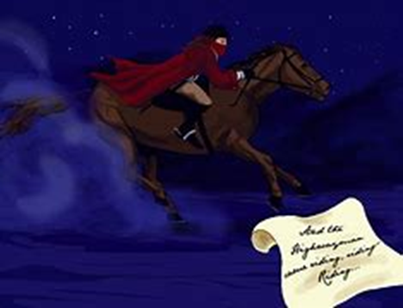
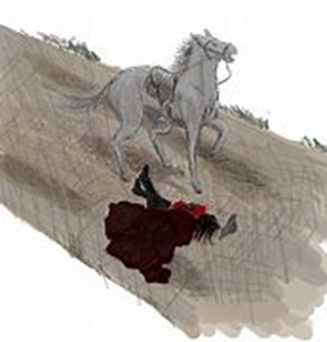
Back, he rode like a madman, shouting a curse to the sky,
With the white road behind him and his sword held up high.
Blood red were his boots in the afternoon sun,
When they shot him down on the highway,
Down like a dog on the highway,
And he lay in his blood on the highway, with a bunch of lace at his throat.

Slide 17
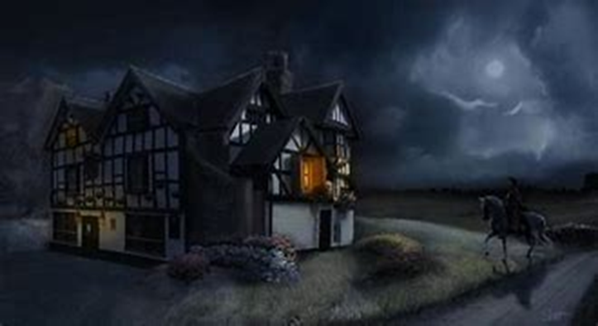
And still of a winter’s night, they say, when the wind is in the trees,
When the moon is a ghostly ship thrown upon cloudy seas,
When the road is a ribbon of moonlight over the purple field,
A highwayman comes riding—
Riding—riding—
A highwayman comes riding, up to the old pub-door.

Slide 18
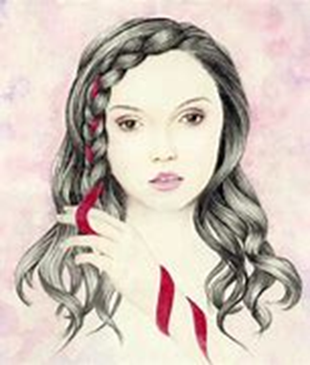
Over the path he clatters and clangs in the dark pub-yard.
He taps with his whip on the shutters, but all is locked and closed.
He whistles a tune to the window, and who should be waiting there
But the pub owner’s black-eyed daughter,
Bess, the pub owner’s daughter,
Twisting a dark red love-knot into her long black hair.

