Slide 1
Learning Intention: To find verbs

Slide 2
What is a verb?
A verb is a doing word.
Verbs are actions that you can do.
Today we’re going to think of as many verbs as we can!

Slide 3
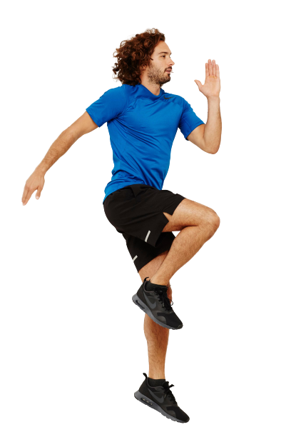
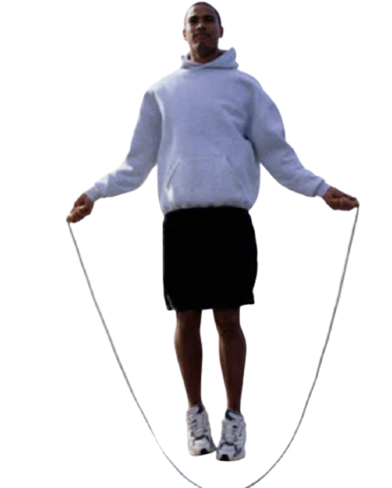
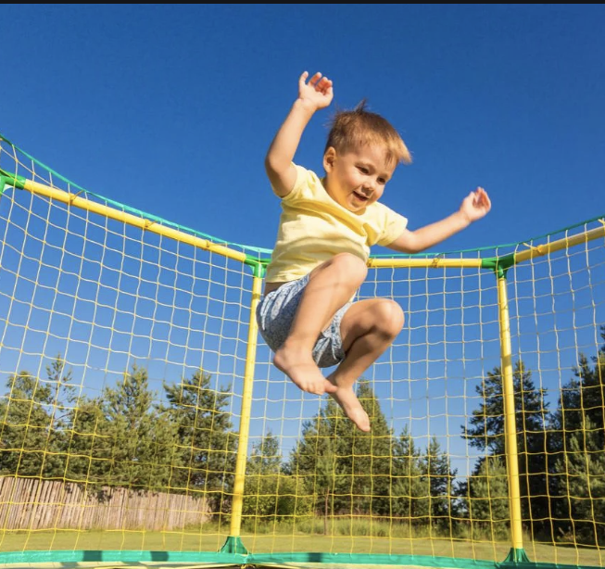
Notes:
What is the man doing? He is doing a h-o-p…. H-o-p. Hop! The verb is hop because he will do it.
What is the man in the middle doing? He has a skipping rope. He is going to s-k-i-p… s-k-i-p… skip! The verb is skip.
What is the boy doing on the trampoline? He is going to do a j-u-m-p… j-u-m-p… jump! The verb is jump.

Slide 4
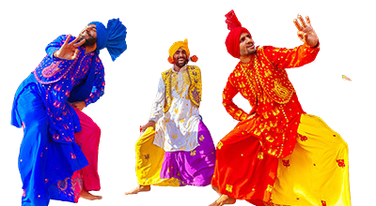
Your turn:
Notes:
Now it’s your turn. Can you draw a picture of another way the we can move our bodies? Use the clues to help you.

Slide 5
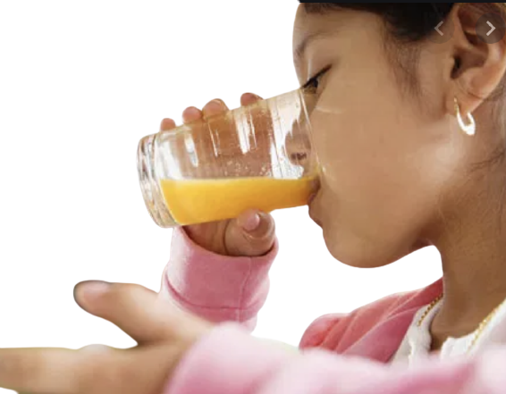
Notes:
What is the man doing with the microphone? La, la, la, he is going to s-i-ng… sing!
What is the girl going to do to the ball? She is going to k-i-ck the ball. K-i-ck… kick!
The girl is holding some juice. What will she do to it? She is going to d-r-i-nk the juice… d-r-i-nk… drink!

Slide 6
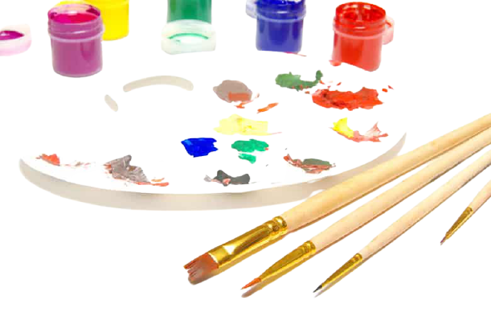
Your turn:
Notes:
It’s your turn to draw a verb, something that we can do. Use the clues to help you if you need them.

Slide 7
Verb Bank:
Notes:
Here are the verbs we have found today, I have put them into a verb bank. You might have found some extras too! We have hop, skip, jump, sing, kick and drink.

Slide 8
Your turn:
Make a poster all about verbs.
Draw different verbs around the circle and word in the middle of the page.

Slide 9
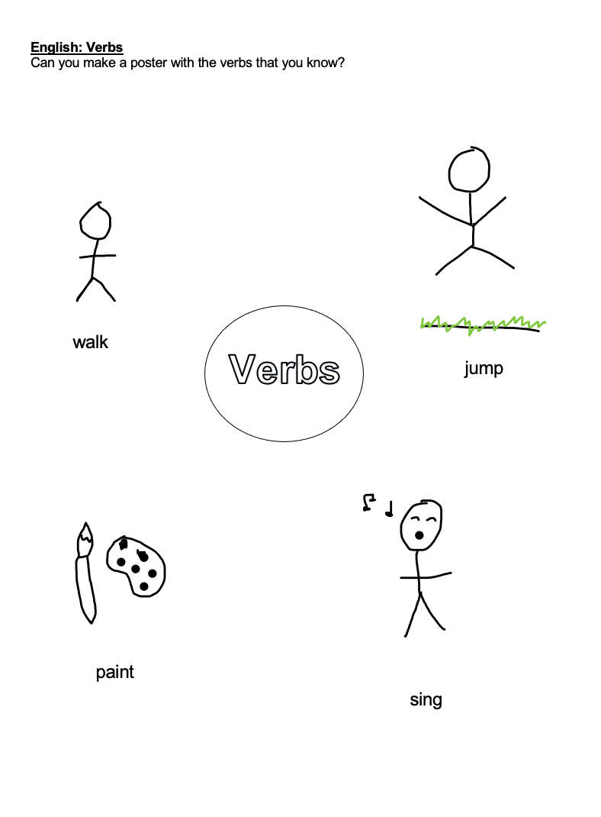
Example:

Slide 10
Commentary:
Slide 3:
What is the man doing? He is doing a h-o-p…. H-o-p. Hop! The verb is hop because he will do it.
What is the man in the middle doing? He has a skipping rope. He is going to s-k-i-p… s-k-i-p… skip! The verb is skip.
What is the boy doing on the trampoline? He is going to do a j-u-m-p… j-u-m-p… jump! The verb is jump.
Slide 4:
Now it’s your turn. Can you draw a picture of another way the we can move our bodies? Use the clues to help you.
Slide 5:
What is the man doing with the microphone? La, la, la, he is going to s-i-ng… sing!
What is the girl going to do to the ball? She is going to k-i-ck the ball. K-i-ck… kick!
The girl is holding some juice. What will she do to it? She is going to d-r-i-nk the juice… d-r-i-nk… drink!

Slide 11
Commentary 2:
Slide 6:
It’s your turn to draw a verb, something that we can do. Use the clues to help you if you need them.
Slide 7:
Here are the verbs that we have found today, I have put them into a verb bank. You might have found some extras too! We have hop, skip, jump, sing, kick and drink.

