Slide 1
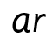

Focus: ar
a – make a curve, go up to the top, come back down and flick
r – start at the top, come down, bounce back up and over

Slide 2
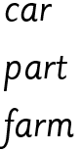
Your turn! Write ar in your book using the lines.
Then try:

