Slide 1

Learning Intention number fact families

Slide 2
What is a fact family?
A fact family is a set of number sentences (facts) you can make using the same three numbers (number family)
20 4 5

Slide 3
20 4 5
4 and 5 are a number fact family because you can multiply and divide them and they work.
4 x 5 = 20? Yes!
4 and 10 are not a fact family because when we multiply or divide, they don’t work.
3 x 4 = 10 ? No!

Slide 4
We are going to look at fact families for
X and ÷

Slide 5
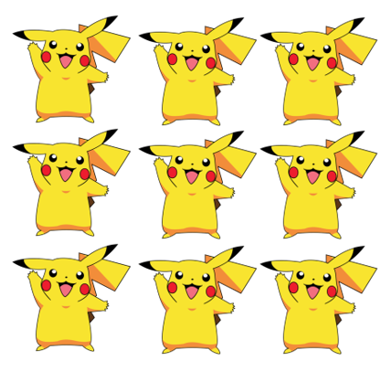
This is an array
2 across
4 down
2 x 4 = 8
8 in total
So 2 4 and 8 are our number fact family.
We can write different number sentences to show this
4 x 2 = 8
8 ÷ 2 = 4

Slide 6
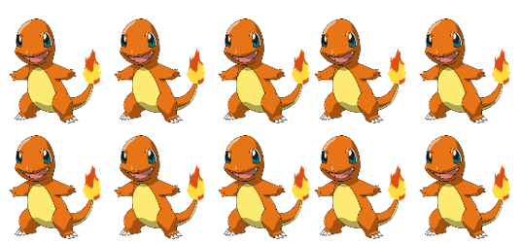
Here is another array
5 across 2 down
5 x 2 = 10
Fact family numbers
5 2 and 10
2 10
10 2 5
____ X ____ = _____
____ ÷ ____ = _____

Slide 7
Your Turn
Find sheet, ‘Maths- Alternative 2 – Fact families’
Complete the sheet.
Look at the slides again if you need to.

