Slide 1
How shadows are formed

Slide 2
Recap
Last week we looked at light and some different light sources.
We thought about whether those light sources were natural or man made.
Talk to someone now about what all these words mean.
light light source
natural man-made
emits
Can you think of some examples of light sources?

Slide 3
Recap
We also learnt about reflection last week.
A reflection is when light bounces off an object.
1. Light hits the object.
2. The light bounces off the object.
3.Then the light travels in a straight line to the eye.
4. The eye sends a signal to the brain for us to know that we have seen something.

Slide 4
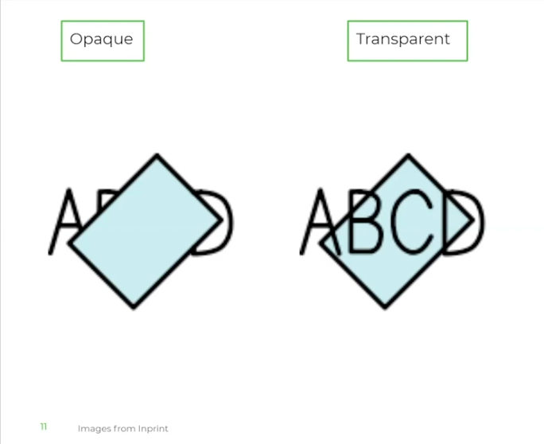
Opaque and transparent
Opaque- A material is opaque if you cannot see through it.
The light rays are blocked by the material.
Transparent- A material is transparent if you can see through it.
The light rays can pass through the material.

Slide 5
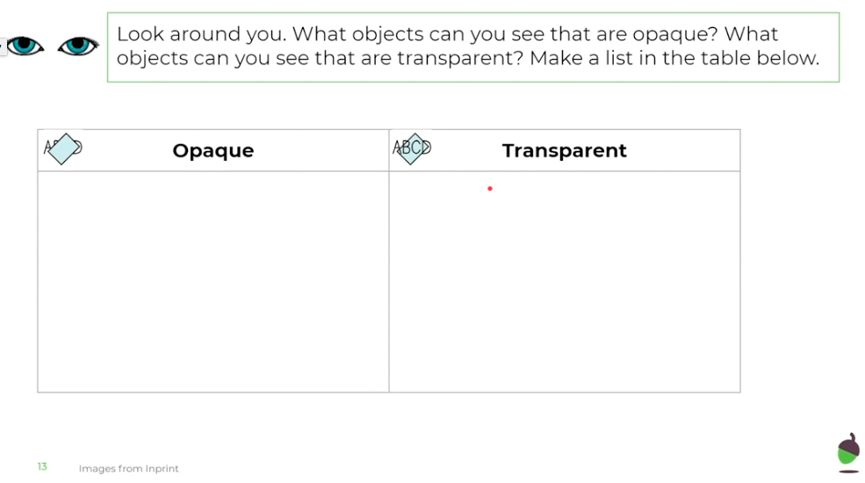
Opaque and transparent- Task

Slide 6
Shadows

Slide 7
Shadows- Task
Now that we have learnt about shadows, we can experiment with them.
Go outside at a time when there is some sun. It doesn’t need to be too sunny, as long as there is some sun.
Take some objects with you outside and see if you can form different shadows using the objects.
Remember transparent objects won’t create a shadow. You could experiment with this by taking a mixture of opaque and transparent objects outside.
What else could you use to form a shadow if it is not sunny outside?

