Slide 1
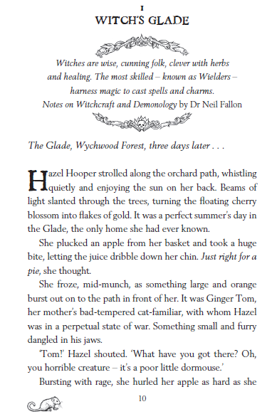
Retrieving Information
Find the sentences with the following words in and see if you can clarify the meaning of the following words:
a) perpetual
b) tended
Find and copy a phrase that shows it is warm in the forest.
What are the most talented type of witches called?
Making Inferences
Use evidence from the text to explain how Hazel feels when she sees Ginger Tom.
Does Hazel find magic easy? Give two reasons for your answer.
What might be causing the “foul smell”?
Writer’s Choices
How does the writer show that Hazel is a caring girl?
Why do you think the writer chose to start with a quote from another book?
Challenge Question (extended answer)
What do we know about Hazel and her life? Use quotes from the text to back up your answer.

