Slide 1
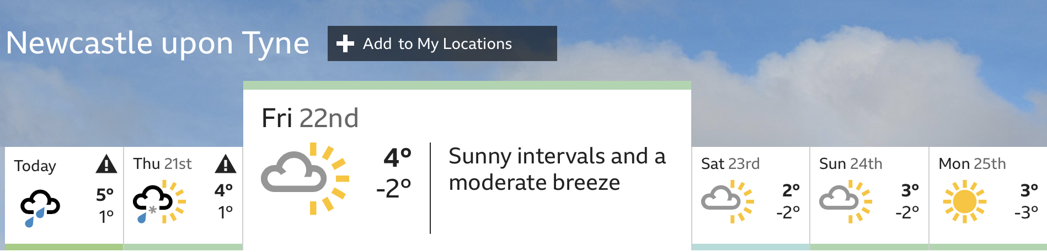
The Weather Report
Wed 20th

Slide 2
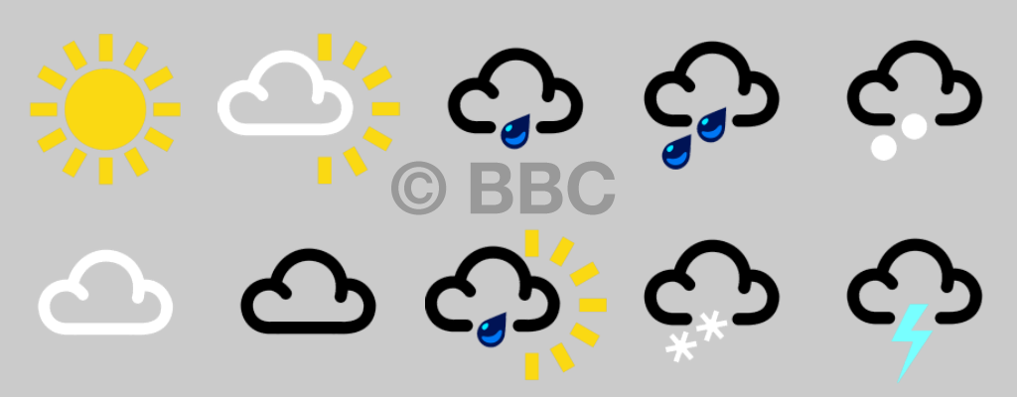

Which weather type is it?

Slide 3
Practice drawing the symbols for each weather type:
Snow
Heavy rain
Cloudy
Sunny
Notes:
Practice drawing a symbol for each weather type: snow, heavy rain, sunny, cloudy

Slide 4
Wed 20th
Notes:
If we take a look at this weather report, it starts from Wednesday and goes to next Monday. Let’s look at Wednesday first, look for the ’w’ and the green circle. Ok, what was the weather like then? Two raindrops suggest that it was heavy rain on Wednesday. Now looking ahead to next Monday, look for the ‘m’ and the red circle. Is the weather the same on Monday and Wednesday? No, on Monday it says it will be sunny. Let’s wait and see! Today is Friday, let’s look for ‘f’ and the purple circle, what does that symbol mean? Partly sunny and partly cloudy, look outside to check.

Slide 5
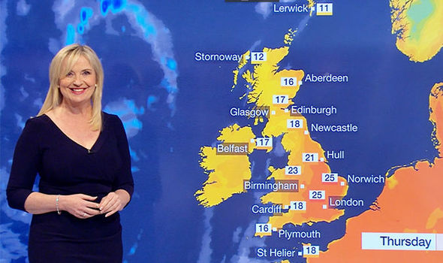
Next week:
you!
Notes:
Next week you’re going to be the weather forecaster, so we need to keep track of the weather!

Slide 6
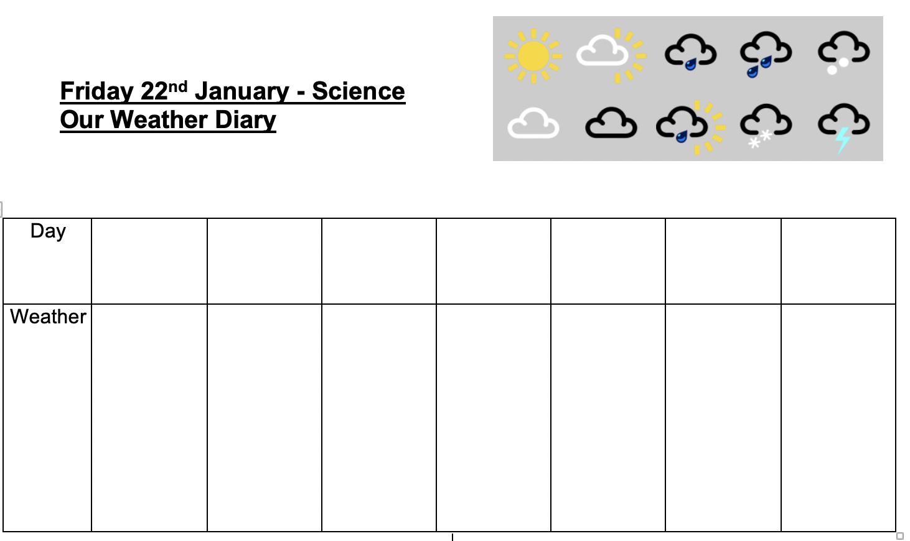
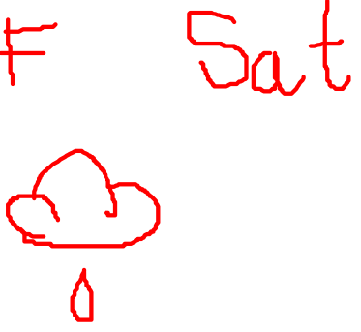
Look at your weather diary:

Slide 7
Commentary:
Slide 2: Look at the different weather symbols, can you decide which weather type it is showing? Can you see sunny, cloudy, snowy, heavy rain? You can tell the different between heavy and light by counting the raindrops.
Slide 3: Practice drawing a symbol for each weather type: snow, heavy rain, sunny, cloudy
Slide 4: If we take a look at this weather report, it starts from Wednesday and goes to next Monday. Let’s look at Wednesday first, look for the ’w’ and the red circle. Ok, what was the weather like then? Two raindrops suggest that it was heavy rain on Wednesday. Now looking ahead to next Monday, look for the ‘m’ and the green circle. Is the weather the same on Monday and Wednesday? No, on Monday it says it will be sunny. Let’s wait and see! Today is Friday, let’s look for ‘f’ and the purple circle, what does that symbol mean? Partly sunny and partly cloudy, look outside to check.
Slide 5: Next week you’re going to be the weather forecaster, so we need to keep track of the weather!
Slide 6: Here is the weather diary. We need to keep track of the weather, so in the day row put either the first sound such as ‘F’ or the first three letters like the forecast. We need to fill this in every day so that we can do our report next week.

