Slide 1


Set 1 Sounds
Day 2

Slide 2



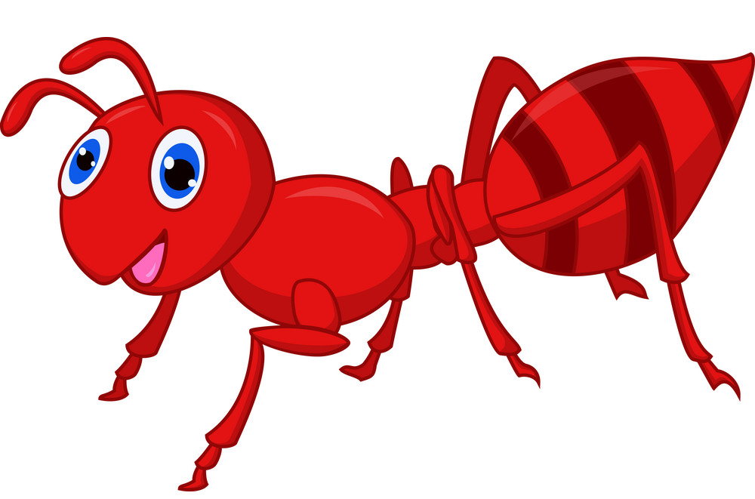

Slide 3
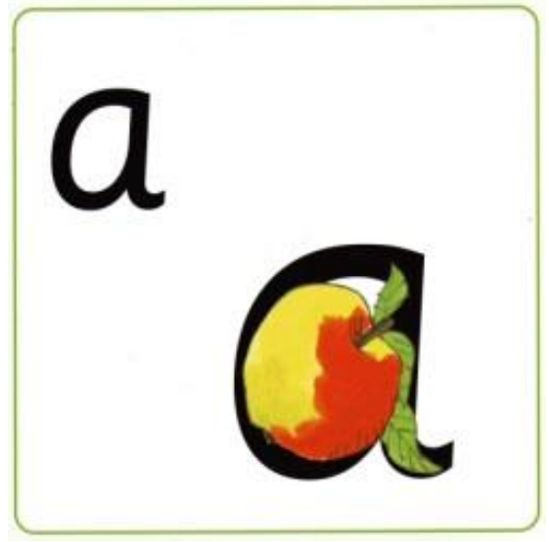

Slide 6


Slide 7
