Slide 1
Set 2 Sounds
‘ay’

Slide 2
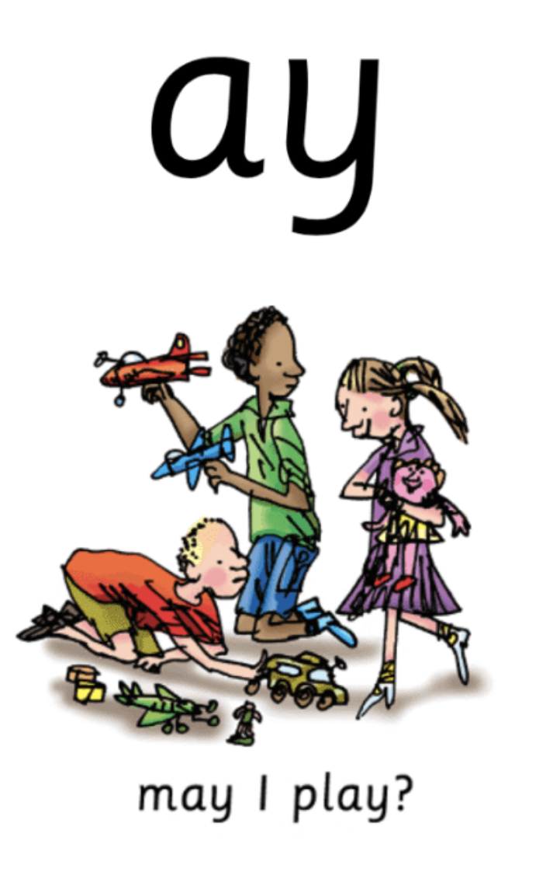
Notes:
May I play?

Slide 3
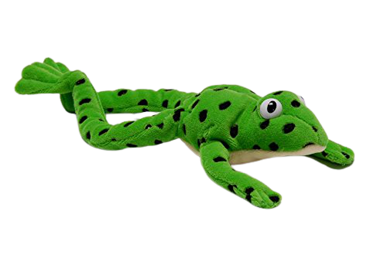
Notes:
Fred talk time! D-ay, p-l-ay, m-ay, w-ay, s-p-r-ay

Slide 4
Notes:
Ay, two letters, one sound, special friends, ay

Slide 5
Notes:
My turn – ay. Your turn. My turn – may I play? Your turn.

Slide 6
Notes:
Now let’s play our game – can you remember? When it wriggles tell me if it’s ay, or may I play. If you don’t have the wiggle don’t worry, ask someone to point and if you don’t have someone there, that’s ok too, have a practice at being super speedy and point when you say it. Ay or may I play?

Slide 7
Notes:
It’s time for some green words – let’s use Fred talk to help us sound them out. D-ay, t-r-ay, l-ay

Slide 8
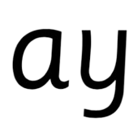
Notes:
Let’s practice writing our sound - ay

Slide 9
Notes:
Can you write some words with today’s sound? Day, play, may. Tick and fix on the next slide

Slide 10
Notes:
Let’s use our Fred fingers, d-ay 2 sounds. P-l-ay 3 sounds and m-ay 2 sounds.

Slide 11
Commentary:
2: May I play?
3: Fred talk time! D-ay, p-l-ay, m-ay, w-ay, s-p-r-ay
4: Ay, two letters, one sound, special friends, ay
5: My turn – ay. Your turn. My turn – may I play? Your turn.
6: Now let’s play our game – can you remember? When it wriggles tell me if it’s ay, or may I play. If you don’t have the wiggle don’t worry, ask someone to point and if you don’t have someone there, that’s ok too, have a practice at being super speedy and point when you say it. Ay or may I play?
7: It’s time for some green words – let’s use Fred talk to help us sound them out. D-ay, t-r-ay, l-ay
8: Let’s practice writing our sound - ay
9: Can you write some words with today’s sound? Day, play, may. Tick and fix on the next slide
10: Let’s use our Fred fingers, d-ay 2 sounds. P-l-ay 3 sounds and m-ay 2 sounds.

