Slide 1
Different types of nouns

Slide 2
Today, we will be looking at common nouns and proper nouns.

Slide 3
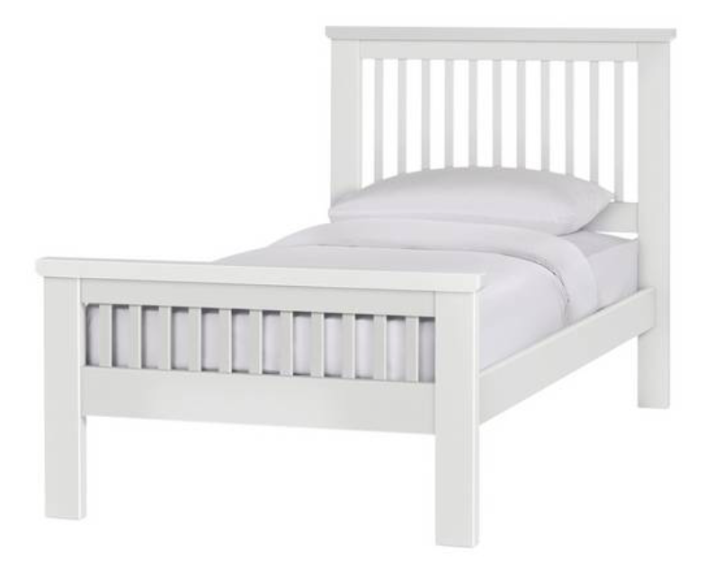
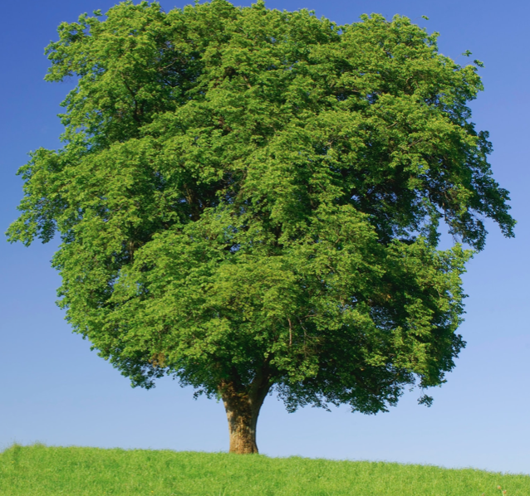
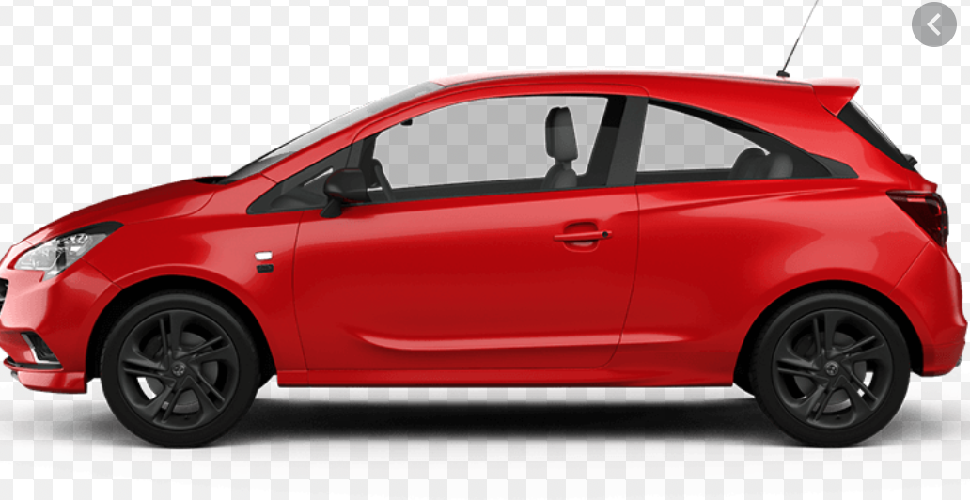
Common Nouns
Common nouns are the general names of places or objects.
Common nouns do not have capital letters.
Look at the images of common nouns below. Can you think of other common nouns?

Slide 4
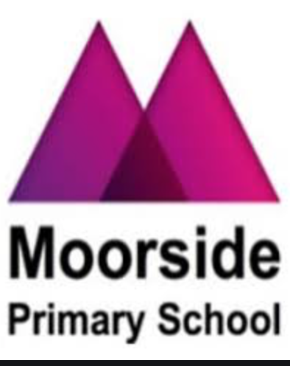
Proper Nouns
Proper nouns are the names of individual people, places or objects. They always begin with a capital letter.
Can you think of three proper nouns?

Slide 5
Underline the common nouns:
Sarah is a shopworker and she loves to help people in her city.
All of the people in the shop like to talk to her.

Slide 6
Underline the common nouns:
Sarah is a shopworker and she loves to help people in her city.
All of the people in the shop like to talk to her.

Slide 7
Underline the proper nouns:
Sarah is very helpful to the people on Beaconsfield Street.
The people of Arthur’s Hill like to go to supermarkets like Iceland and Asda to get their food.

Slide 8
Underline the proper nouns:
Sarah is very helpful to the people on Beaconsfield Street.
The people of Arthur’s Hill like to go to supermarkets like Iceland and Asda to get their food.

Slide 9
Quiz – Question 1
What type of words are the names of things, places or objects?
Verbs
Adjectives
Nouns

Slide 10
Quiz – Question 1
What type of words are the names of things, places or objects?
Verbs ✅
Adjectives
Nouns

Slide 11
Quiz – Question 2
What do proper nouns start with?
Capital letters
Lower case letters
Numbers

Slide 12
Quiz – Question 2
What do proper nouns start with?
Capital letters ✅
Lower case letters
Numbers

Slide 13
Quiz – Question 3
Which of the following is a proper noun?
Mrs Kilmartin
dinosaurs
jungle

Slide 14
Quiz – Question 3
Which of the following is a proper noun?
Mrs Kilmartin ✅
dinosaurs
jungle

Slide 15
Quiz – Question 4
Which of the following is a common noun?
Jack
bed
looking

Slide 16
Quiz – Question 4
Which of the following is a common noun?
Jack
bed ✅
looking

