Slide 1
Learning intention: To solve division problems.

Slide 2
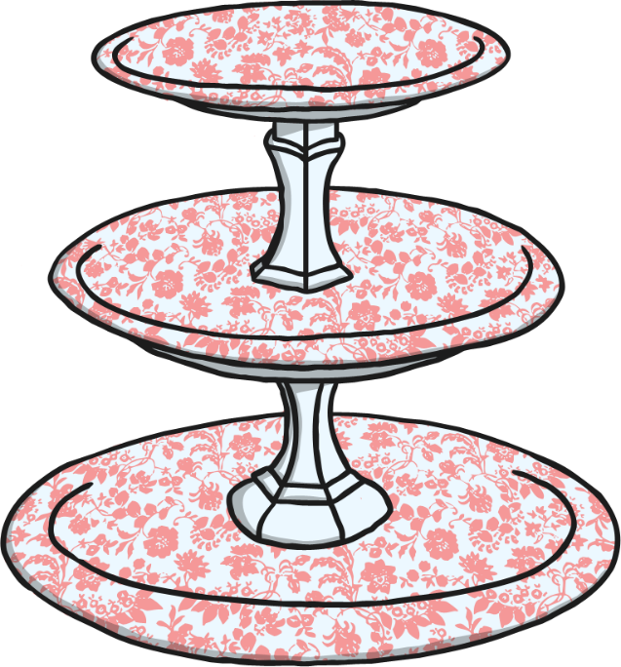
Share the cookies equally between the children. How many will they each get?
Serena
Bobby

Slide 3
Share the slices of pizza equally between the plates.
How many pieces will be on each plate?
Plate 1
Plate 2

Slide 4
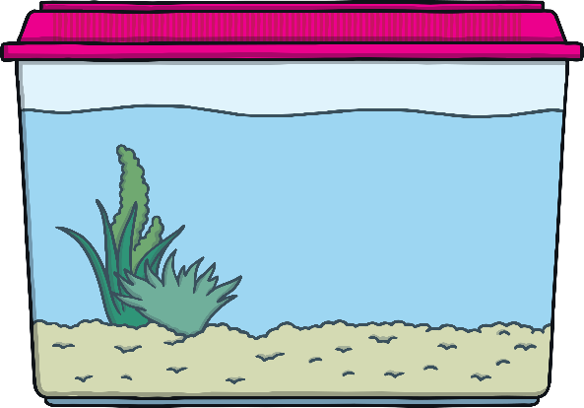
Share the fish equally between the tanks. How many fish in each tank?

Slide 5
Share the strawberries equally between Anne and Sanjeev. How many will they each get?
Anne
Sanjeev

Slide 6
Share the worms between the birds. How many worms does each bird get?
Bird 1
Bird 2

