Slide 1
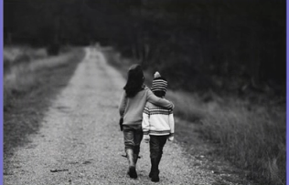
Acts of kindness
Think about something kind you could do.
It doesn’t have to cost money!
Hug
Draw a picture for someone
Give someone a flower
Smile
What other things can you think of?
Try and do an ‘act of kindness’ for someone you like this week.

Slide 2
Fair and unfair
What do these key words mean?
fair unfair

Slide 3
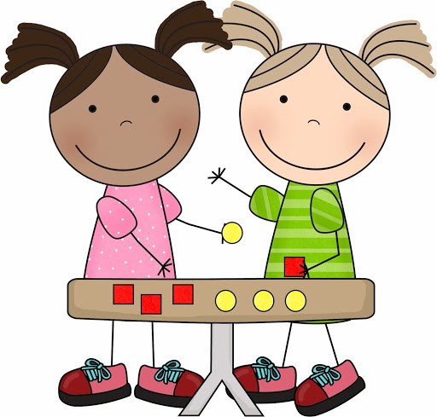
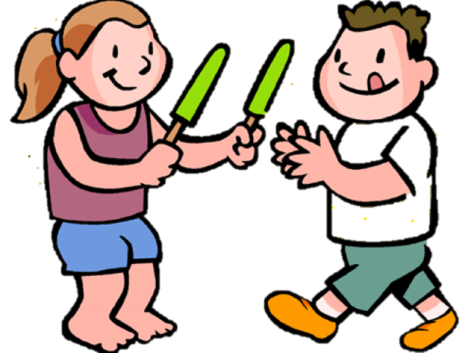
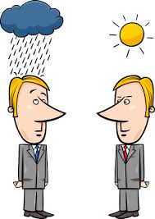
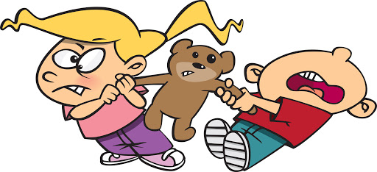
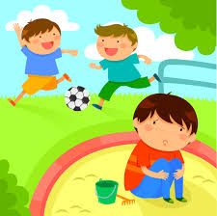
Fair means we are all the same and equal.
People are sharing
Working together
Same opportunities (able to do the same things)
Making the right choices
Unfair is the opposite
People might feel left out
Not everybody gets a turn
It is not the same or equal
Not everybody is doing the right thing or making the right choice

Slide 4
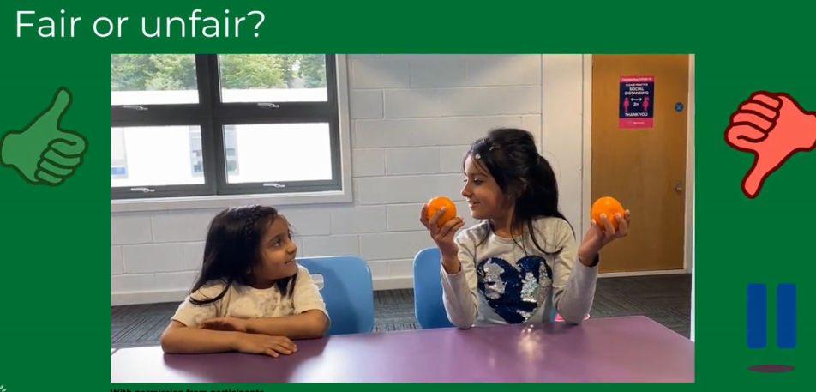
How do you know? Explain your answer.

Slide 5
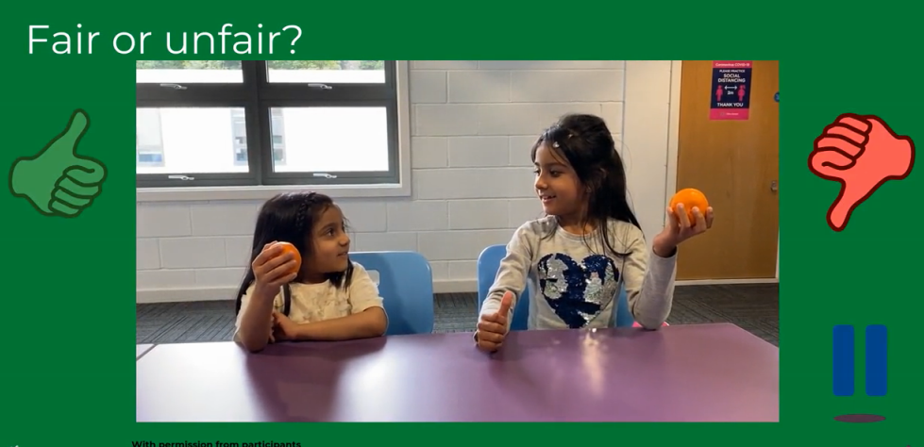
How do you know? Explain your answer.

Slide 6
How do you know? Explain your answer.

Slide 7
Fair and unfair: sort the examples into fair and unfair. Try to think of your own ideas.
fair unfair

