Slide 1
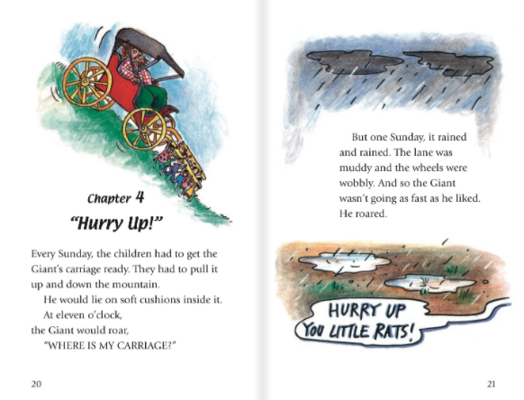
1. Every Saturday the children pulled the Giant’s carriage up and down the mountain.
2. The Giant yelled at the children at eleven o’clock.
3. The carriage was going too fast because it was muddy.

Slide 2
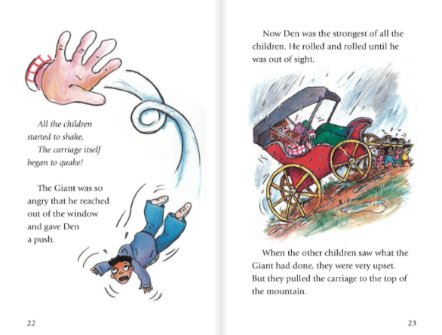
4. The Giant pushed Den out of the window.
5. Den was the weakest of the children.

Slide 3
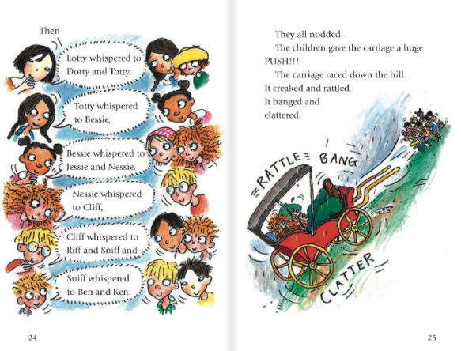
6. The children gave the carriage a huge push to the top of the hill

Slide 4
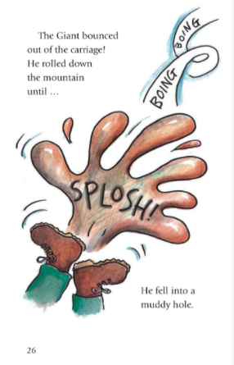
7. The Giant rolled down the hill and fell into a dirty hole.

