Slide 1
Learning intention: To recap the four seasons
Geography
Seasons Quiz

Slide 2
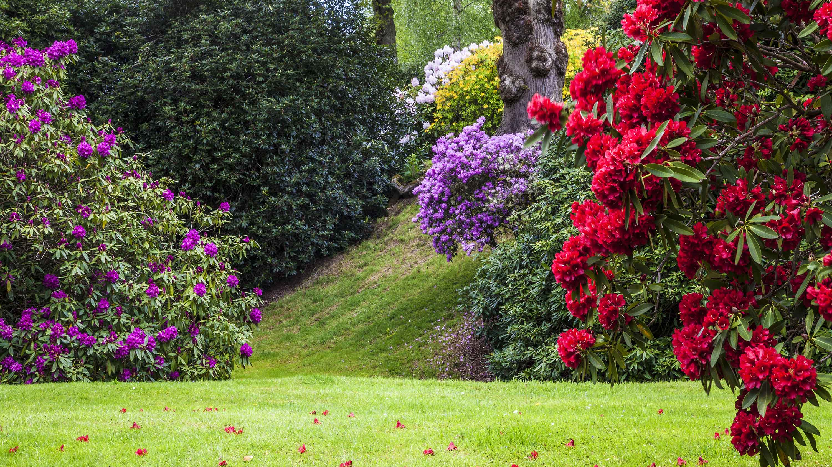
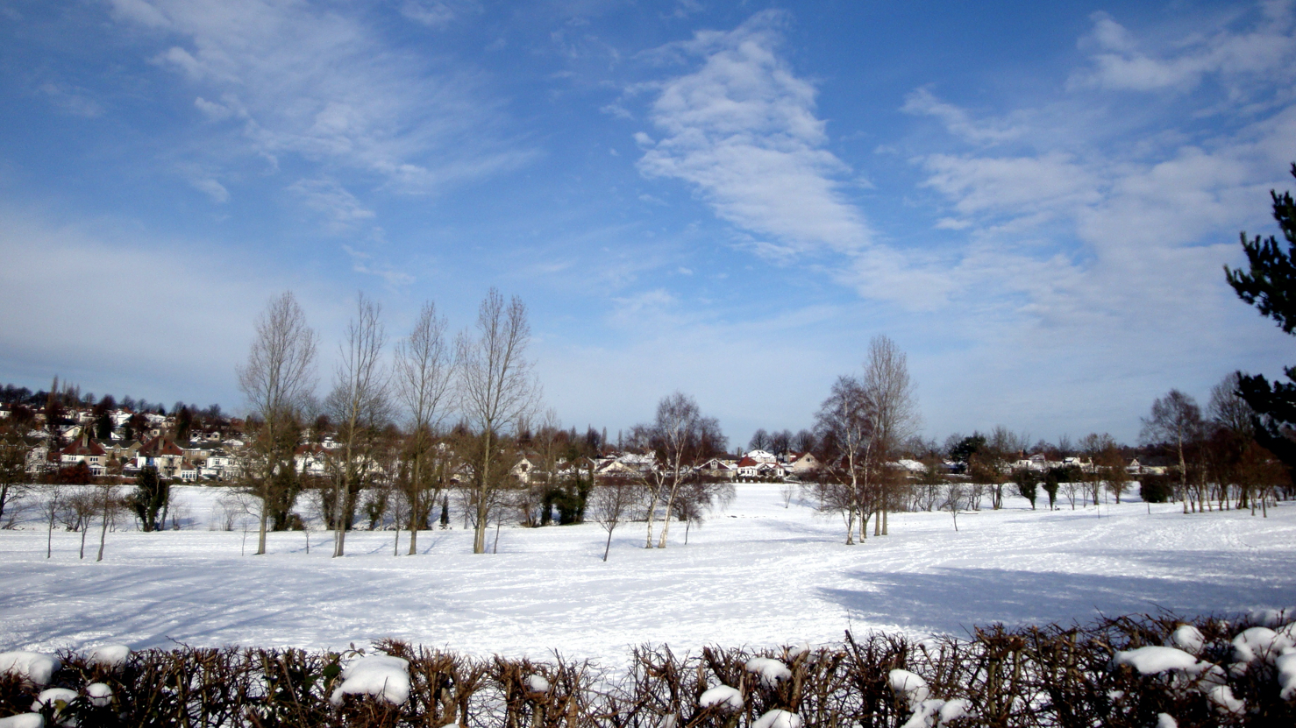
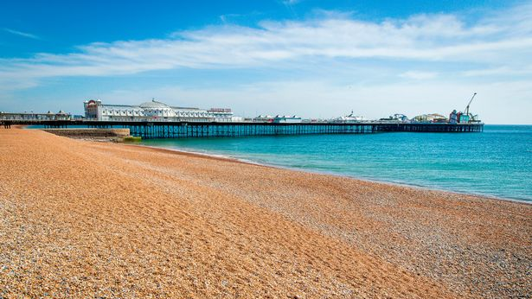
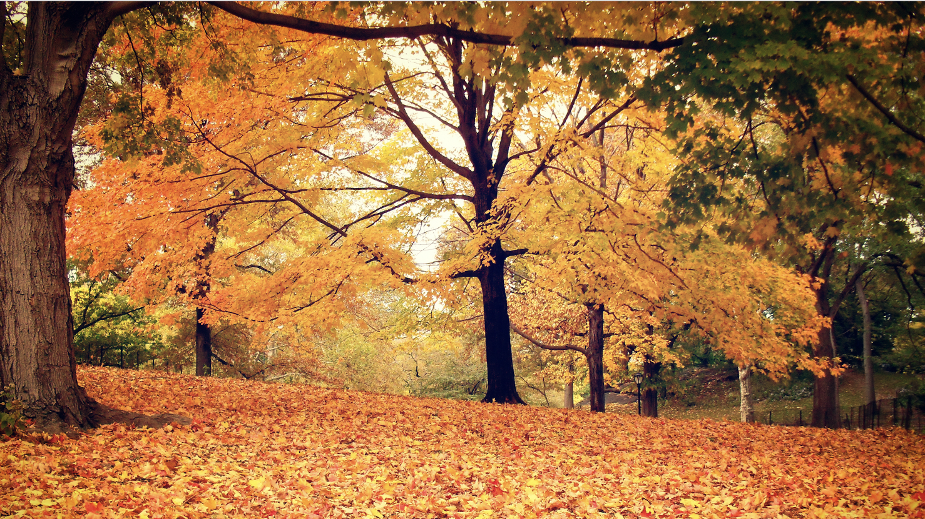
Match the season to the picture:
Summer
Spring
Autumn
Winter

Slide 3
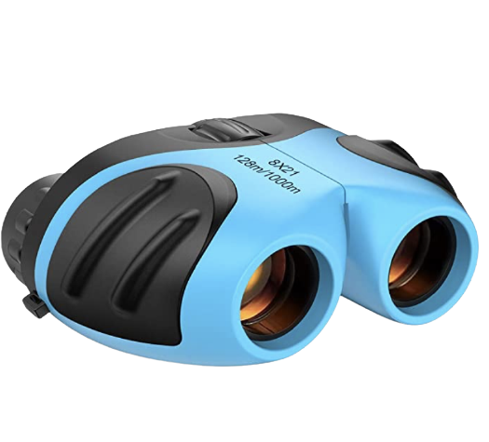
Spring
Summer

Slide 4
Autumn
Winter

Slide 5
1. Which season is this?

Slide 6
2. Which season is this?

Slide 7
3. Which season is this?

Slide 8
4. Which season is this?

Slide 9
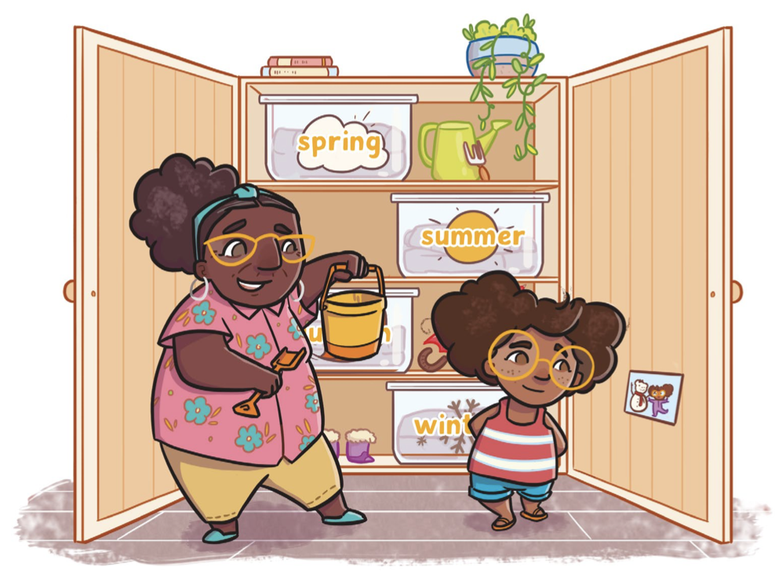
Nana
Serena
Notes:
This is Serena and her Nana. She has a wardrobe with clothes for each season, but something terrible has happened! The labels are mixed up and now she doesn’t have the right clothes to wear. Can you help her?

Slide 10
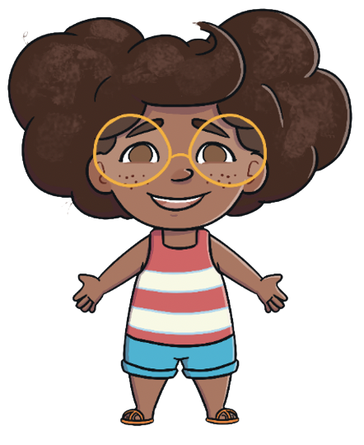
Winter

Slide 11
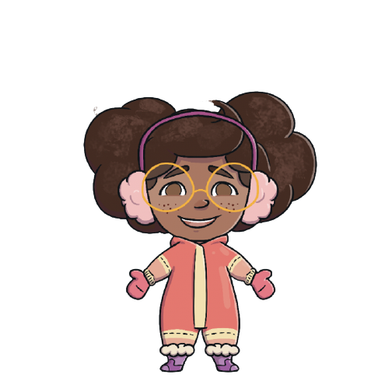
Spring

Slide 12
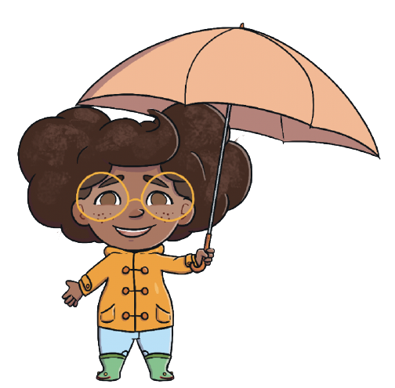
Summer

Slide 13
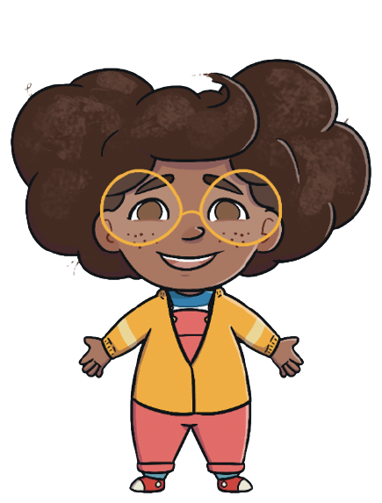
Autumn

Slide 14
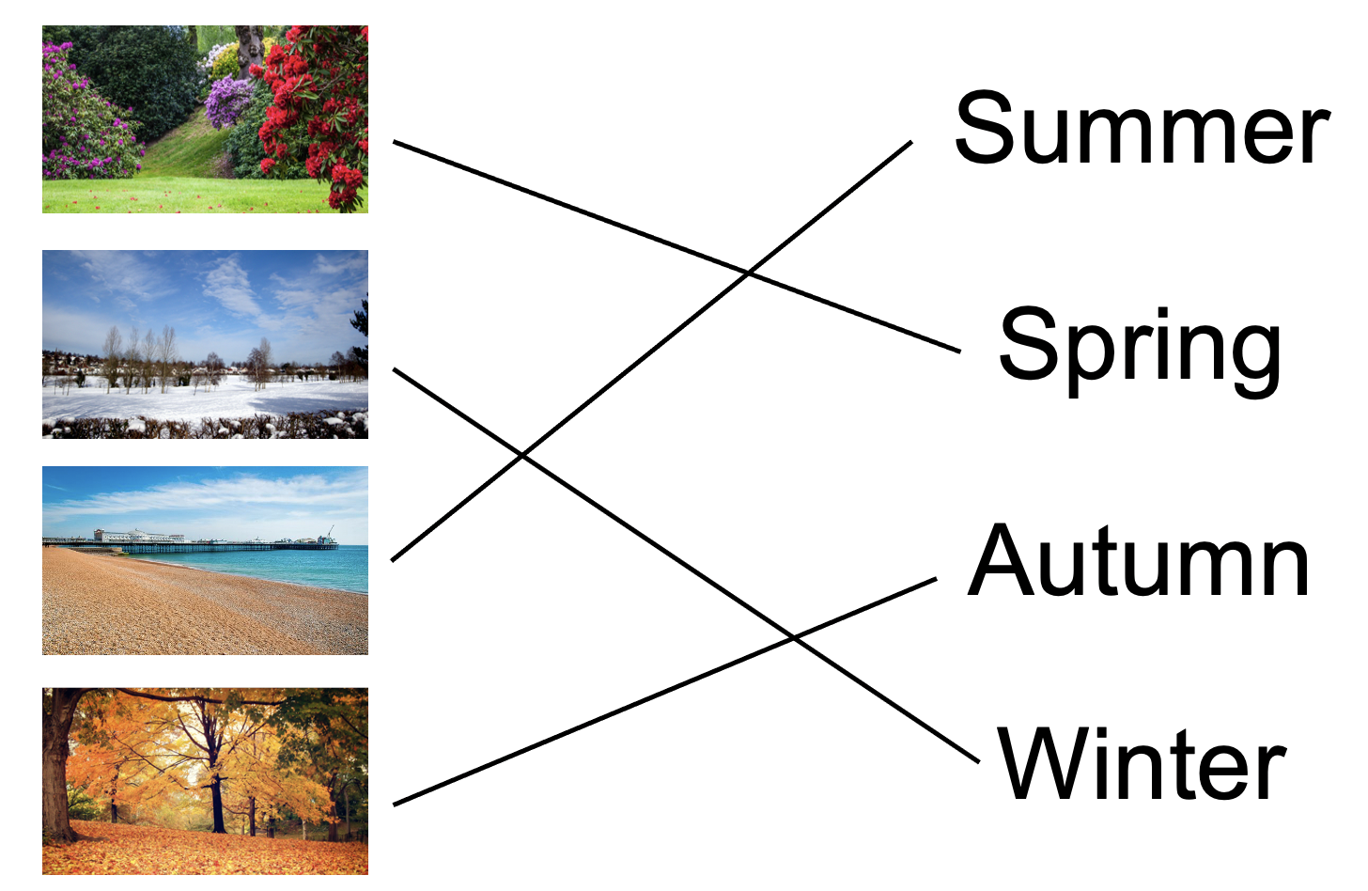
Answers:
Match the season to the name:
Picture quiz:
Winter
Spring
Autumn
Summer

Slide 15
Commentary:
Slide 9: This is Serena and her Nana. She has a wardrobe with clothes for each season, but something terrible has happened! The labels are mixed up and now she doesn’t have the right clothes to wear. Can you help her?
Slide 10: Is Serena wearing the right clothes for winter?
Slide 11: Is Serena wearing the right clothes for spring?
Slide 12: Does Serena need wellies and an umbrella in summer?
Slide 13: It’s a little chilly for just a cardigan. What could Serena wear in Autumn?

