Slide 1
Learning intention – interpreting bar charts

Slide 2
What is a bar chart?
Bar charts are used to compare things between different groups or to track changes over time. However, when trying to measure change over time, bar charts are best when the changes are larger.

Slide 3
Reading bar charts
When reading bar charts you need to look at the information on them carefully. The y axis tells you how many or how much there is of what you are measuring and the x axis tells you what is being measured.
Look at the example on the next slide.

Slide 4
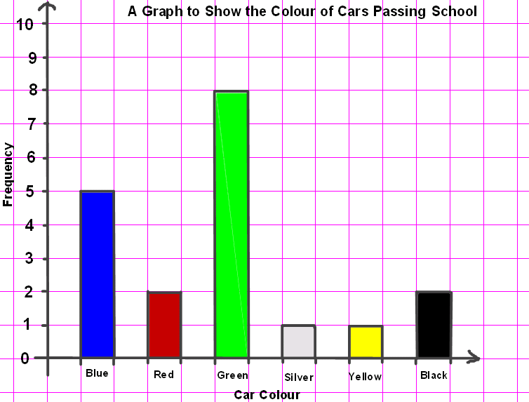
The y axis (frequency tells us how many cars passed school.
The x axis (car colour) tells us what is being measured – the colour of the car.
When you look at the bar chart you can see that 5 blue cars passed the school. I know this because the blue bar goes up to the number 5.
I also know there are three more blue cars than red cars that passed the school. I know this because there were 2 red cars and 5 blue cars and 5 – 2 = 3

