Slide 1
Learning intention performing poetry poetic devices

Slide 2
Poetic devices
We are going to read and listen to a few poems today.
We will then look at what a poet uses to make poetry exciting and interesting to write, read, listen to and perform.

Slide 3
Alliteration
Alliteration is when the start of one word is the same sound as the start of another word.
Example:
Sammy the slimy slug, slowly slid by.
Can you hear the ‘s’ sound repeated?
Follow the link to
https://www.bbc.co.uk/bitesize/articles/zc3v6g8
Watch the videos to
see examples of alliteration
and see poet Joseph Coelho talk about poetic devices.
To find out about alliteration, start watching at 1 minute and 18 seconds and finish at around 3 minutes and 17 seconds.

Slide 4
Here are some other examples of alliteration
All Adam ate in August was apples.
Barry bought a book.
Come and clean your closet, Carly.

Slide 5
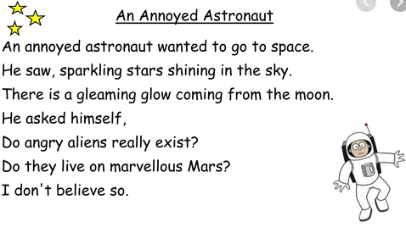
Look at this poem. Listen as I read. Can you hear the alliteration? Some have been done for you.

Slide 6
Look at this poem. Listen as I read. Can you hear the alliteration? Some have been done for you.

Slide 7
Task
Read back the poem. Notice the alliteration.
Does it change the way you read the poem?
Try to read with expression which we have talked about before.
Try using a happy voice, a sad voice or an angry voice.

