Slide 1

Geography
Settlements

Slide 2
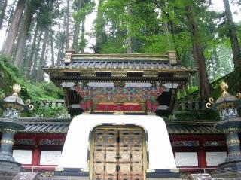
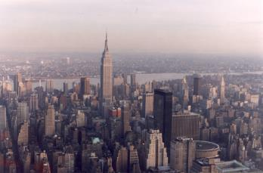
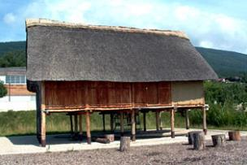
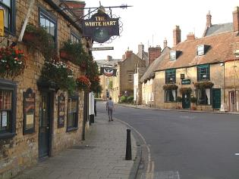
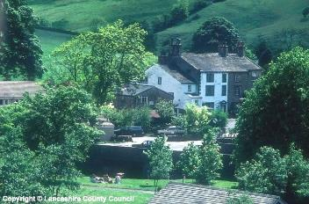
What do these photos all have in common?
They are all places where people live!

Slide 3
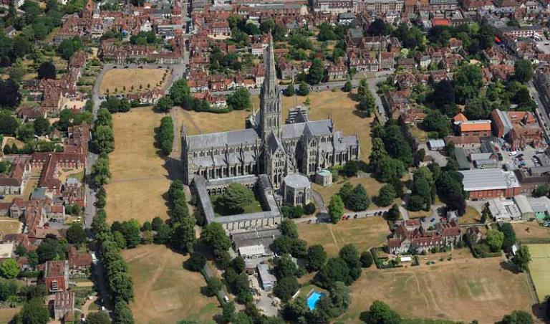
To know what a settlement is…
A settlement is a dwelling (homes) or group of dwellings where people live.
What do you notice about this photograph?
Notes:
Exercise, types of settlement
3

Slide 4
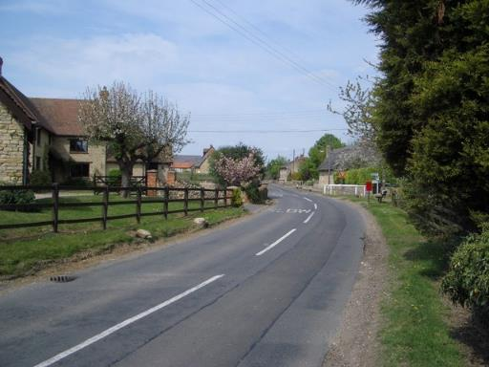
Hamlet
Hamlets are tiny settlements - they are just a collection of houses, perhaps centred around a few farms. Hamlets have no amenities.

Slide 5
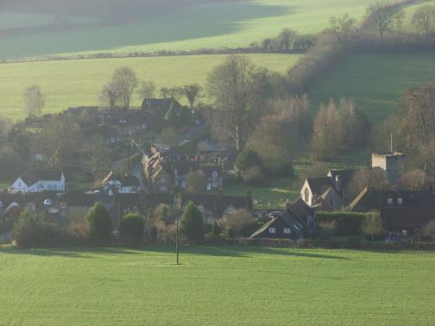
  Villages
  Villages are small settlements . Several hundred people live in them and they have a few shops, a place of worship and maybe a school .

Slide 6
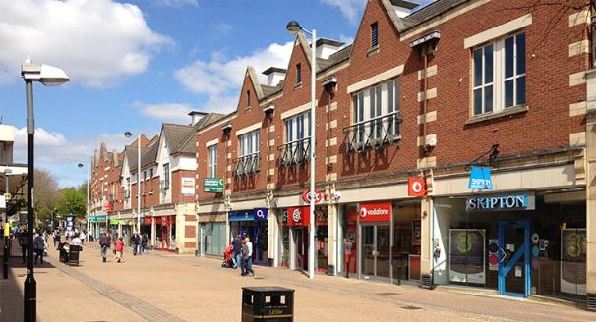
Towns
Towns are medium-sized settlements - thousands of people live in them and they have a shopping centre and factories.

Slide 7
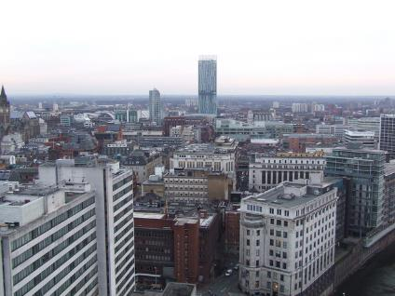
Cities
Cities are large settlements - they usually have lots of amenities and sometimes a cathedral too (megacities have over 10 million people living in them).

Slide 8
Lets recap upon the settlement vocabulary we have learned.
Hamlet - a few houses in a rural area with no amenities
Village - a rural settlement with a collection of houses , a few amenities such as a shop and a post office
City - are large settlements - they usually have lots of amenities and sometimes a cathedral too (megacities have over 10 million people living in them).
Town - are medium-sized settlements - thousands of people live in them and they have a shopping centre and factories;
What do you think rural and urban means?
Notes:
Temporary
Built up areas including towns and cities
Permanent
A few houses in a rural area. No amenities. Spread out
Hamlet
A countryside location.
Conurbation
Somewhere only lived in for part of the year
Villages
Where cities have grown to swallow up other cities
City
A population centre with a large population
Town
Somewhere lived in at all times
Rural
A rural settlement of a collection of houses, a few amenities such as a pub, post office, few shops e.t.c.
Urban
A population centre larger than a village but smaller than a city
8

Slide 9
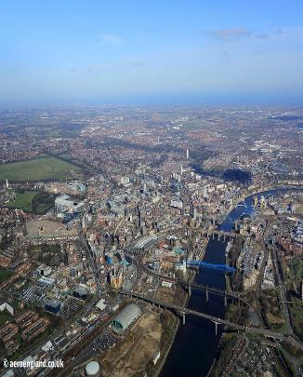
Rural areas are places in the countryside with few buildings; urban areas are settlements with lots of buildings in them.
Transport links, services and entertainment facilities are better in urban areas because more people live in them.
Do you think Newcastle upon Tyne is a hamlet, village, town or city?
Why do you think this?

Slide 10
What services are you likely to find at each of these settlements?
Village | Town | City

Slide 11
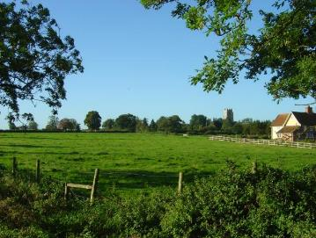

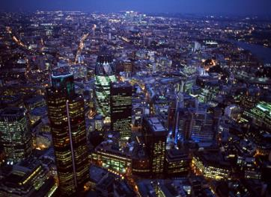
Using your table and your knowledge, justify where you would most like to live.

Slide 12
What do you think makes a good area to develop a settlement?
Access Routes for Trade
(Rivers/Roads)
Flat land
(Easy to build on)
Reliable water supply
(River or Lake?)
Fertile Land
(Agriculture)

