Slide 1
Learning Intention: To learn about Purim

Slide 2
What is Purim?
Purim is a special celebration for Jewish people.
It will be celebrated on:
Thursday 25th February 2021
until
Friday 26th February 2021.

Slide 3
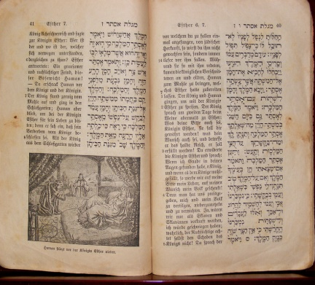
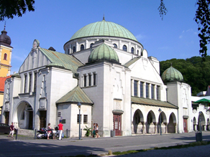
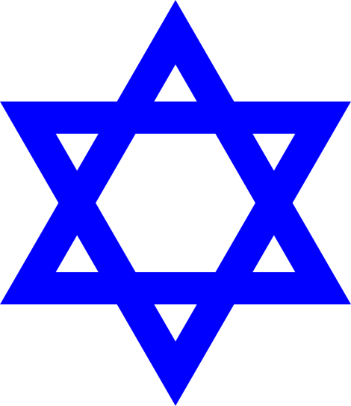
Quick recap: Judaism
Notes:
People who believe in Judaism are Jewish. Do you remember when we looked at what is special for Jewish people?
The Torah is their holy book, it cannot be touched. Remember, don’t touch the Torah!
The Star of David is a symbol to represent Judaism.
The Synagogue is a holy place to pray and worship.

Slide 4
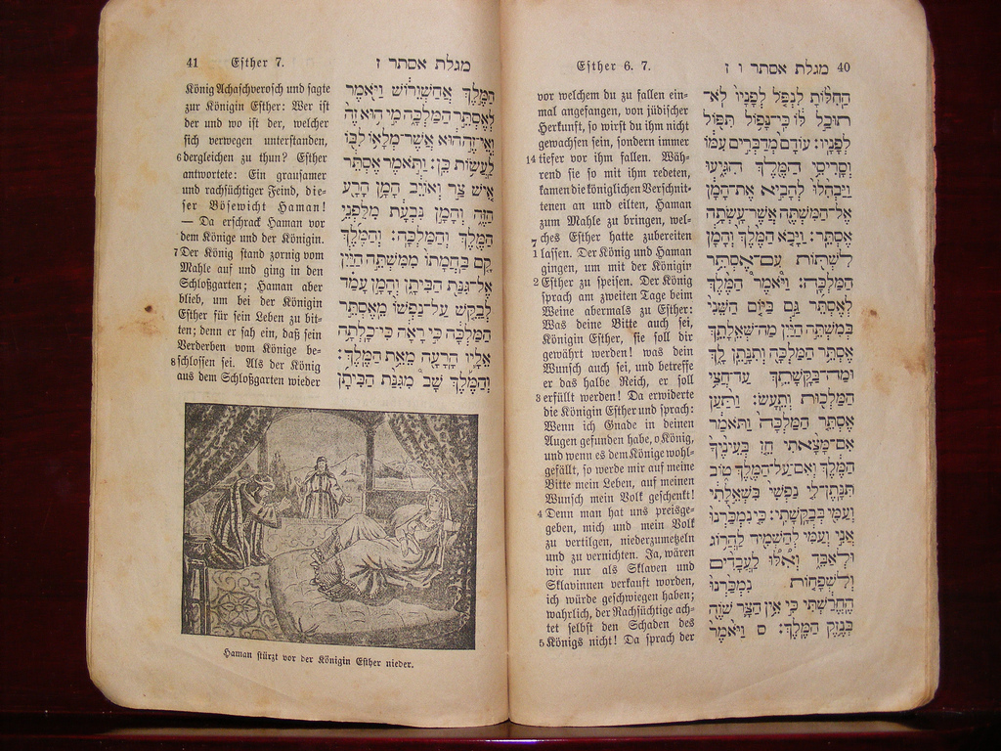
The Book of Esther
Notes:
The story of Purim can be found in the Torah (don’t touch the Torah!) and is in the Book of Esther.

Slide 5
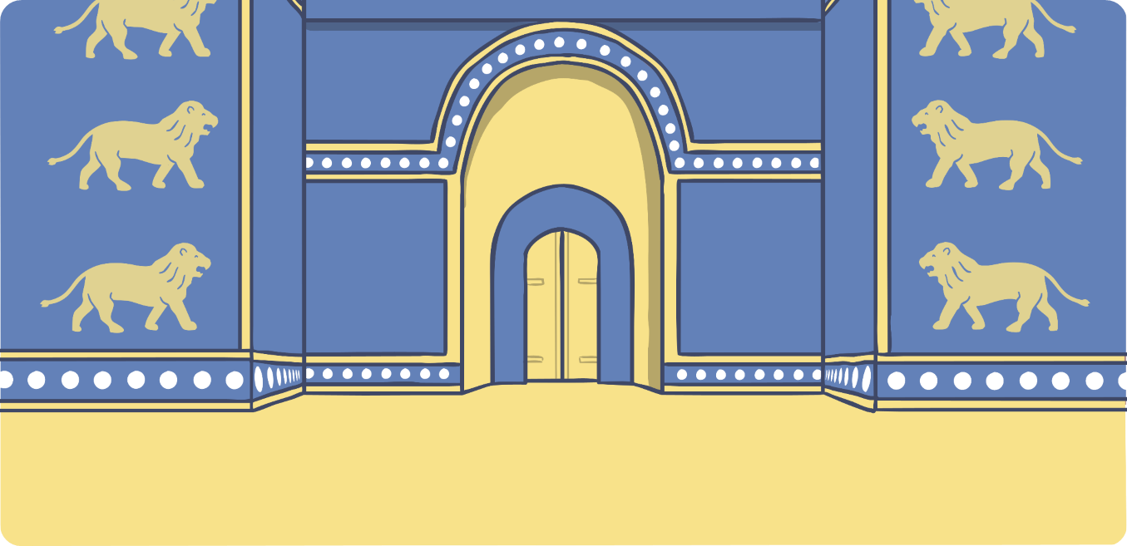
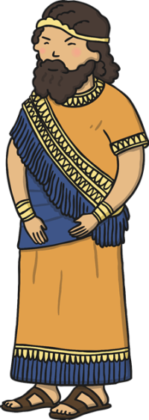
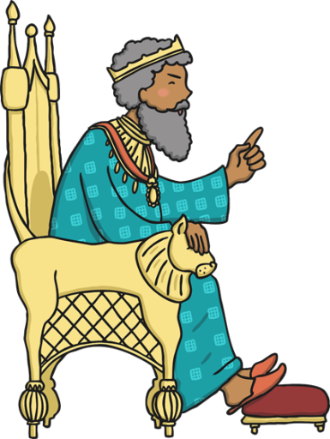
The Story of Purim
Notes:
The King of Persia and his favourite nobleman Haman, wanted to hurt the Jewish people.
Esther was a brave girl who became Queen to persuade the King to save the Jewish people and not hurt them.
She managed to stop the King and Haman’s idea and so Jewish people now celebrate Esther and her bravery.
To celebrate Purim, Jewish people often read the story the night before and the day of Purim.

Slide 6
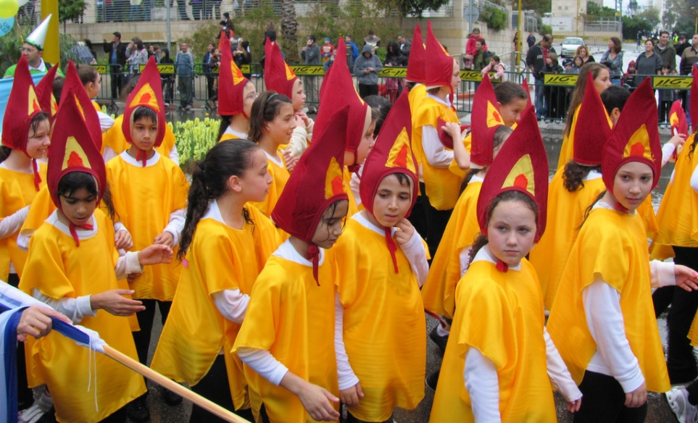
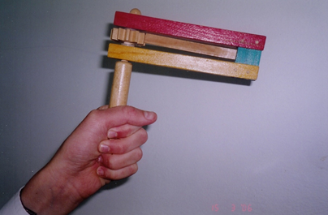
Celebrating Purim
Notes:
To celebrate Purim, bright clothes are worn to carnivals and synagogues to listen to the story of Esther. When Haman’s name is read aloud, a gragger (see the picture) is used to make loud noises so people don’t hear his name.

Slide 7
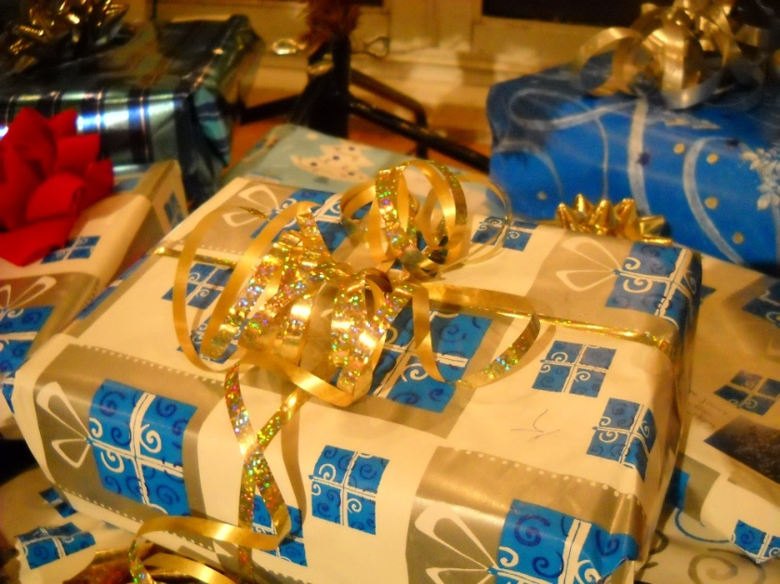
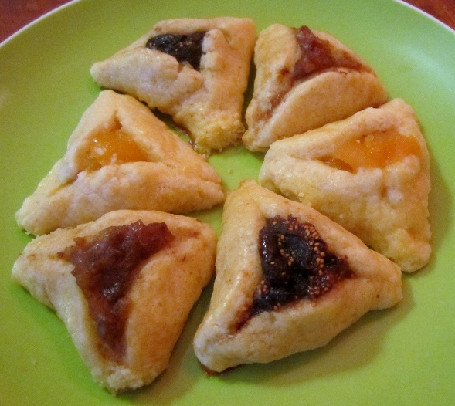
Celebrating Purim
Notes:
To celebrate Purim, Jewish people often give gifts and donate to charity. They also eat and drink special foods such as ‘Hamantashen’ which are biscuits filled with different food such as jam, chocolate or fruit. They are triangle shaped to represent Haman’s hat.

Slide 8
Your turn:
Can you make a poster about Purim?
Notes:
Can you make a poster about Purim? Try and draw the story and some of the celebrations.

Slide 9
Commentary:
Slide 3: People who believe in Judaism are Jewish. Do you remember when we looked at what is special for Jewish people? The Torah is their holy book, it cannot be touched. Remember, don’t touch the Torah! The Star of David is a symbol to represent Judaism. The Synagogue is a holy place to pray and worship.
Slide 4: The story of Purim can be found in the Torah (don’t touch the Torah!) and is in the Book of Esther.
Slide 5: The King of Persia and his favourite nobleman Haman, wanted to hurt the Jewish people. Esther was a brave girl who became Queen to persuade the King to save the Jewish people and not hurt them. She managed to stop the King and Haman’s idea and so Jewish people now celebrate Esther and her bravery. To celebrate Purim, Jewish people often read the story the night before and the day of Purim.

Slide 10
Commentary 2:
Slide 6: To celebrate Purim, bright clothes are worn to carnivals and synagogues to listen to the story of Esther. When Haman’s name is read aloud, a gragger (see the picture) is used to make loud noises so people don’t hear his name.
Slide 7: To celebrate Purim, Jewish people often give gifts and donate to charity. They also eat and drink special foods such as ‘Hamantashen’ which are biscuits filled with different food such as jam, chocolate or fruit. They are triangle shaped to represent Haman’s hat.

