Slide 1
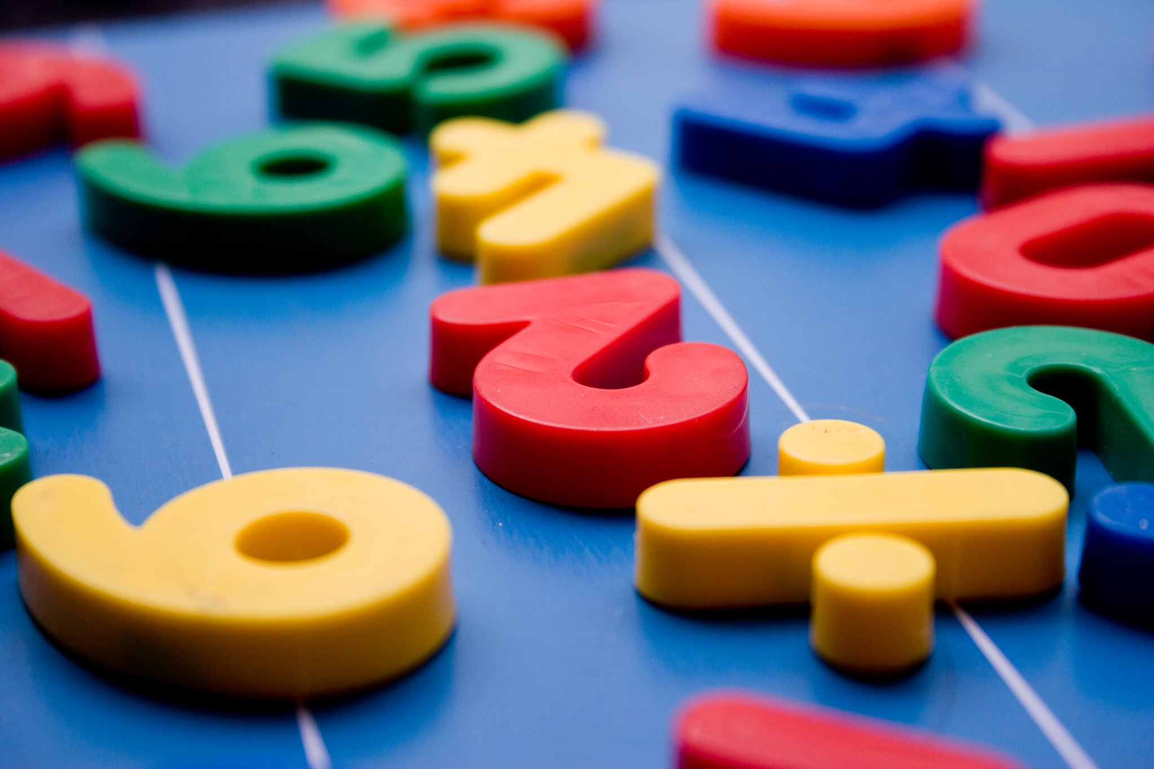
Year 1
Subtraction

Slide 2
Subtraction
5 – 2 = 3

Slide 3
Subtraction
3 - 1 =

Slide 4
Subtraction
4 - 2 =

Slide 5
Subtraction
8 - 3 =

Slide 6
Subtraction
6 - 2 =

Slide 7
Subtraction using a number line
5 – 3 = 2
3
2
1

Slide 8
Subtraction using a number line
4 – 1 =

Slide 9
Subtraction using a number line
6 – 3 =

Slide 10
Subtraction using a number line
7 – 1 =

Slide 11
Subtraction using a number line
4 - 3 =

Slide 12
Subtraction using a number line
9 – 4 =

Slide 13
Slide 1 – Hello year 1 today we are going to be learning about subtraction.
Slide 2 – Subtraction means take away, so when we take away our number will get smaller. Look I have done the first one for you. Our sum is 5 – 2. I have 5 spots and I need to take away 2, So I have crossed 2 out and I have 3 left. So 5 take away 2 equals 3.
Slide 3 – Now try this one. 3 take away 1. How many spots are left, what is the answer?
Slide 4 - Now try this one. 4 take away 2. How many spots are left, what is the answer?
Slide 5 - Now try this one. 8 take away 3. How many spots are left, what is the answer?
Slide 6 - Now try this one. 6 take away 2. How many spots are left, what is the answer?
Slide 7 – Another way we can take away numbers is using a number line. Look my sum is 5 take away 3. So I find 5 on my number line and I need to jump backwards 3 numbers. 1, 2, 3. 5 take away 3 equals 2.
Slide 8 - Now try this one. 4 take away 1. Remember to jump backwards, what is the answer?
Slide 9 - Now try this one. 6 take away 3. Remember to jump backwards, what is the answer?
Slide 10 - Now try this one. 7 take away 1. Remember to jump backwards, what is the answer?
Slide 11 - Now try this one. 4 take away 3. Remember to jump backwards, what is the answer?
Slide 12 - Now try this one. 9 take away 4. Remember to jump backwards, what is the answer?

