Slide 1
To find fractions of an amount
Finding ¼ of an amount

Slide 2
What is ¼?
A quarter is when we share an amount or a shape in 4 equal parts.

Slide 3
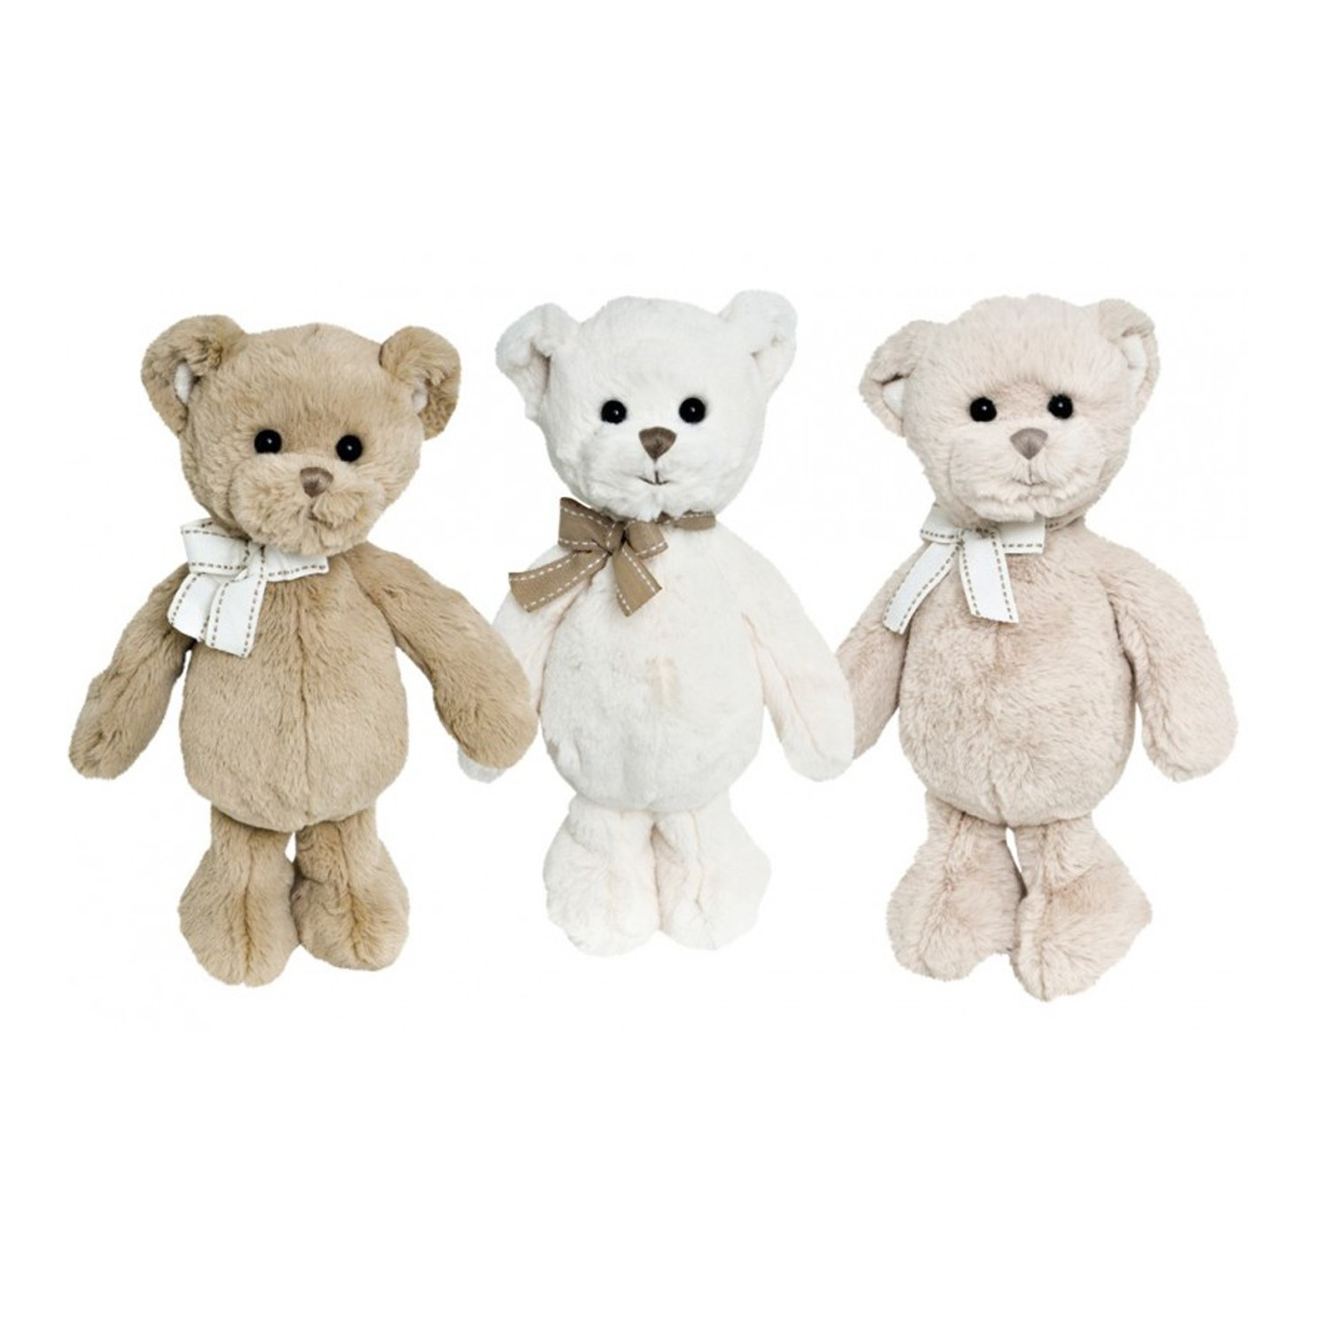
Today’s task
Today you will have to collect different amounts of things (it could be anything you want, as long as you have the correct amount), and practice sharing it equally into 4 groups.
¼ of 12. This means you need to get 12 items and share them into 4 groups to find out how much is in each group.
My 12 teddies have been shared into 4 groups of 3. so ¼ of 12 = 3

Slide 4
Your questions.
For each question get the correct amount of objects then share into 4 groups. You could work with someone in your house and talk about your answers.
¼ of 16 2) ¼ of 8
¼ of 12 4) ¼ of 4
5) ¼ of 20 6) ¼ of 24
Share your answers with someone in your house, you do not need to write anything down today.

