Slide 1
Equivalent Fractions

Slide 2
Look at the diagram.
Can you write the equivalent fractions shown?
=
=
$$\frac{\text{1}}{\text{3}}$$
?
$$\frac{\text{1}}{\text{4}}$$
?
2

Slide 3
Look at the diagram.
Can you write the equivalent fractions shown?
=
=
$$\frac{\text{1}}{\text{3}}$$
$$\frac{\text{3}}{\text{9}}$$
$$\frac{\text{1}}{\text{4}}$$
$$\frac{\text{2}}{\text{8}}$$
$$\frac{\text{1}}{\text{3}}$$
$$\frac{\text{3}}{\text{9}}$$
$$\frac{\text{1}}{\text{4}}$$
1 x 2 =
4 x 2 =
$$\frac{\text{2}}{\text{8}}$$
1 x 3 =
3 x 3 =
4 – Fractions
3

Slide 4
Use two strips of equally sized paper.
Fold one strip into quarters and the other into eighths.
Place the quarters on top of the eighths and lift up one quarter.
How many eighths are equivalent to one quarter?
?
Which other equivalent fractions can you find?
4 – Fractions
4

Slide 5
Use two strips of equally sized paper.
Fold one strip into quarters and the other into eighths.
Place the quarters on top of the eighths and lift up one quarter.
How many eighths are equivalent to one quarter?
2, therefore $\frac{\text{2}}{\text{8}}$ = $\frac{\text{1}}{\text{4}}$.
4 – Fractions
5

Slide 6
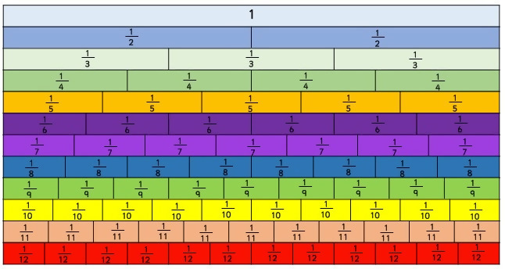
How many fractions equivalent to one half can you see on the fraction wall?
?
Draw extra rows to show other equivalent fractions.
6

Slide 7
How many fractions equivalent to one half can you see on the fraction wall?
$$\frac{\text{1}}{\text{2}}$$
$$\frac{\text{2}}{\text{4}}$$
$$\frac{\text{3}}{\text{6}}$$
$$\frac{\text{4}}{\text{8}}$$
$$\frac{\text{5}}{\text{10}}$$
$$\frac{\text{6}}{\text{12}}$$
4 – Fractions
7

Slide 8
Leanna says:
I know that $\frac{\text{5}}{\text{7}}$ is equivalent to $\frac{\text{5}}{\text{14}}$ because the numerators are the same.
Is Leanna correct? Explain why.

Slide 9
Leanna says:
I know that $\frac{\text{5}}{\text{7}}$ is equivalent to $\frac{\text{5}}{\text{14}}$ because the numerators are the same.
Leanna is incorrect. $\frac{\text{5}}{\text{7}}$ is not equivalent to $\frac{\text{5}}{\text{14}}$. When the numerators are the same, the larger the denominator, the smaller the fraction.

