Slide 1

Add two or more fractions

Slide 2
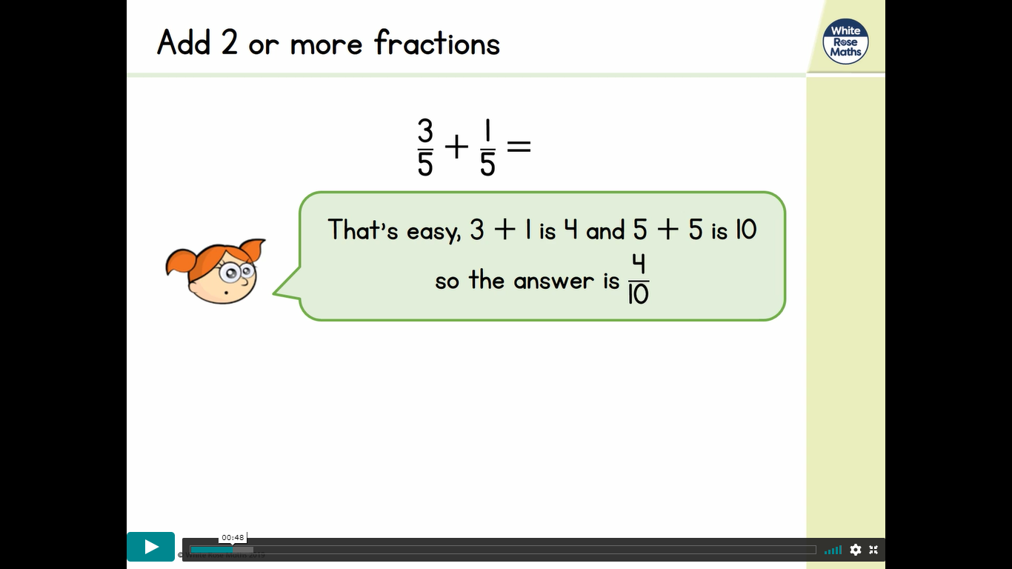
Take a look at this example
Is this right?

Slide 3
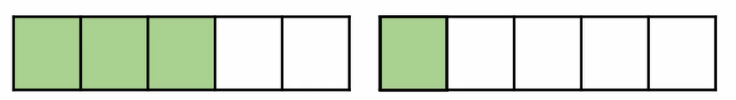
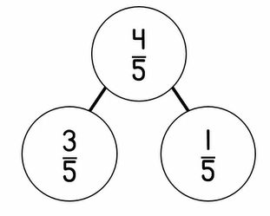
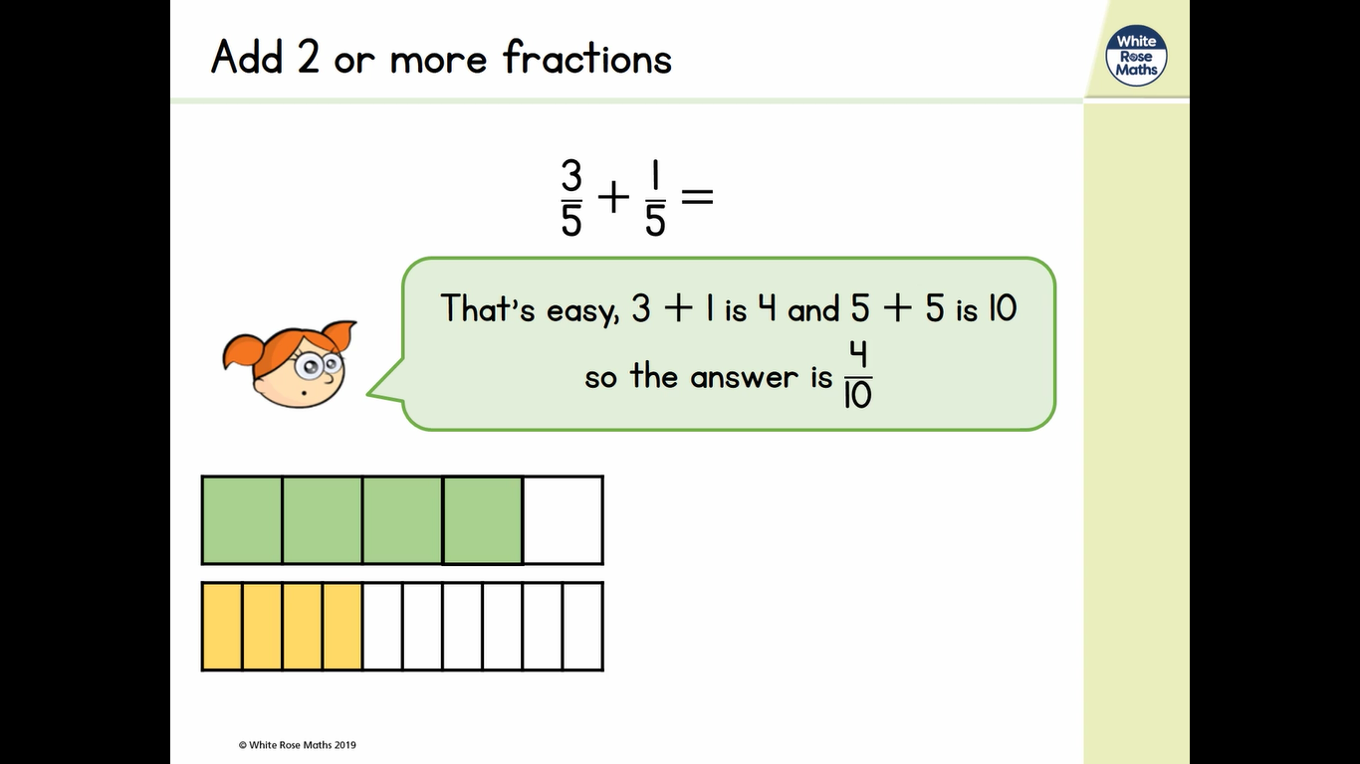
Let’s think

Slide 4
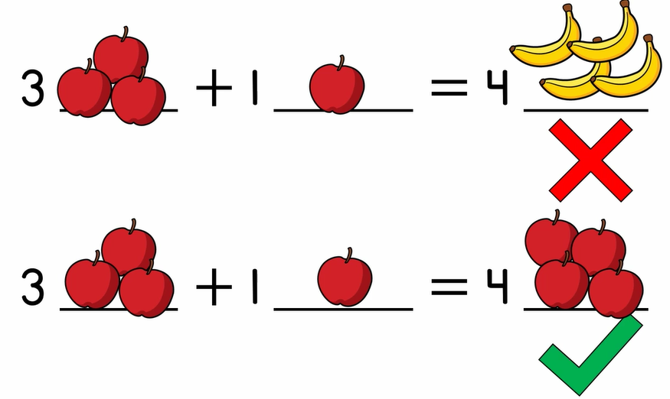
So why don’t we add the denominators?

Slide 5
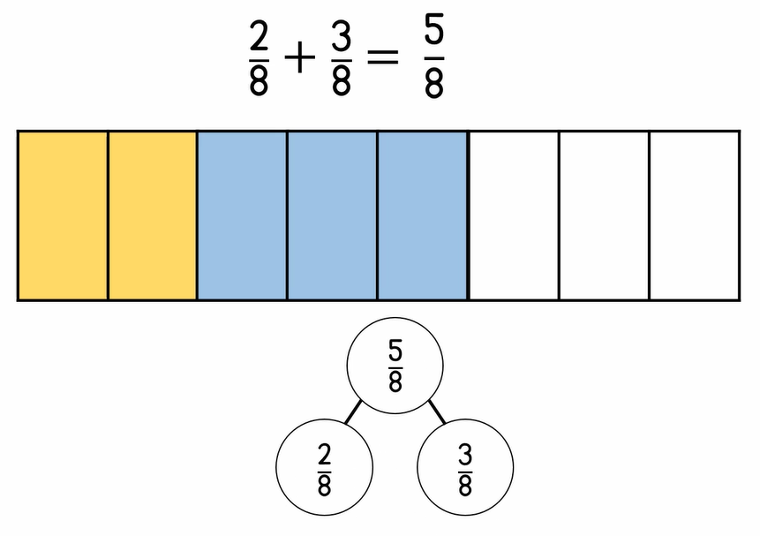
Let’s do an example together

Slide 6
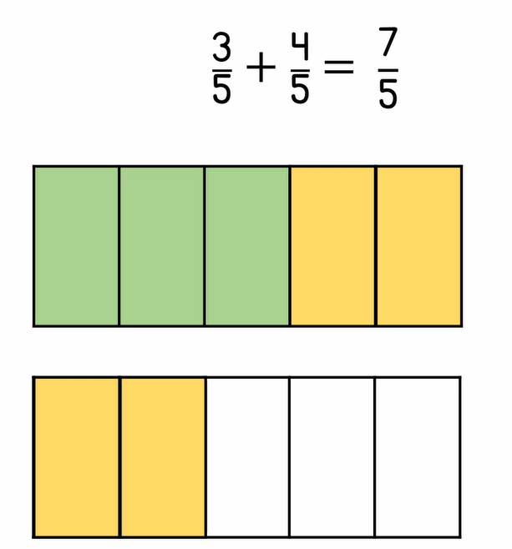
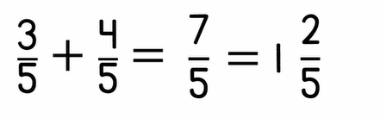
Let’s do another example together
This one is a trickier.
How else can I write this fraction?

Slide 7
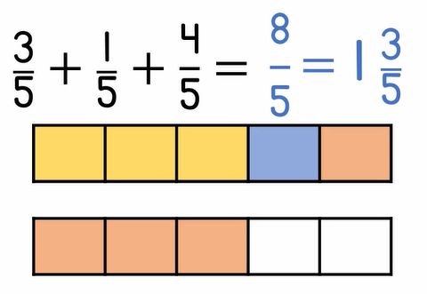
Let’s add three fractions with the same denominator

