Slide 1
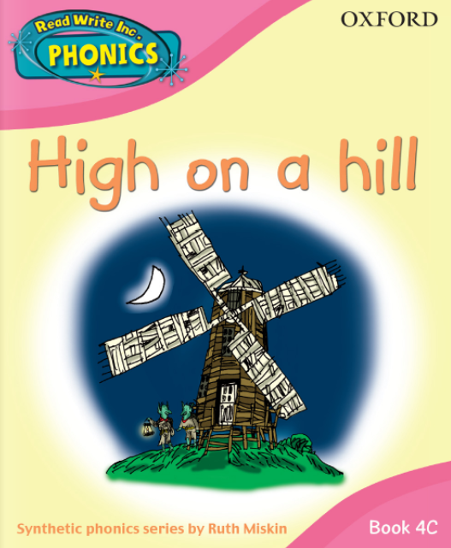


Slide 2
f ff | l ll le | m mm | n nn kn | r rr | s ss se | v ve | z zz s | sh | th | ng nk
b bb | c k ck | d dd | g gg | h | j | p pp | qu | t tt | w wh | x | y | ch tch
Speed Sounds

Slide 3
a at | e hen | i in | o on | u up | ay day | ee y see | igh high | ow blow
oo zoo | oo look | ar car | or for | air fair | ir whirl | ou shout | oy boy
Speed Sounds

Slide 4
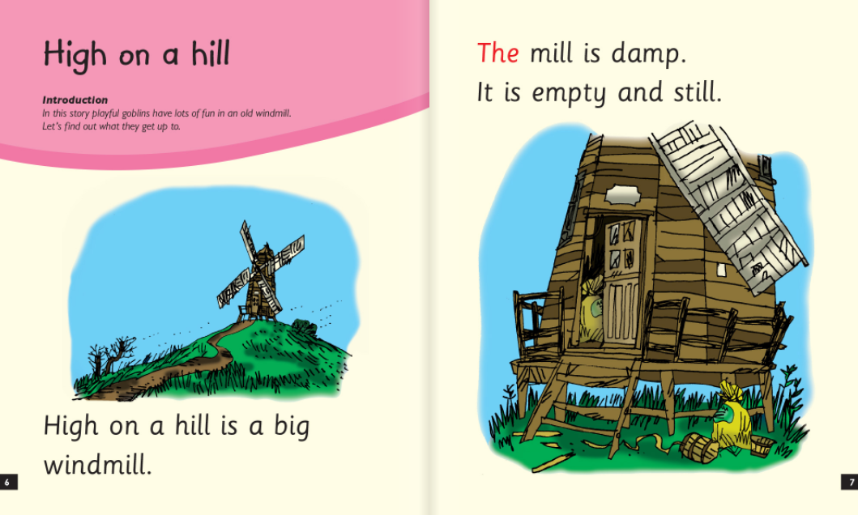

Slide 5
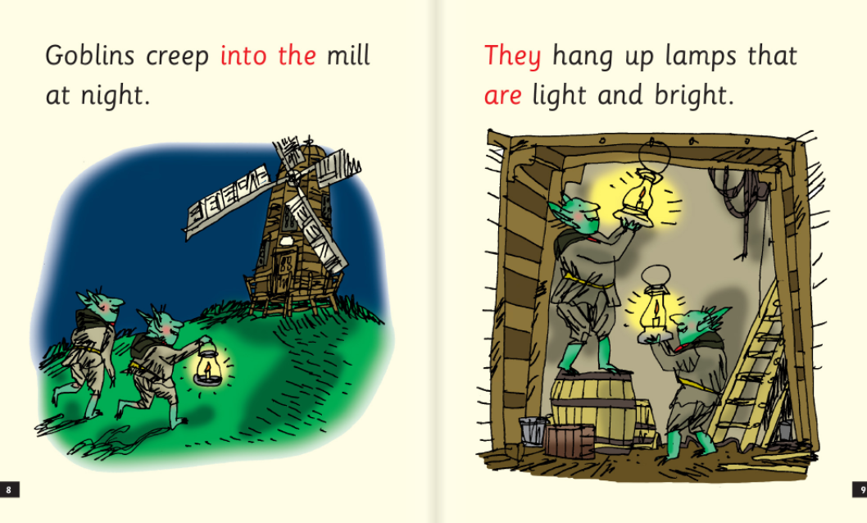

Slide 6
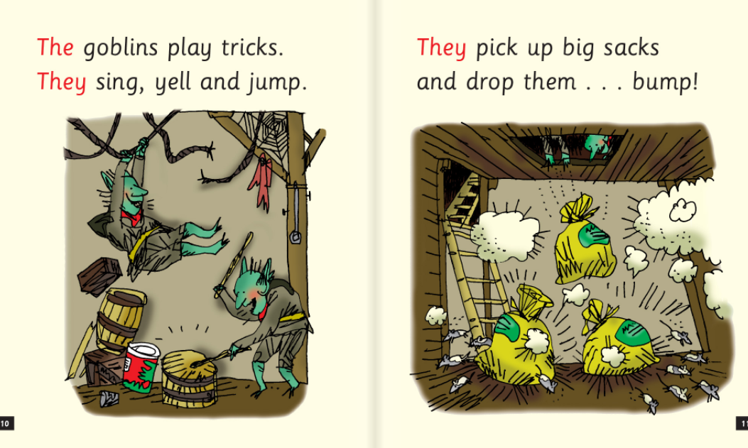

Slide 7
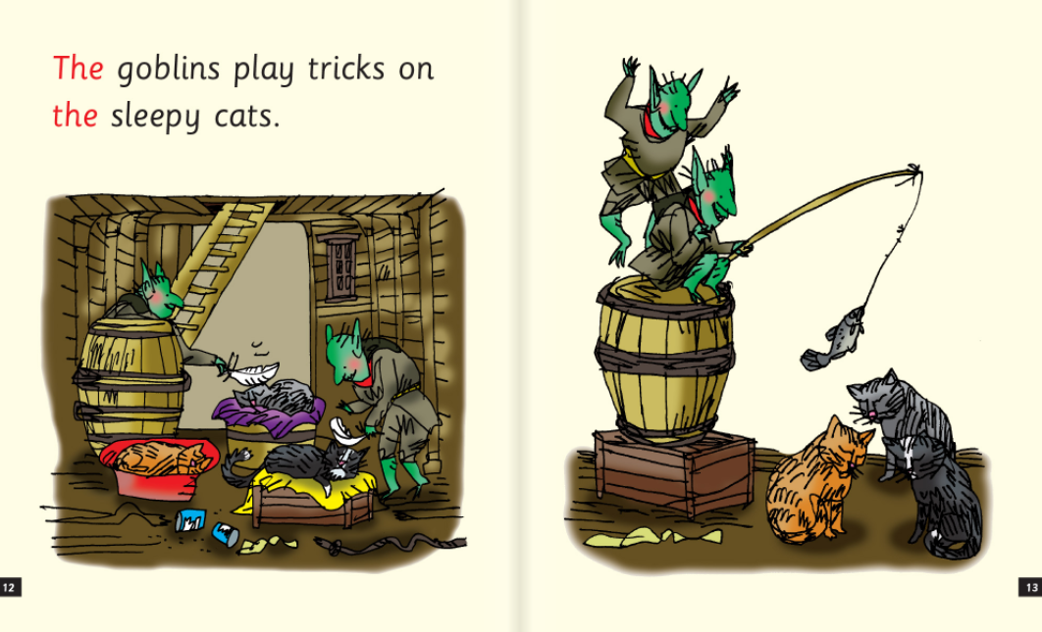

Slide 8
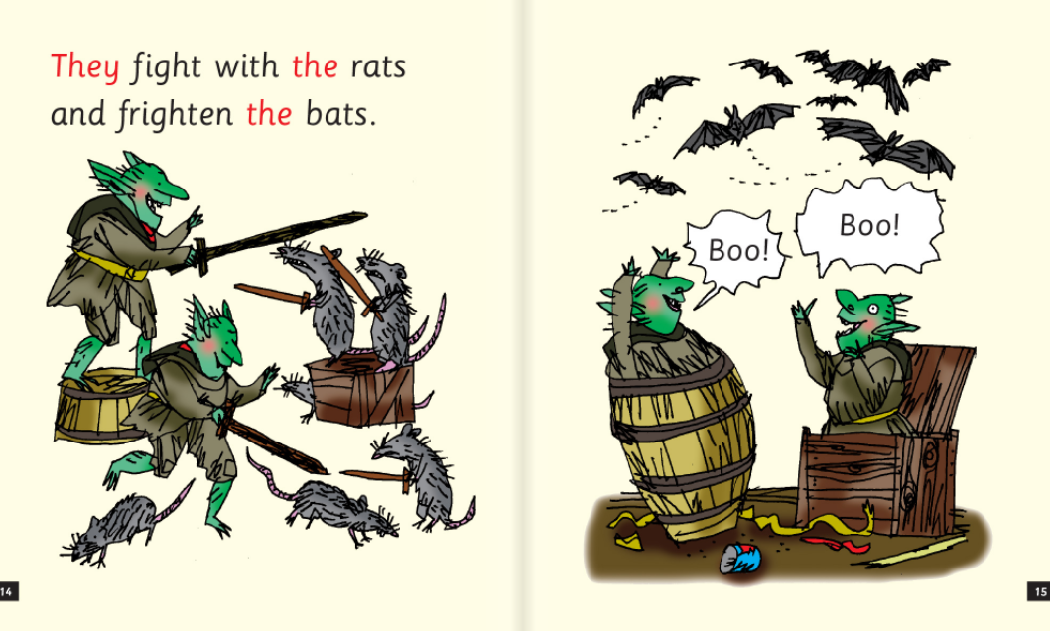

Slide 9
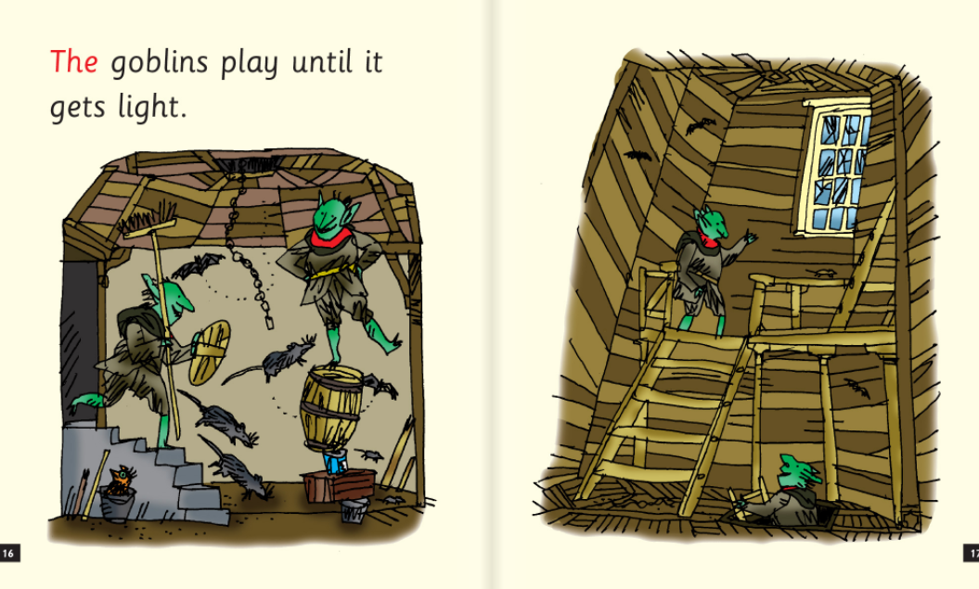

Slide 10
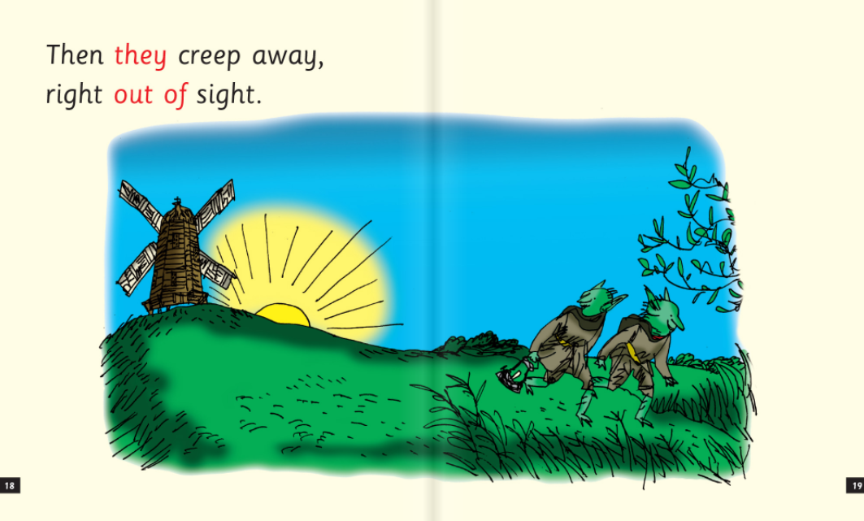

Slide 11
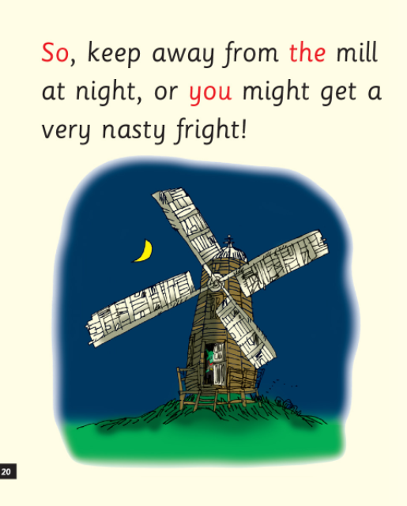

Slide 12
1. Where is the big windmill?
2. When do the goblins go to the mill?
3. Who do the goblins fight with?
4. Why do you think the goblins creep away when it gets light?

