Slide 1
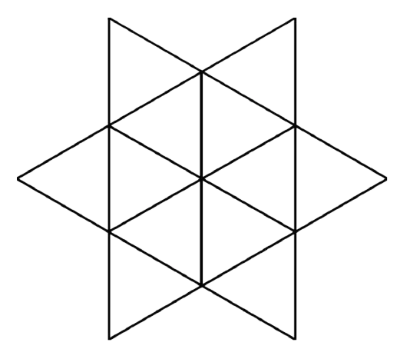

Warm up – How many triangles?

Slide 2
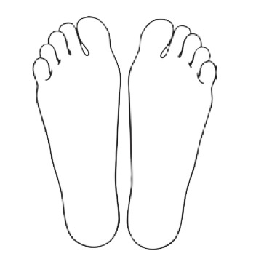
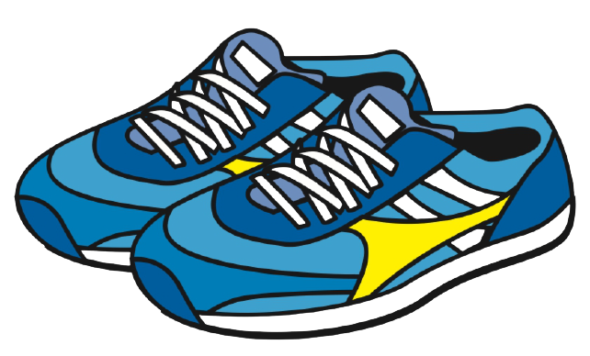
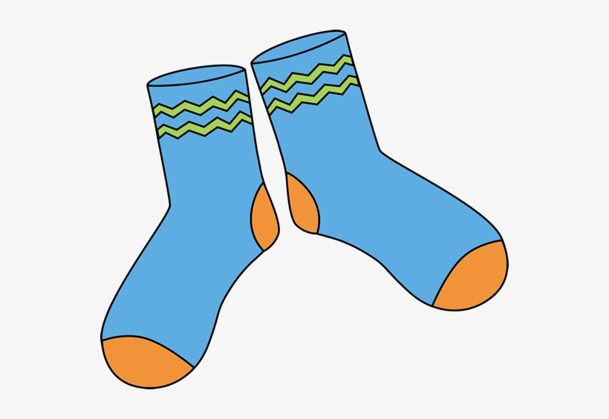
Counting in Twos
Notes:
Today we’re going to start counting in twos, why might counting in twos be useful?

Slide 3


Slide 4


Slide 5
4

Slide 6

6

Slide 7

8

Slide 8
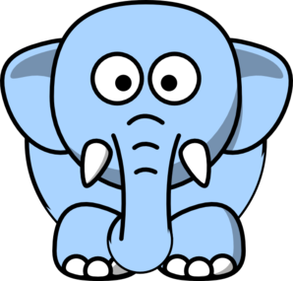
10

Slide 9


