Slide 1
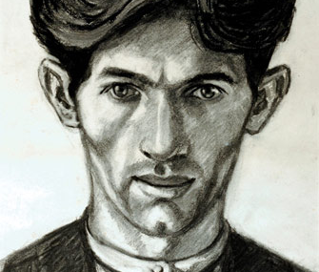
Norman Cornish
Durham Artist
Self-portrait

Slide 2
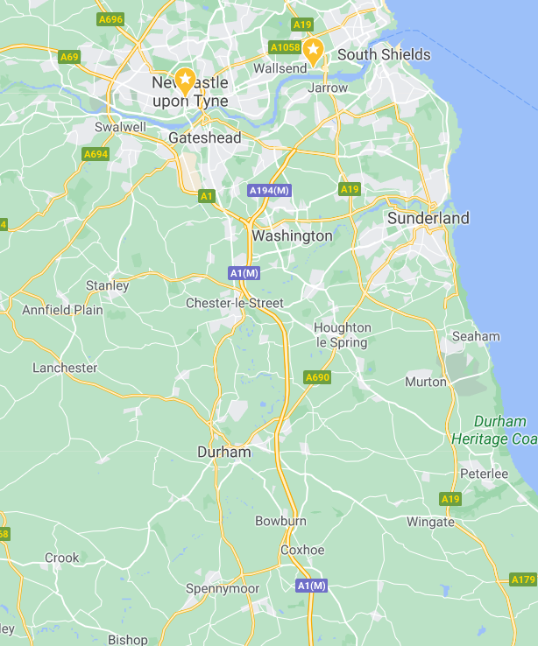

Early Life
Norman Cornish was born on 18th November 1919 in Spennymoor in Durham, only a short distance from Newcastle.
He was interested in drawing from an early age and even won a prize for his drawing of a leather boot, when he was just 4 years old!

Slide 3
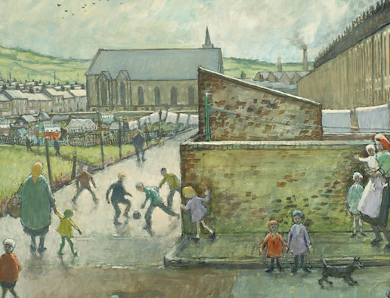
What did he paint?
In Spennymoor there were lots of coal mines
He saw lots of men walking to the pits and the pit buildings and machinery
Children were often playing in the streets
After work, the men would go to the pubs with their friends and play dominoes
This was what he “knew” so this was what he painted
Can you see the mining buildings in the background?

Slide 4
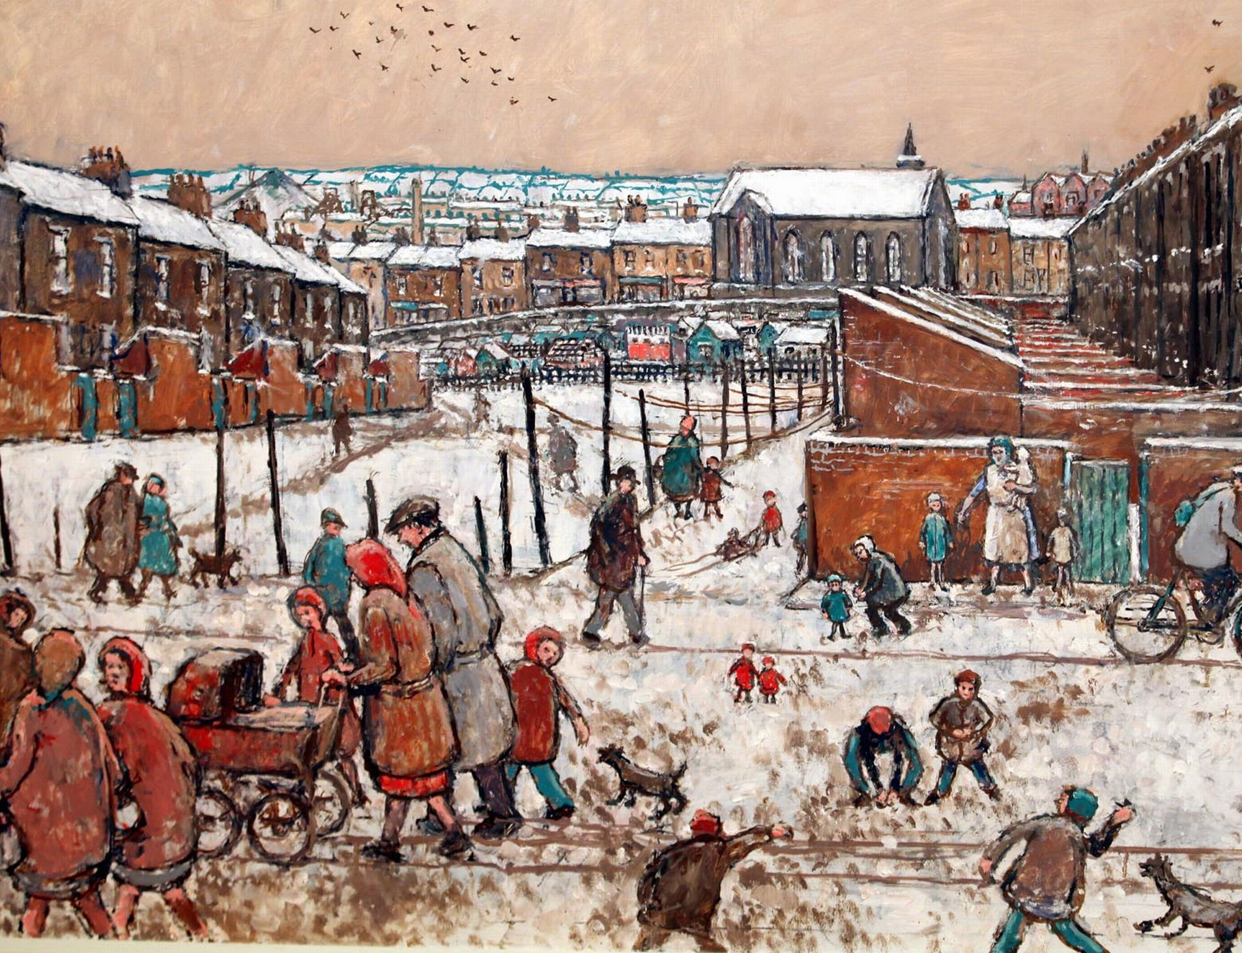
He worked as a miner for more than 30 years
He continued to paint and draw throughout this time
In the 1960s, he left the mine and became a full-time professional artist
He died in 2014, at the age of 94

Slide 5
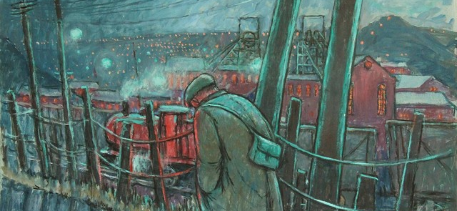
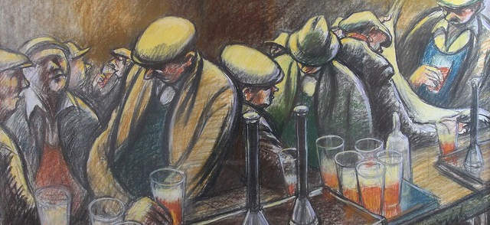
Importance
Cornish’s paintings have shown us what life was like in these poorer villages in the North East of England.
Lots of other miners took up painting as a hobby and an escape from the hard, dirty, dangerous work of coal mining.
They have become an important source of information on life for people in pit villages then.

Slide 6

The busy bar
‘The busy bar’ is one of Norman
Cornish’s most famous paintings.
The painting shows a busy pub, typical of a busy night in Spennymoor in the 1950’s and 1960’s.
What can you see in the painting?
What do you find interesting about the painting?
Why do you think Norman Cornish used the colours that he did?
Do you like the painting? Why or why not?

Slide 7
Monochrome
This painting can be described as
‘monochromatic’.
What do you think this word means?
Monochromatic means the use of only one colour.
Here Norman Cornish has only used different tones of orange to create this painting.
Why do you think he did this?
Remember many different tones can be created from one colour. How can this be done?

Slide 8
Creating different tones
To create different tones of a colour we can add white or black to it.
You can tint the colour by adding white- This will lighten the colour.
You can shade the colour by adding black- This will darken the colour.

Slide 9
Your turn!
Have a go at creating your own Norman Cornish inspired piece.
You could use one of his paintings to do this.
Have a go at drawing the picture, taking your time to look at the detail and add this to your own piece.
Then add colour to your drawing. You can do this with paint if you have some at home but if not then use colouring pencils or even just a writing pencil!
Remember your piece should be monochromatic and you should only use one colour!
If you are using colour pencils you can change the tone with white and black.
If you are using a writing pencil, the tone can be changed using shading.

