Slide 1
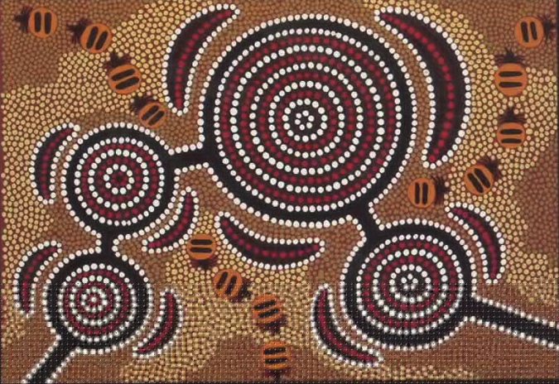
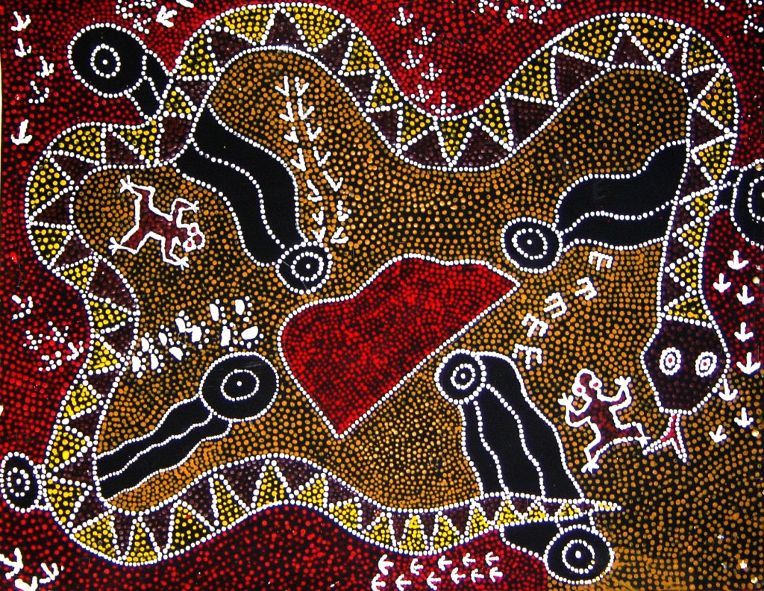

Aboriginal Art

Slide 2
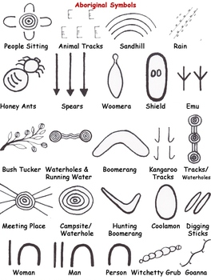
Key vocabulary
Design a plan or drawing of your ideas
Pattern a repeated decorative design.
Symbols a mark, sign or word that represents an idea or object

Slide 3
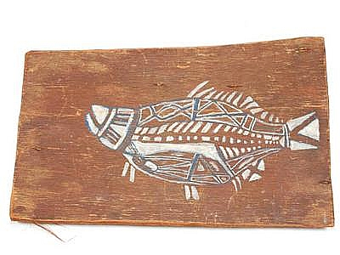
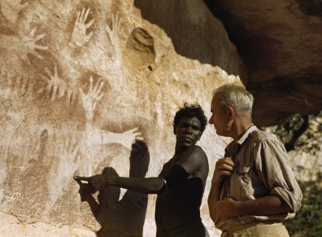
Recapping from last week
Here are three different of Aboriginal Art
Bark painting- X-ray fish
Negative printing - Simple figures
Geometrical

Slide 4
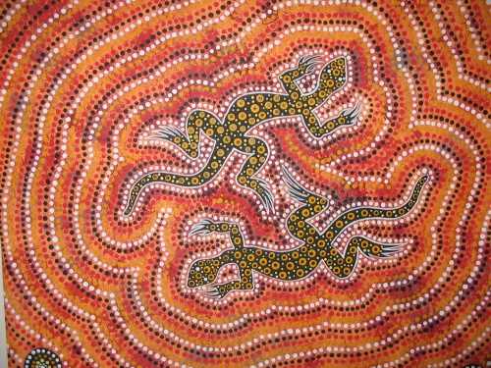
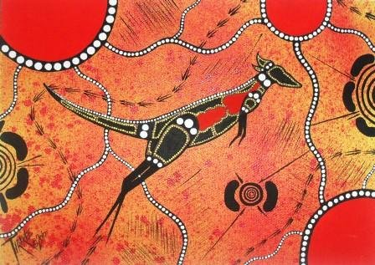
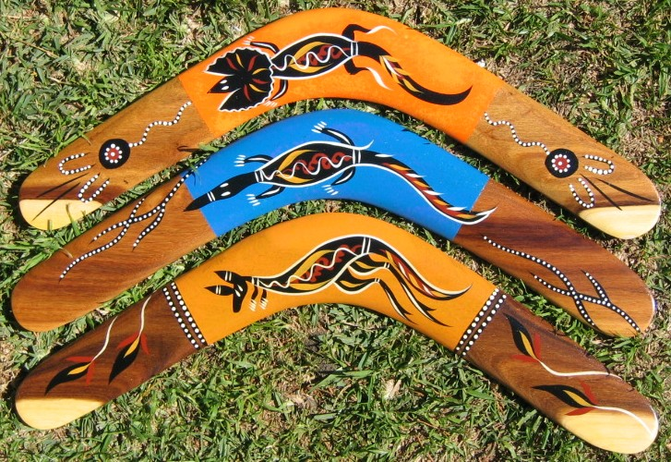
Animals in Aboriginal Art
Objects in Aboriginal Art

Slide 5
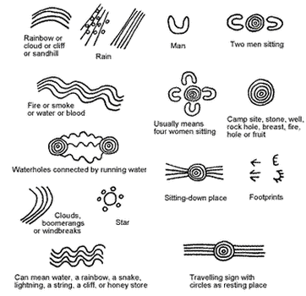

Slide 6
Now it’s your turn
Last week you made your own design using
three symbols that you used to create your storyline and art work.
You made a repeated pattern.
You drew your design and if you had colours or paint then could add this to your own design.
Th

Slide 7
This week we would like you to think about and share your thoughts with someone at home.
What do you like about your design? Why?
Would you change anything about your design?
What have you learnt about patterns?
Using your ideas from today draw another design inspired by the symbols or patterns that we have explored over the past few weeks.

